Slide 1
The Jesuit Mission to China: Intellectual Exchange between China and Europe, 17th - 18th c.
Dr. Söderblom Saarela will discuss European contact with China as mediated by Jesuit missionaries in the seventeenth and eighteenth century. He will also highlight primary sources and other resources held at the Ricci Institute.

Slide 2
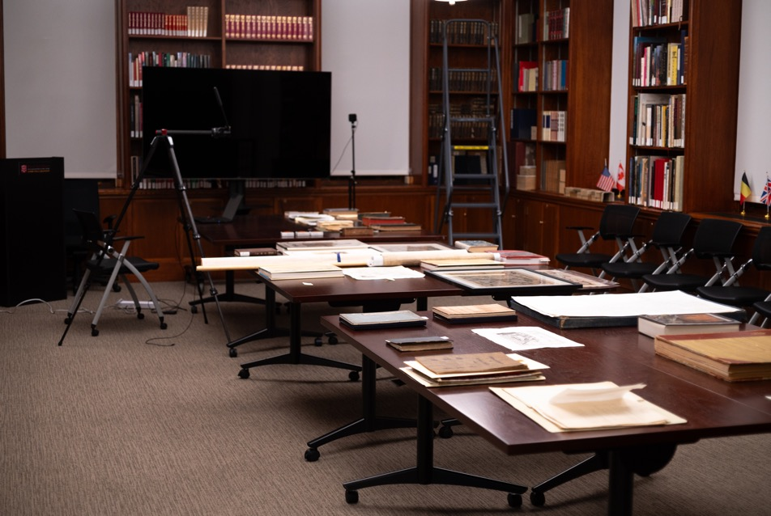

Setup of the conference room

Slide 3
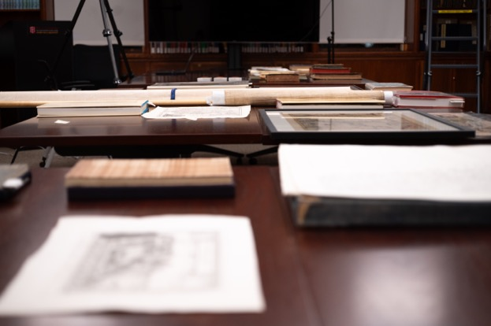
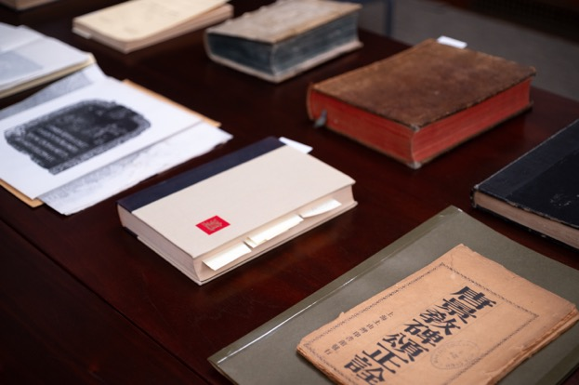
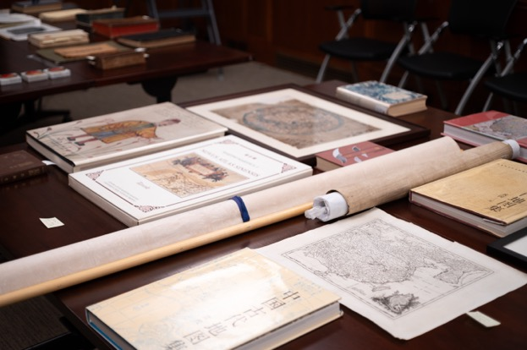
Setup of the conference room

Slide 4
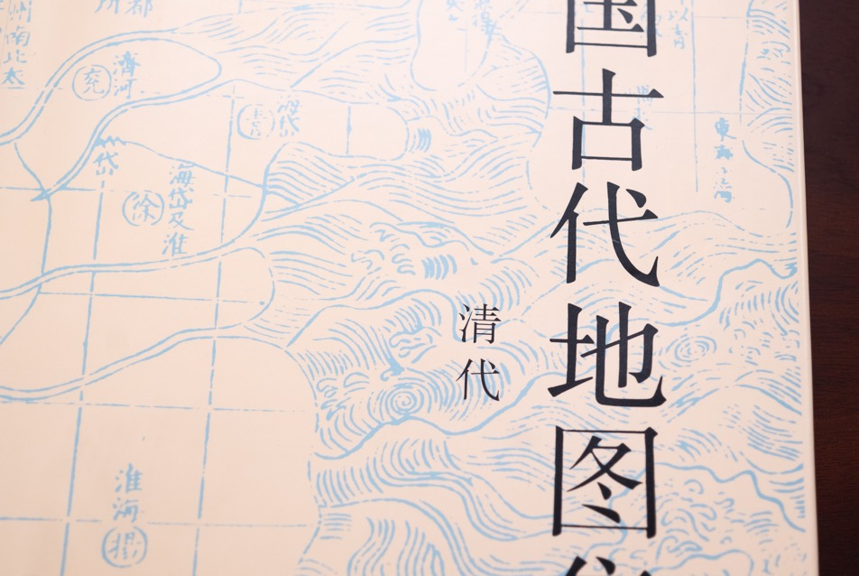
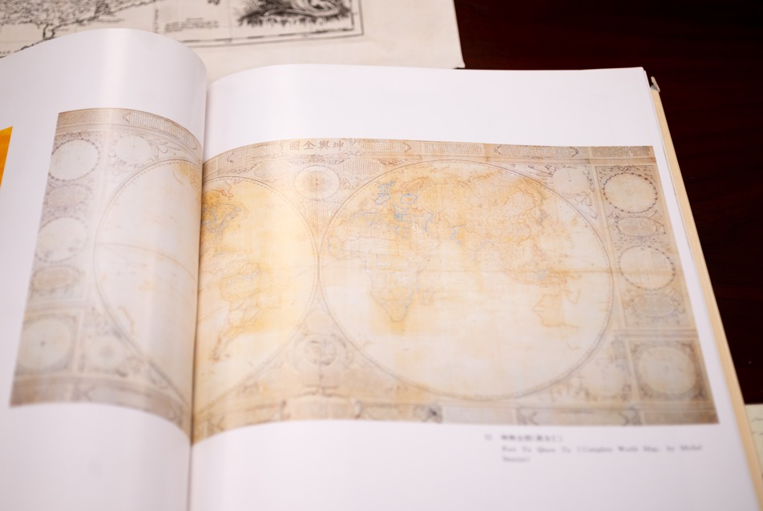
Benoist’s world map

Slide 5


Benoist’s world map

Slide 6
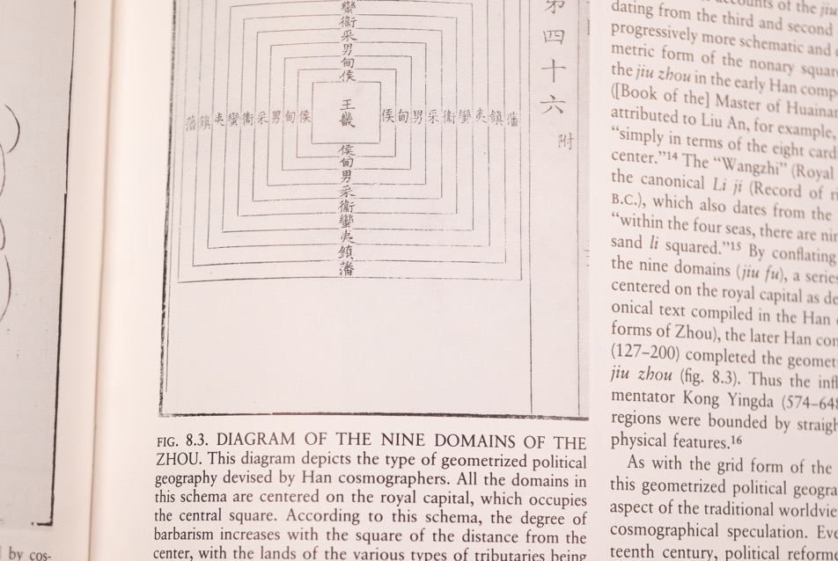
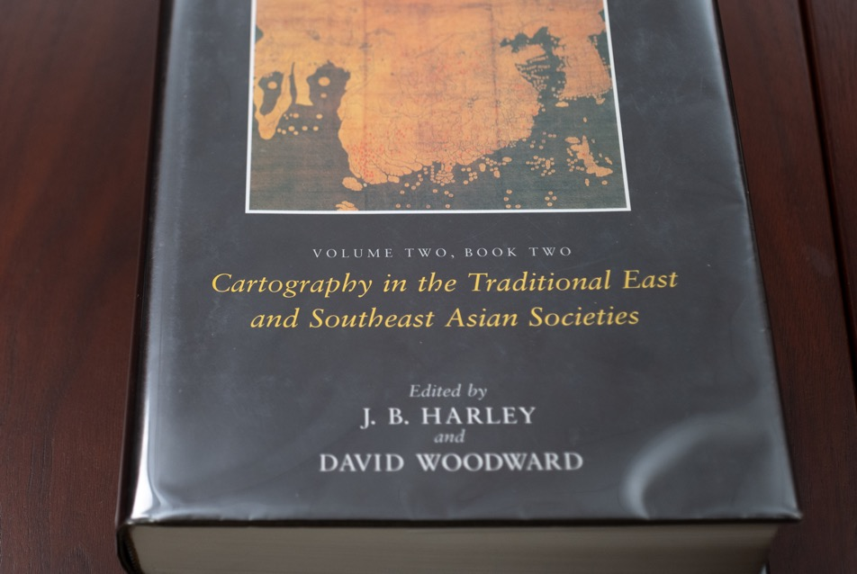
Chinese Cosmology

Slide 7
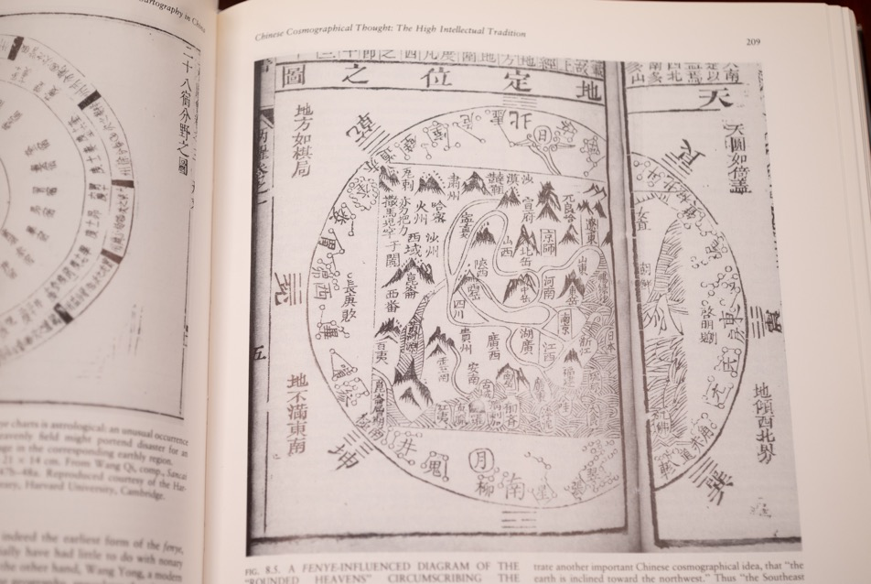
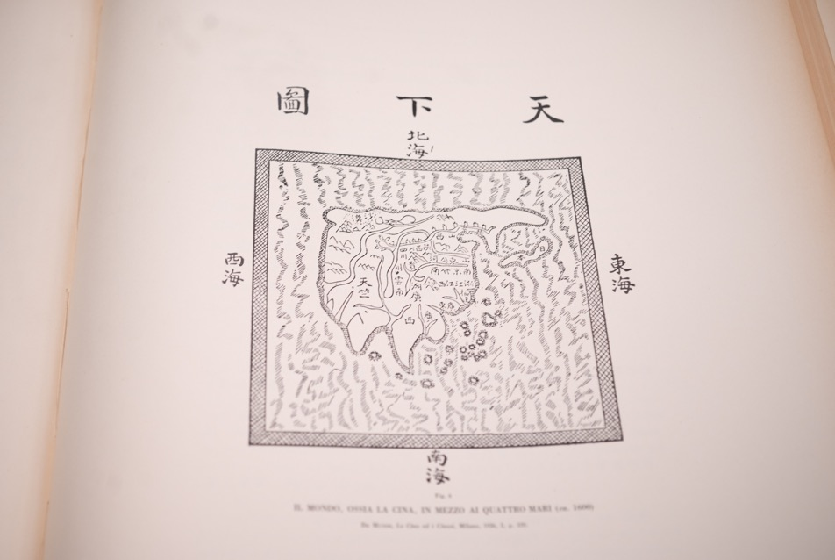
Chinese Cosmology

Slide 8
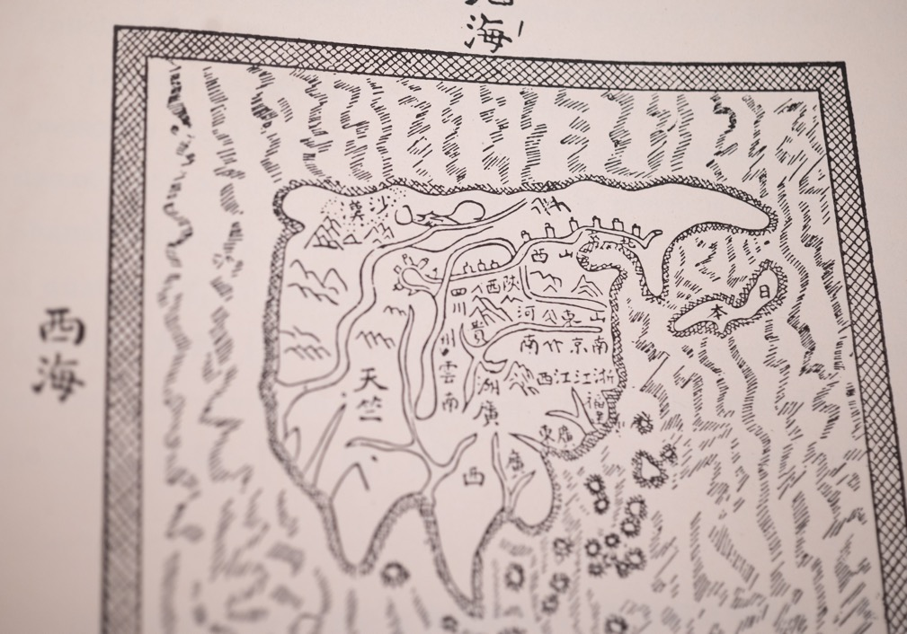
Chinese Cosmology

Slide 9
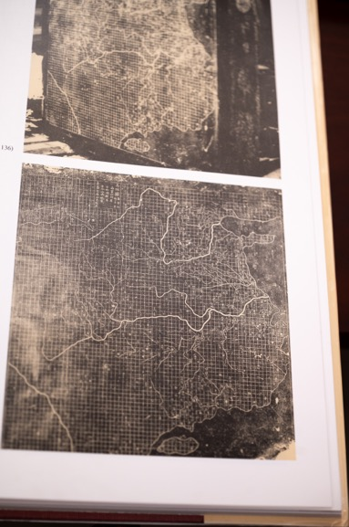
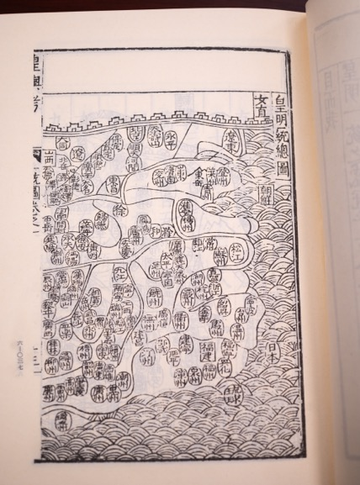
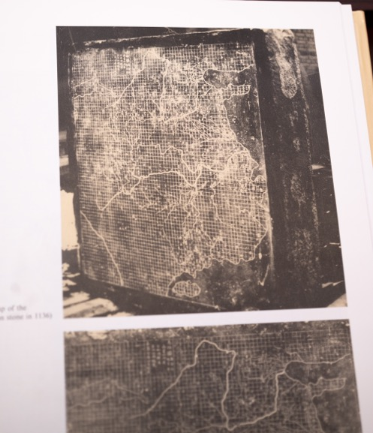
Chinese maps of China

Slide 10
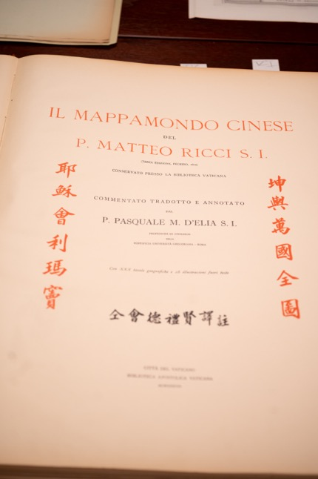
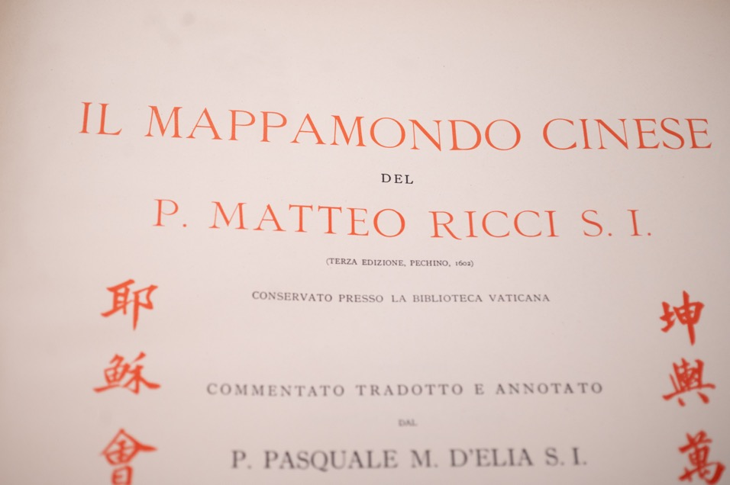
D’Elia’s edition of Ricci’s world map

Slide 11
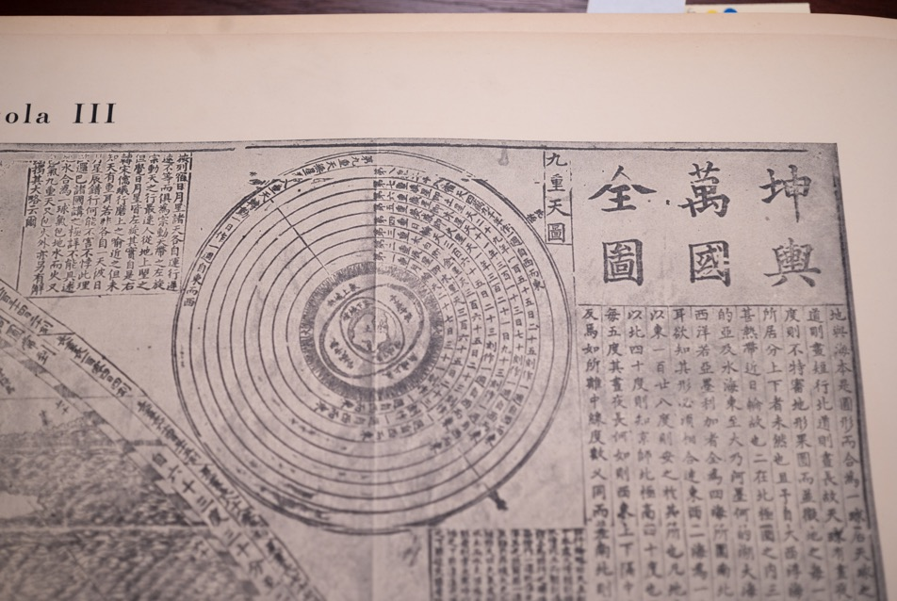
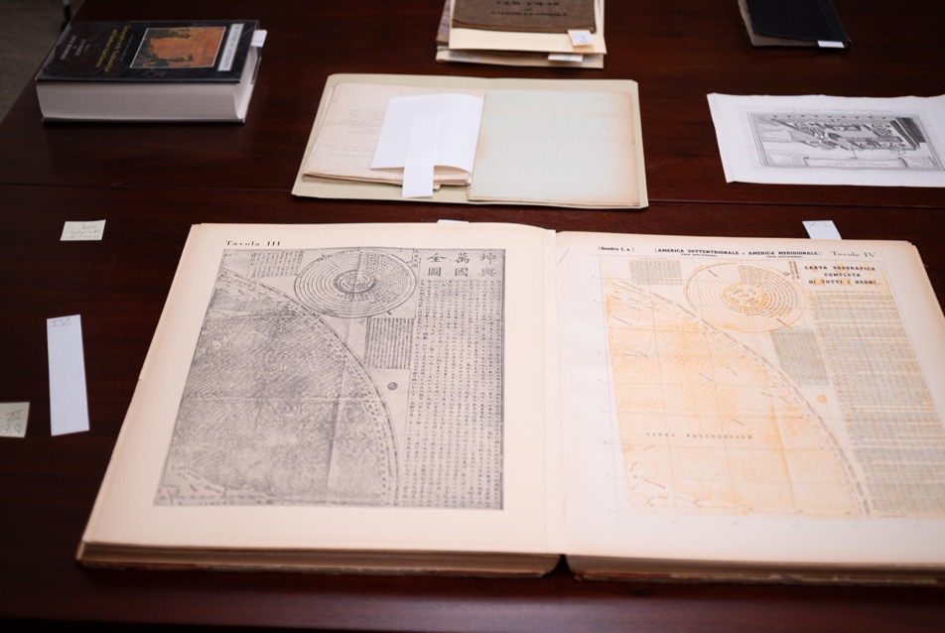
D’Elia’s edition of Ricci’s world map

Slide 12
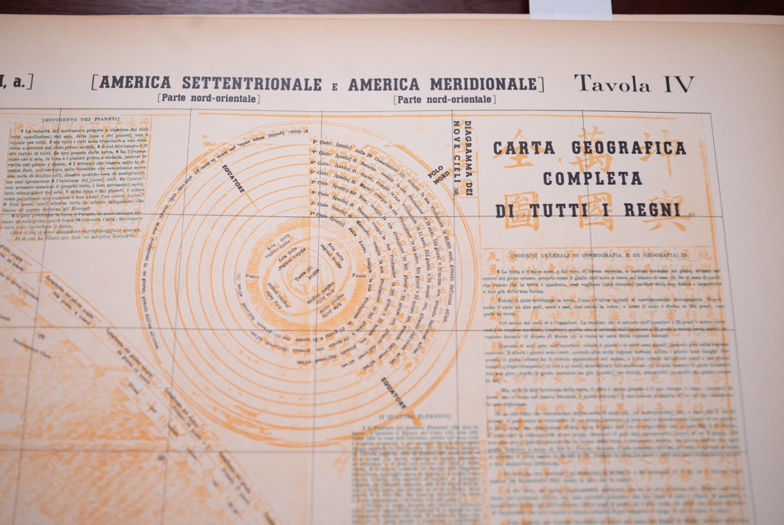
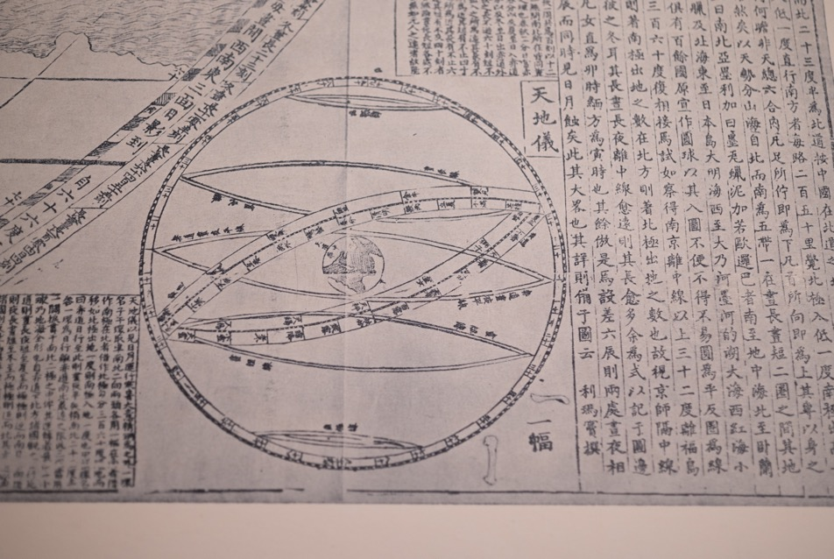
D’Elia’s edition of Ricci’s world map

Slide 13
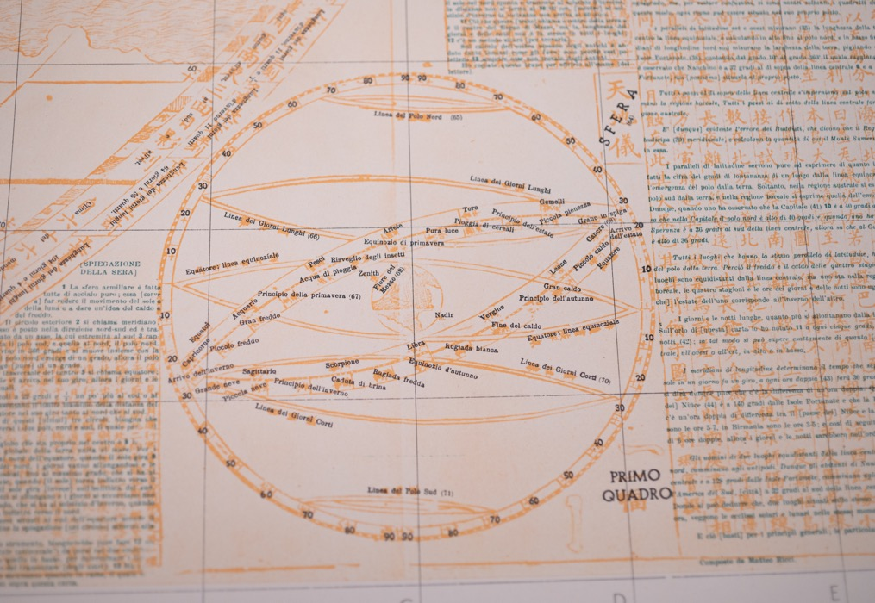
D’Elia’s edition of Ricci’s world map

Slide 14
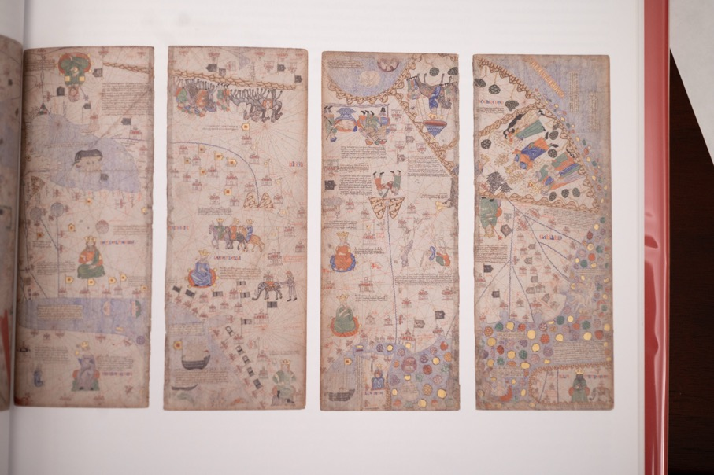
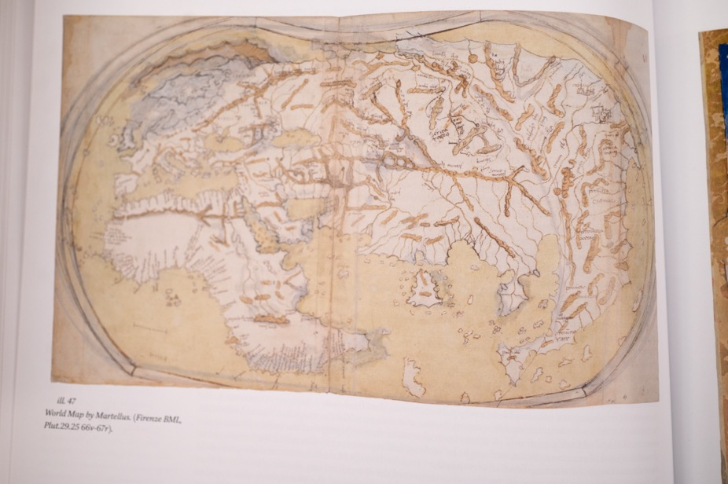
European Maps of China

Slide 15
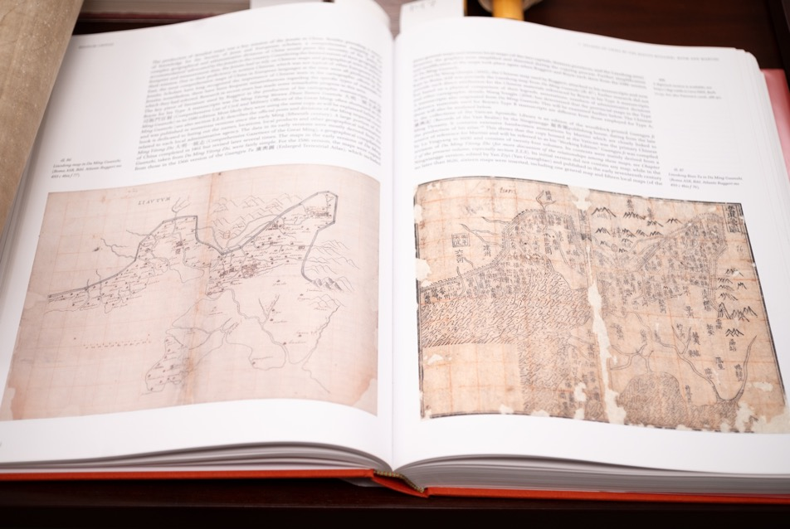
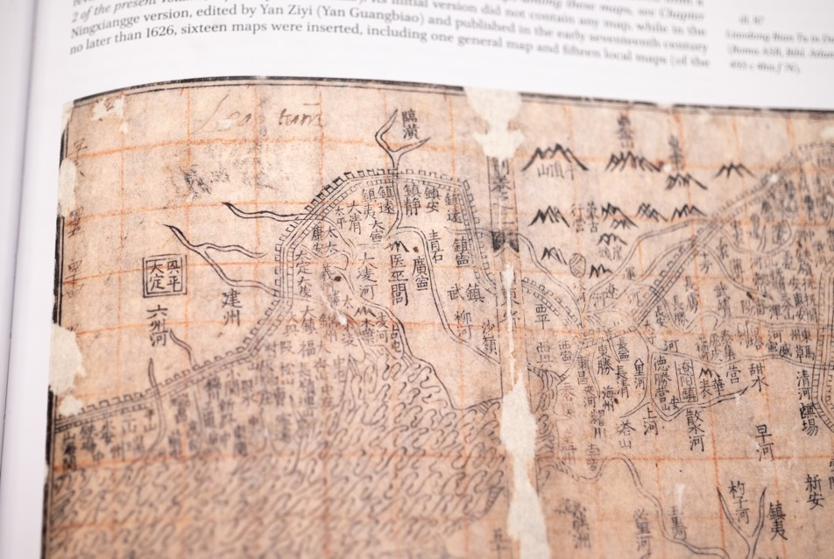
European Maps of China

Slide 16
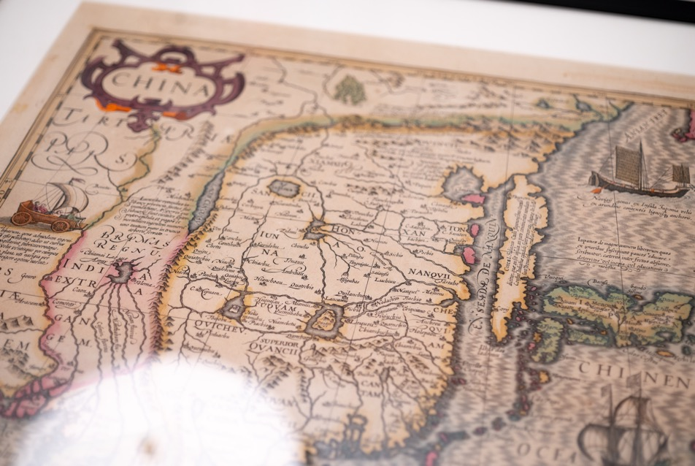
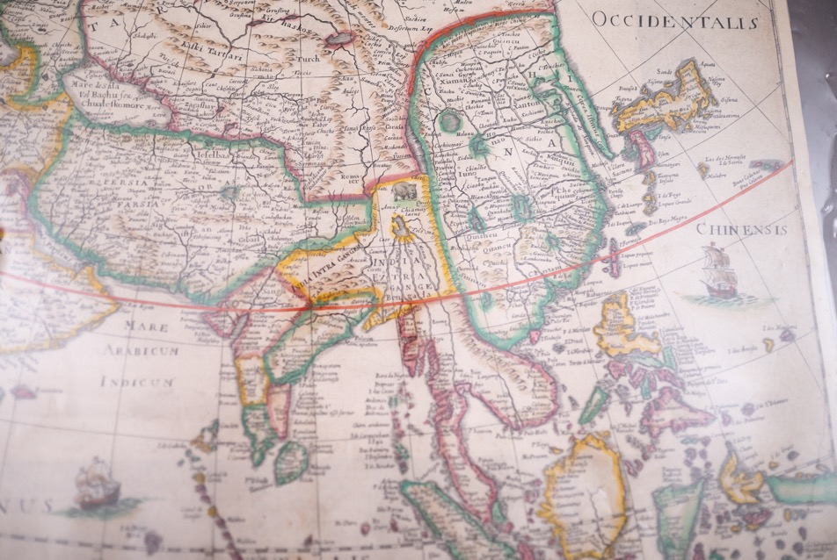
European Maps of China

Slide 17
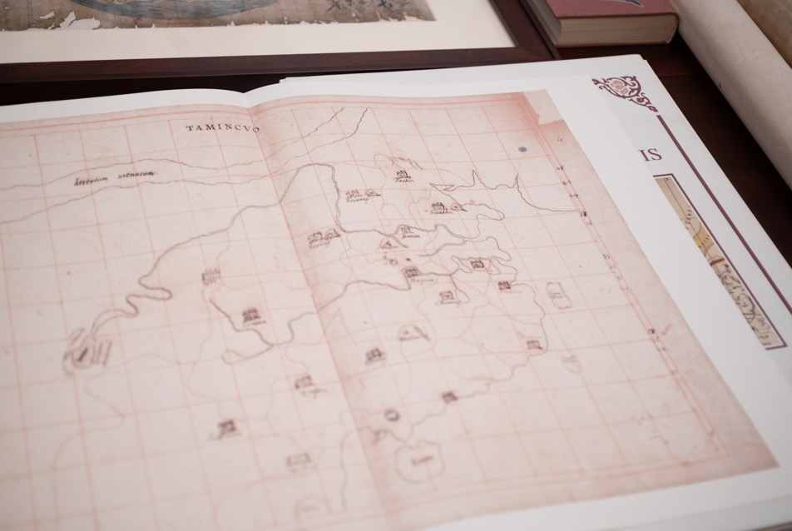
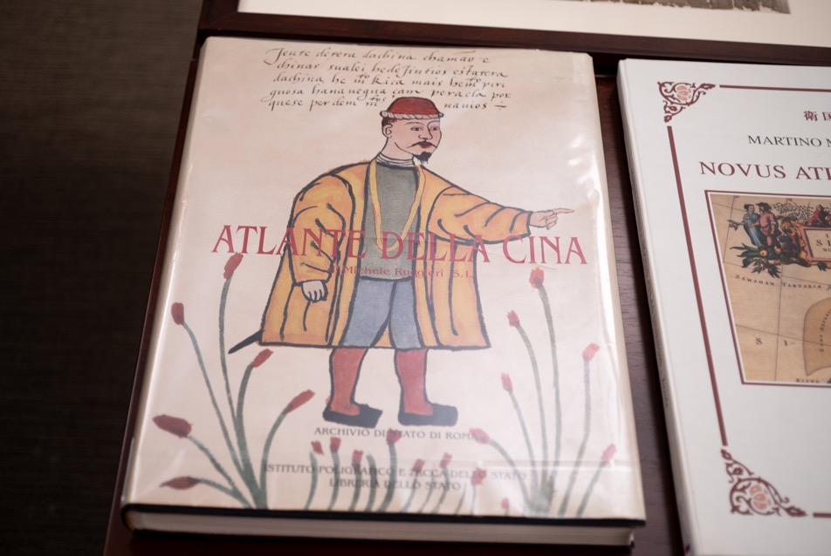
European Maps of China

Slide 18
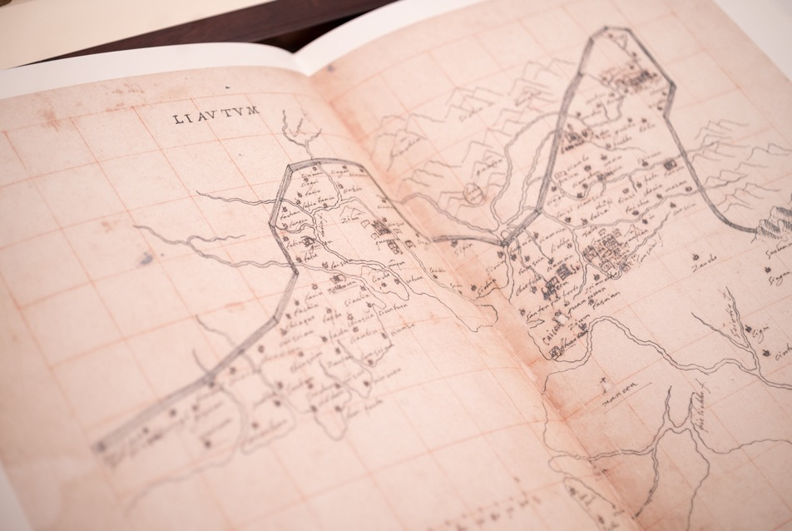
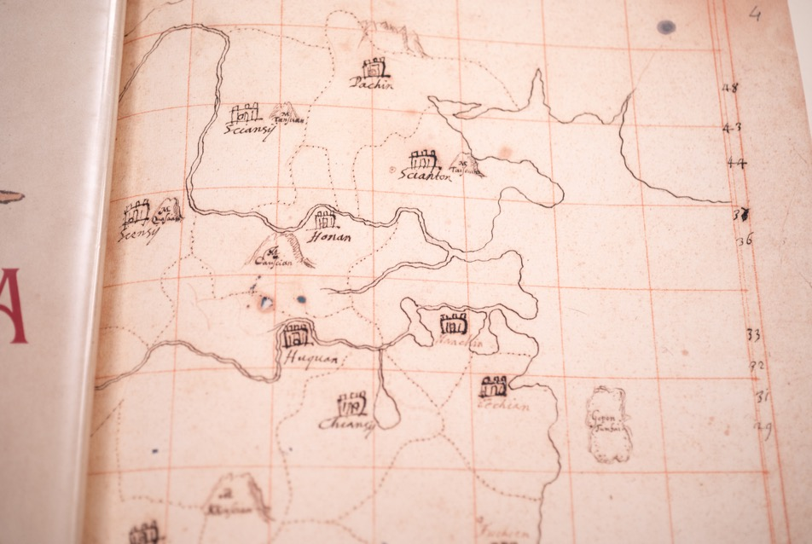
European Maps of China

Slide 19
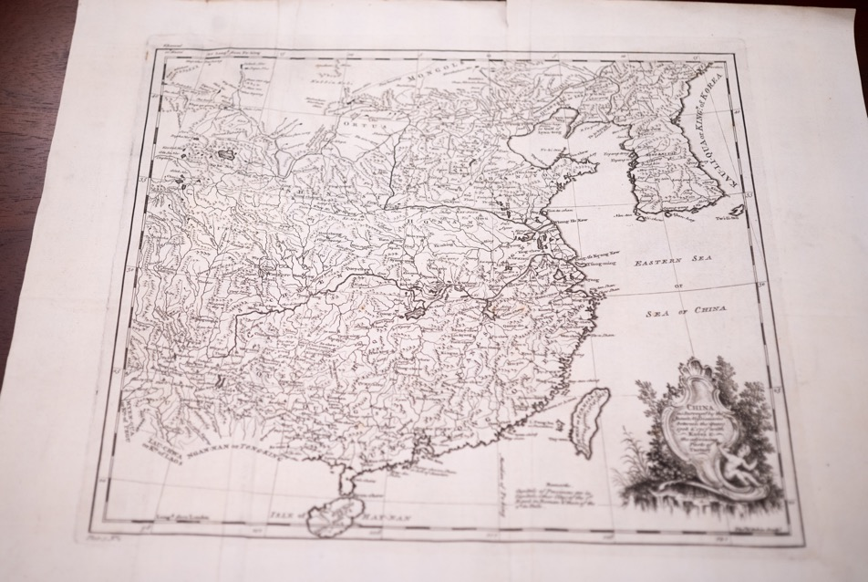
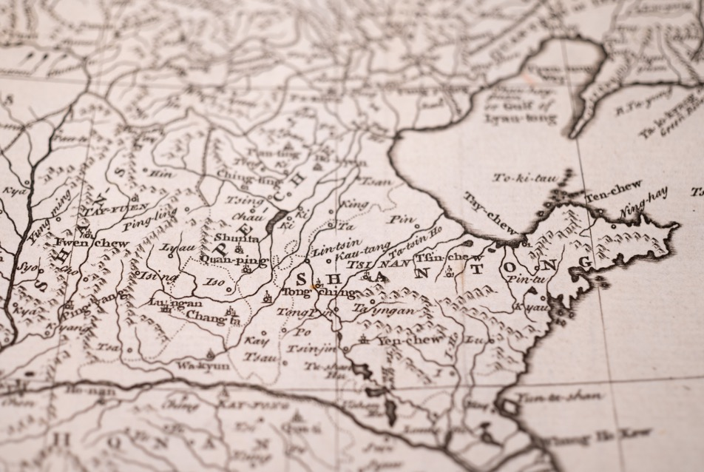
European Maps of China

Slide 20
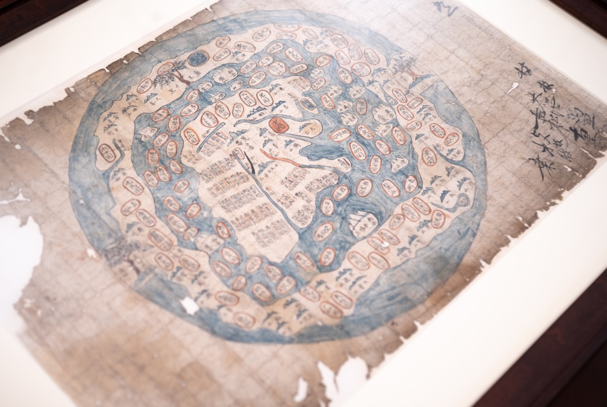
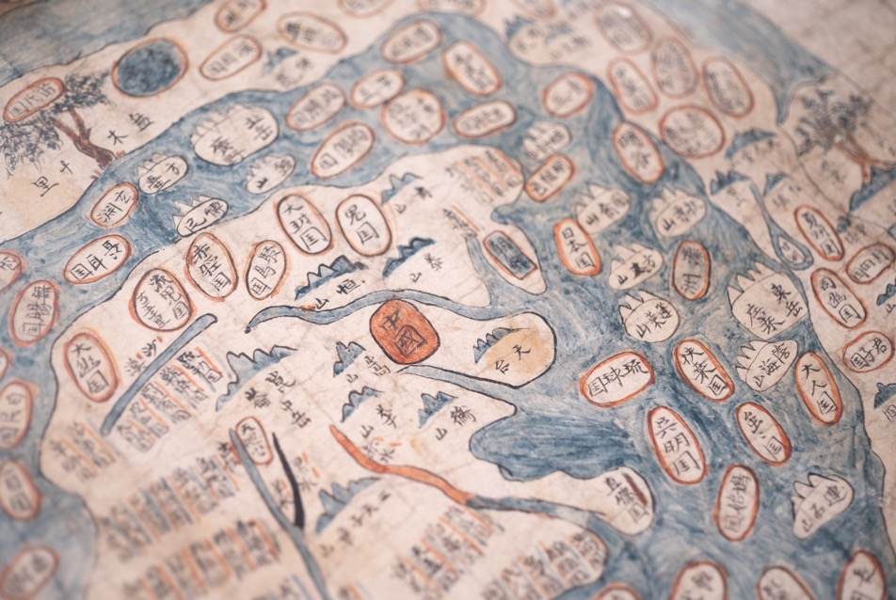
Korean world maps

Slide 21
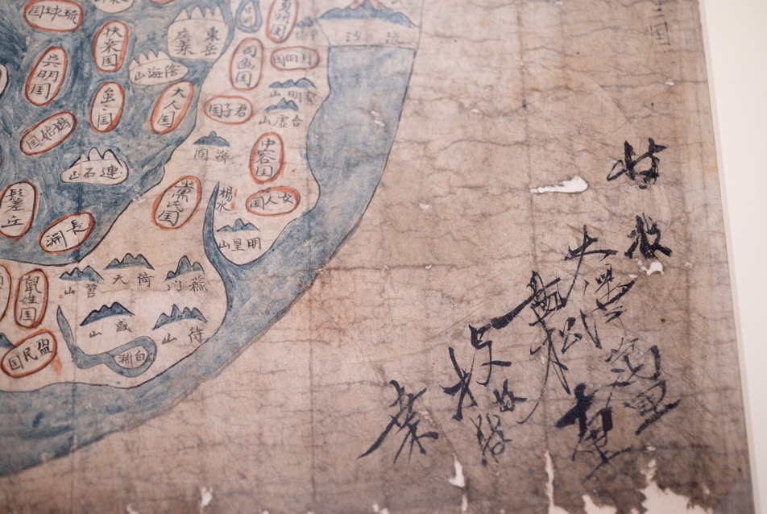
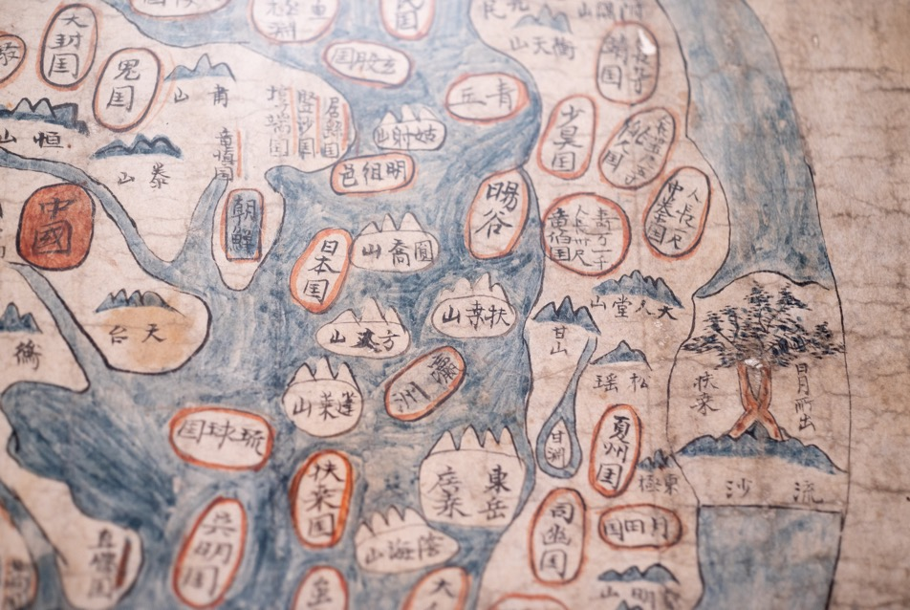
Korean world maps

Slide 22
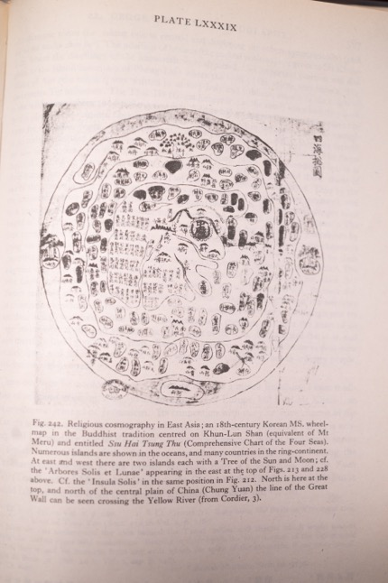
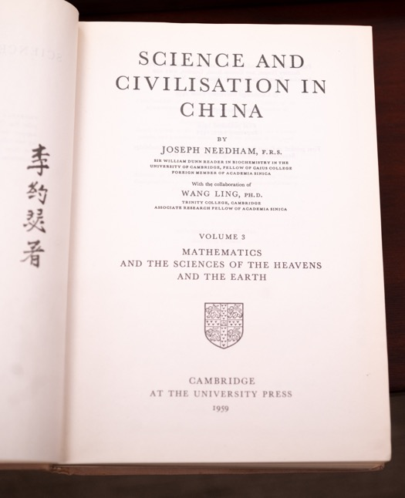
Korean world maps

Slide 23
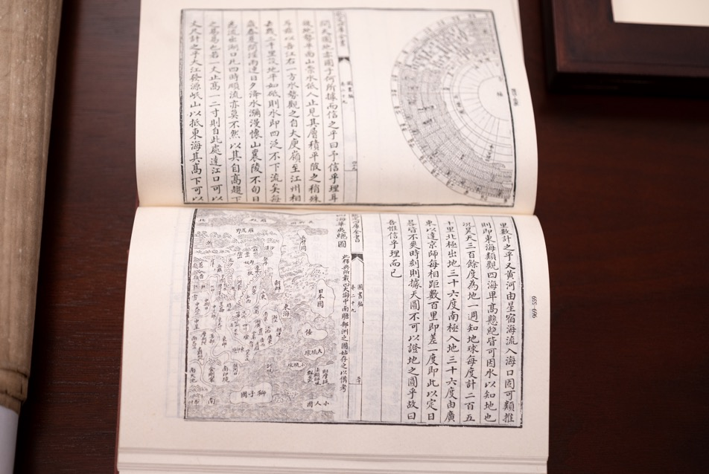
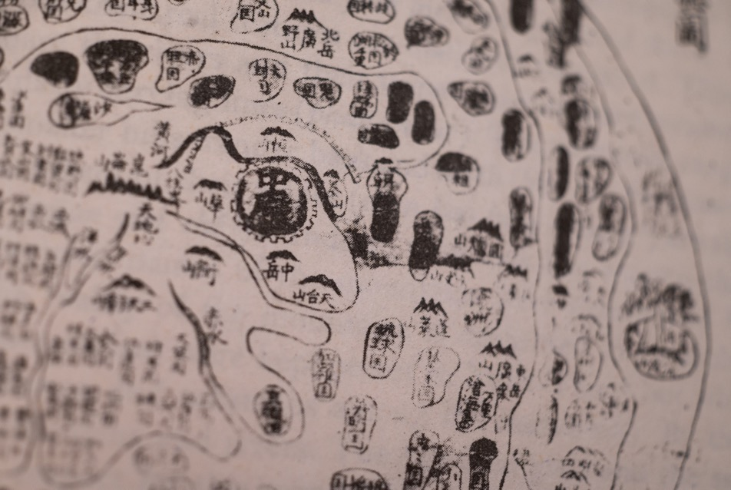
Korean world maps

Slide 24
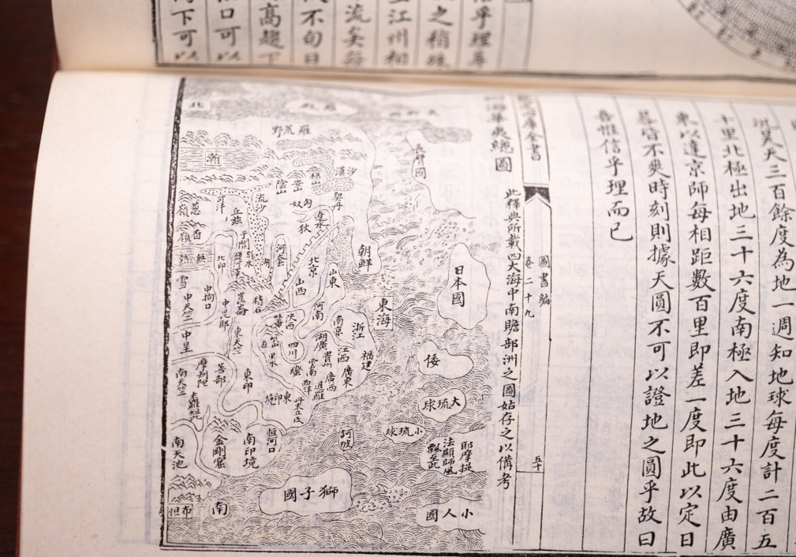
Korean world maps

Slide 25
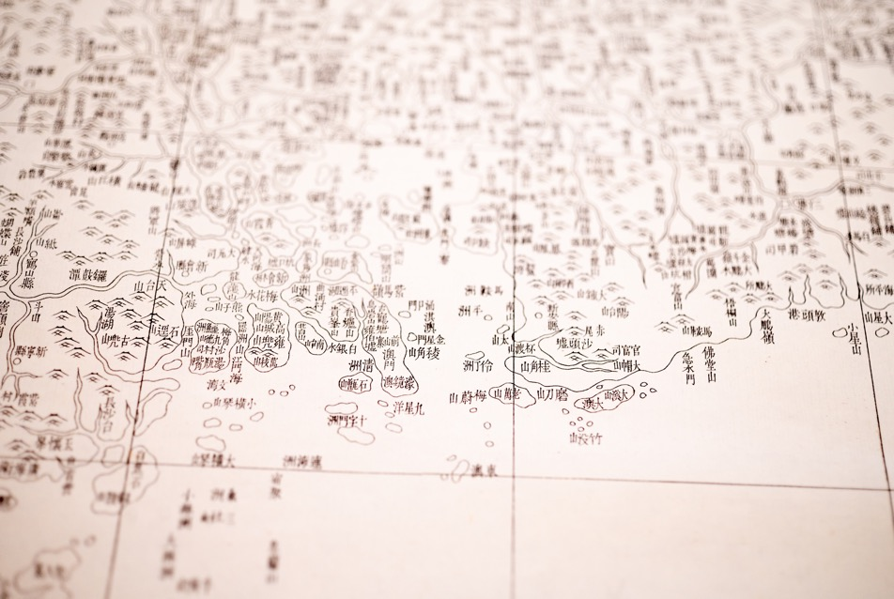
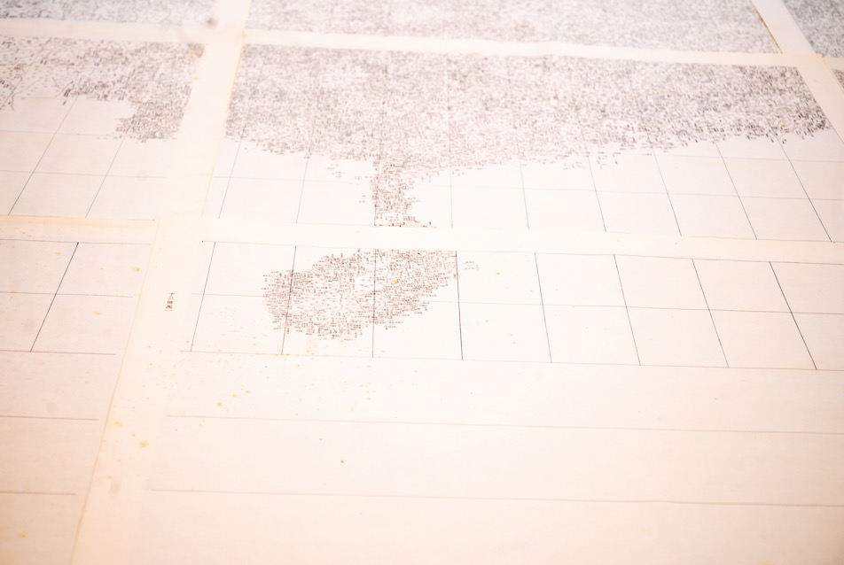
Qianlong’s etched atlas

Slide 26

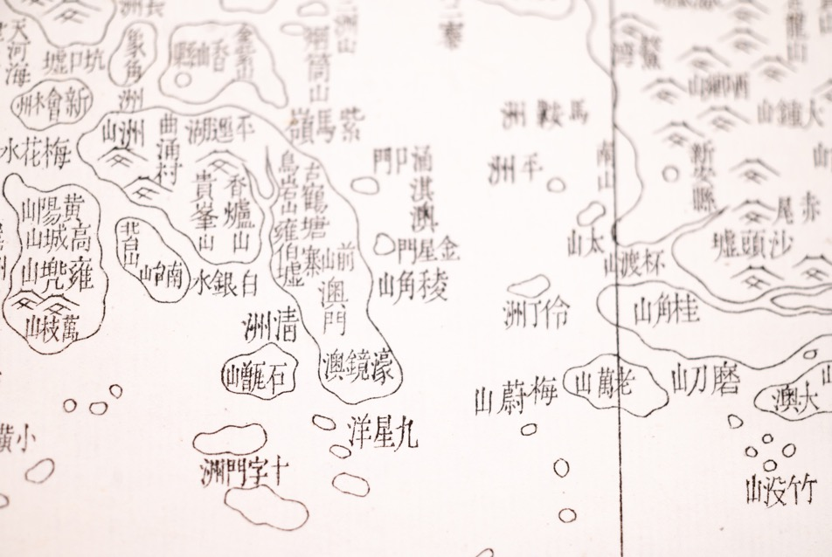
Qianlong’s etched atlas

Slide 27
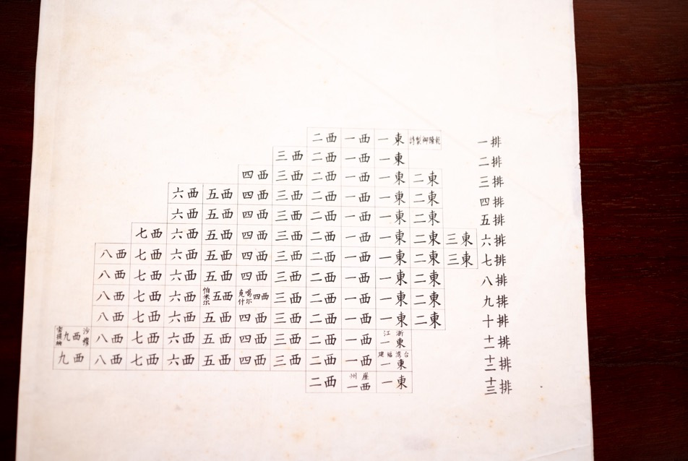
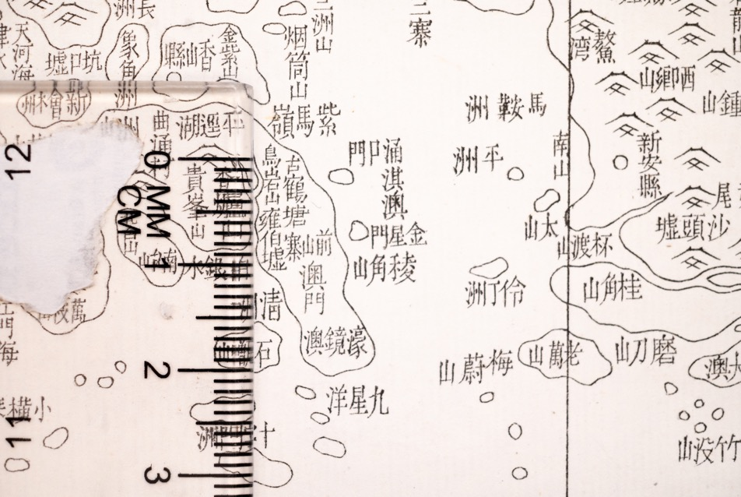
Qianlong’s etched atlas

Slide 28
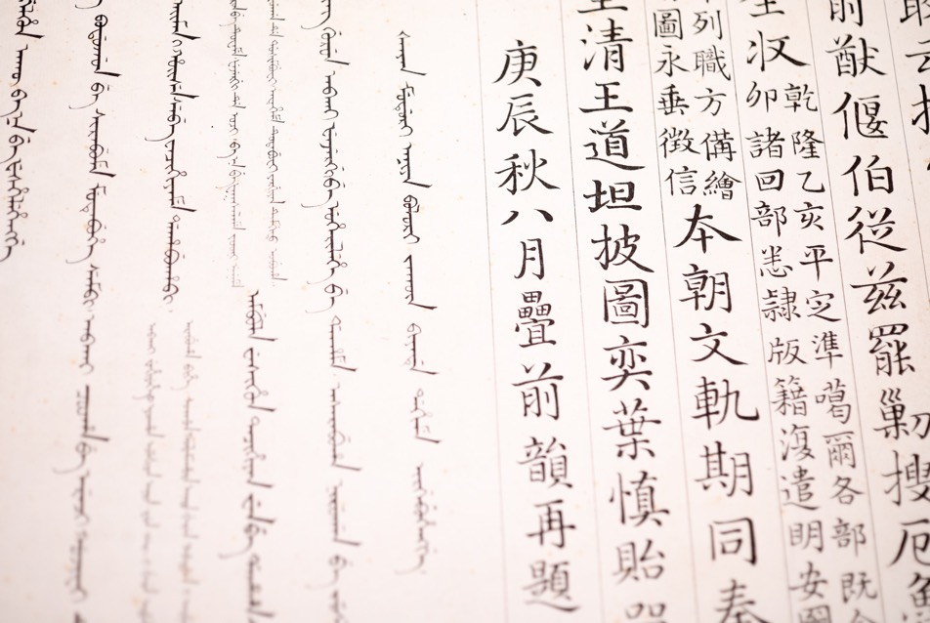
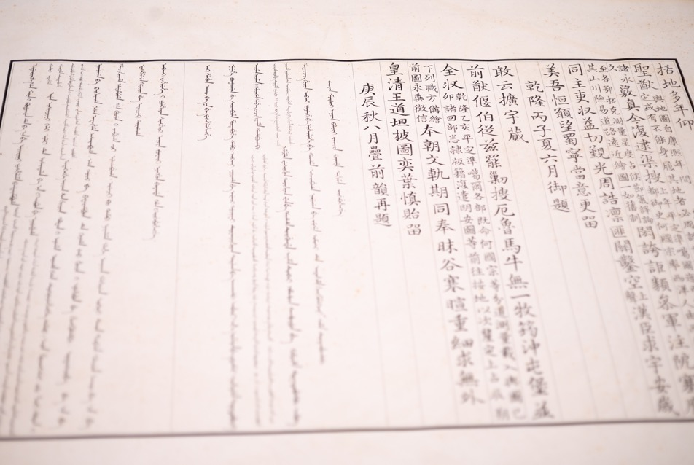
Qianlong’s etched atlas

Slide 29
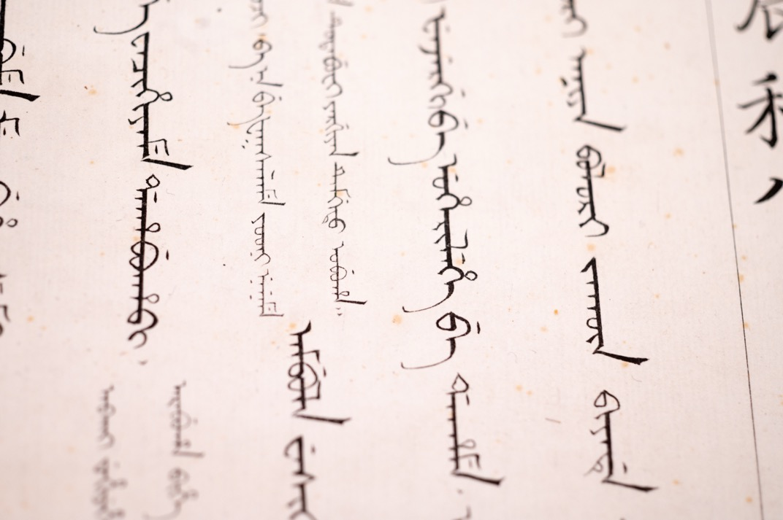
Qianlong’s etched atlas

Slide 30


The Church of the East stele

Slide 31



The Church of the East stele

Slide 32



The Church of the East stele

Slide 33


The Church of the East stele

Slide 34


The Church of the East stele

Slide 35


The Church of the East stele

Slide 36


The Church of the East stele

Slide 37


The Church of the East stele

Slide 38


The Church of the East stele

Slide 39


The Church of the East stele

Slide 40


The Jews of Kaifeng

Slide 41


The Jews of Kaifeng

Slide 42

The Jews of Kaifeng

Slide 43


The Xujiahui observatory

Slide 44


The Xujiahui observatory

Slide 45


The Xujiahui observatory

Slide 46


The Xujiahui observatory

Slide 47

The Xujiahui observatory

Slide 48


The Yangzhou tombstone

Slide 49


The Yangzhou tombstone

Slide 50


The Yangzhou tombstone

Slide 51


The Yangzhou tombstone

Slide 52

The Yangzhou tombstone

Slide 53


Tokugawa ms Ricci map

Slide 54


Tokugawa ms Ricci map

Slide 55


Tokugawa ms Ricci map

Slide 56


Tokugawa ms Ricci map

Slide 57

Tokugawa ms Ricci map

Slide 58


Tokugawa ms versions of Schall’s books

Slide 59


Tokugawa ms versions of Schall’s books

Slide 60


Tokugawa ms versions of Schall’s books

Slide 61


Tokugawa ms versions of Schall’s books

Slide 62


Tokugawa ms versions of Schall’s books

Slide 63


Trigault’s edition of Ricci’s diaries

Slide 64


Trigault’s edition of Ricci’s diaries

Slide 65


Trigault’s edition of Ricci’s diaries

Slide 66


Verbiest and astronomy under Kangxi

Slide 67

Verbiest’s world map

Slide 68


Verbiest’s world map

