Slide 1
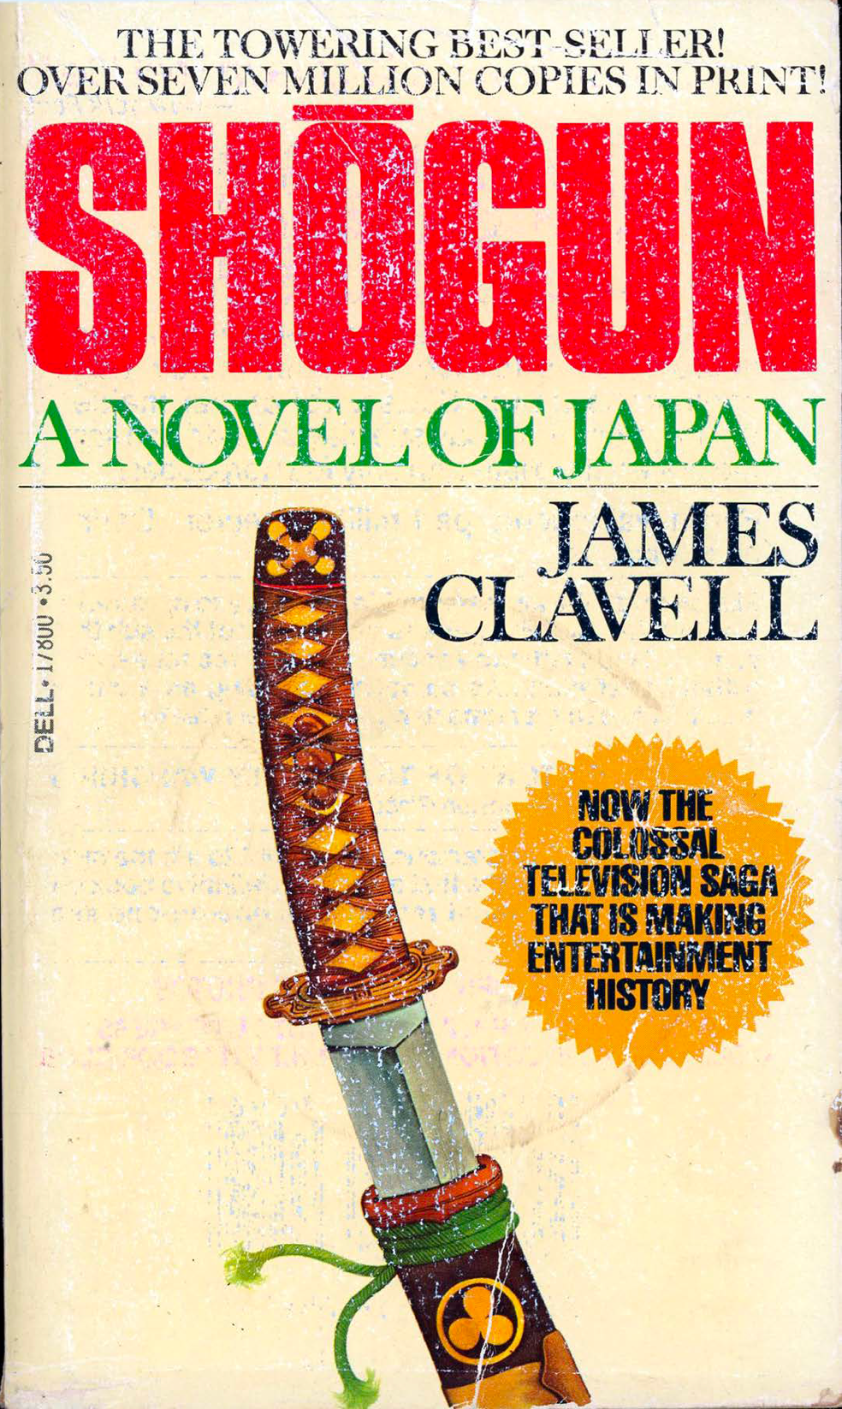
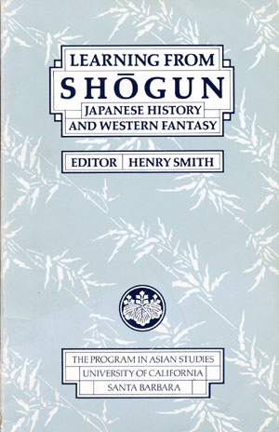
https://www.columbia.edu/~hds2/learning/

Slide 2
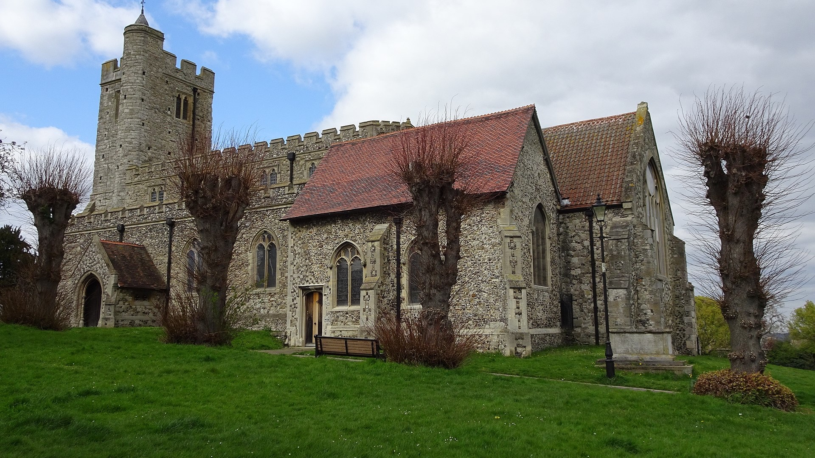
Notes:
Hugh Llewelyn from Keynsham, UK - Gillingham Church (St. Mary Magdalene) https://ja.wikipedia.org/wiki/ウィリアム・アダムス#/media/ファイル:Gillingham_Church_(St._Mary_Magdalene)_(51103021697).jpg

Slide 3
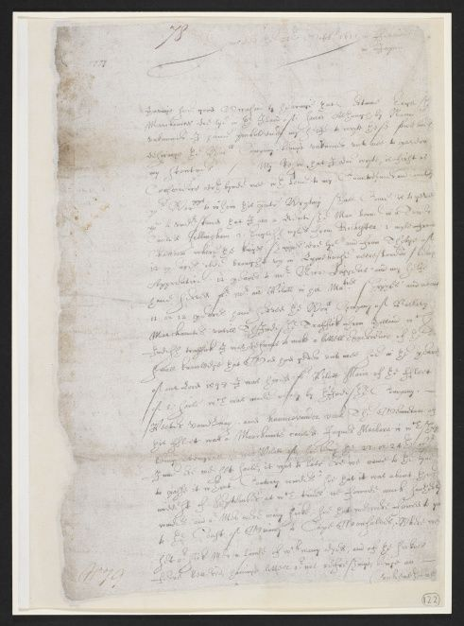
Notes:
23 October 1611 Will Adams letter https://blogs.bl.uk/untoldlives/2016/05/william-adams-from-gillingham-to-japan.html

Slide 4
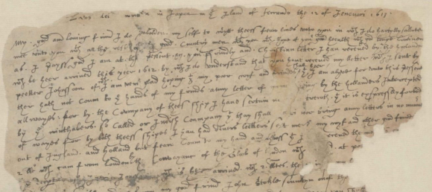
Notes:
IOR/E/3/1 ff. 157-58 Letter from William Adams at Hirado to Augustine Spalding at Bantam 12 January 1613 https://blogs.bl.uk/untoldlives/2020/11/william-adams-in-japan-a-new-digital-resource.html

Slide 5
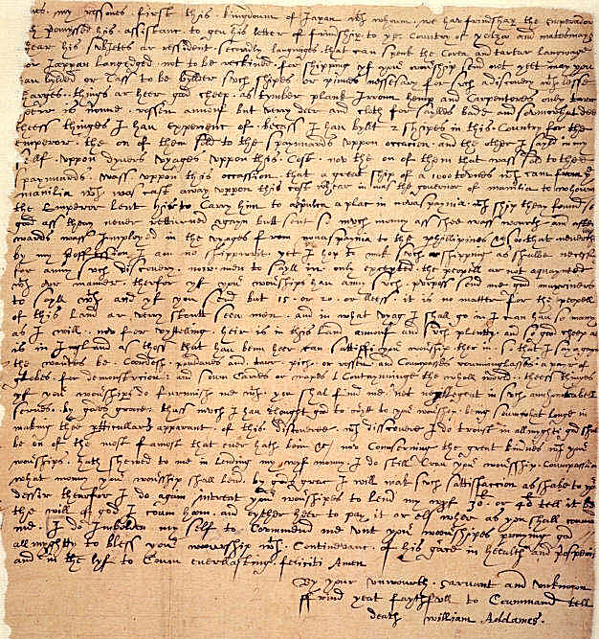
Notes:
Excerpt from a letter written by William Adams at Hirado in Japan to the East India Company in London, 1 December 1613. British Library. https://commons.wikimedia.org/wiki/File:AdamsLetter.jpg

Slide 6
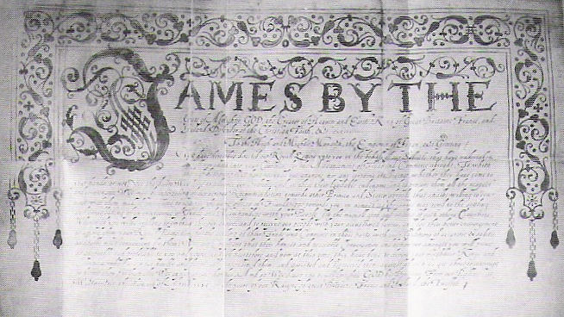
Notes:
https://en.wikipedia.org/wiki/William_Adams_(samurai)#/media/File:KingJamesLetter.jpg Copy of Letter Tokyo University Archives

Slide 7
Notes:
https://blogs.bl.uk/.a/6a00d8341c464853ef01901e9d3b76970b-pi

Slide 8
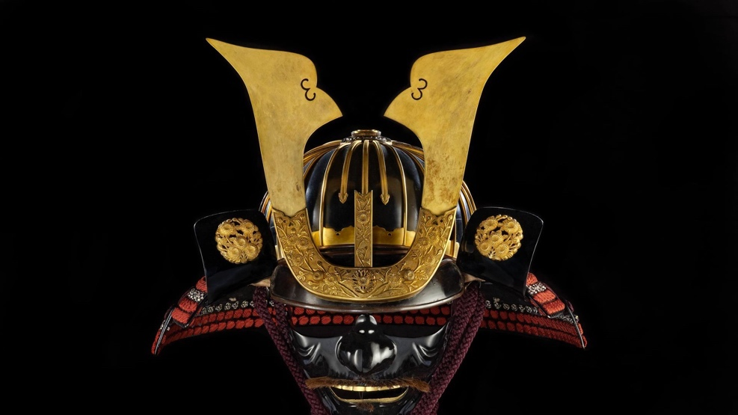

Slide 9
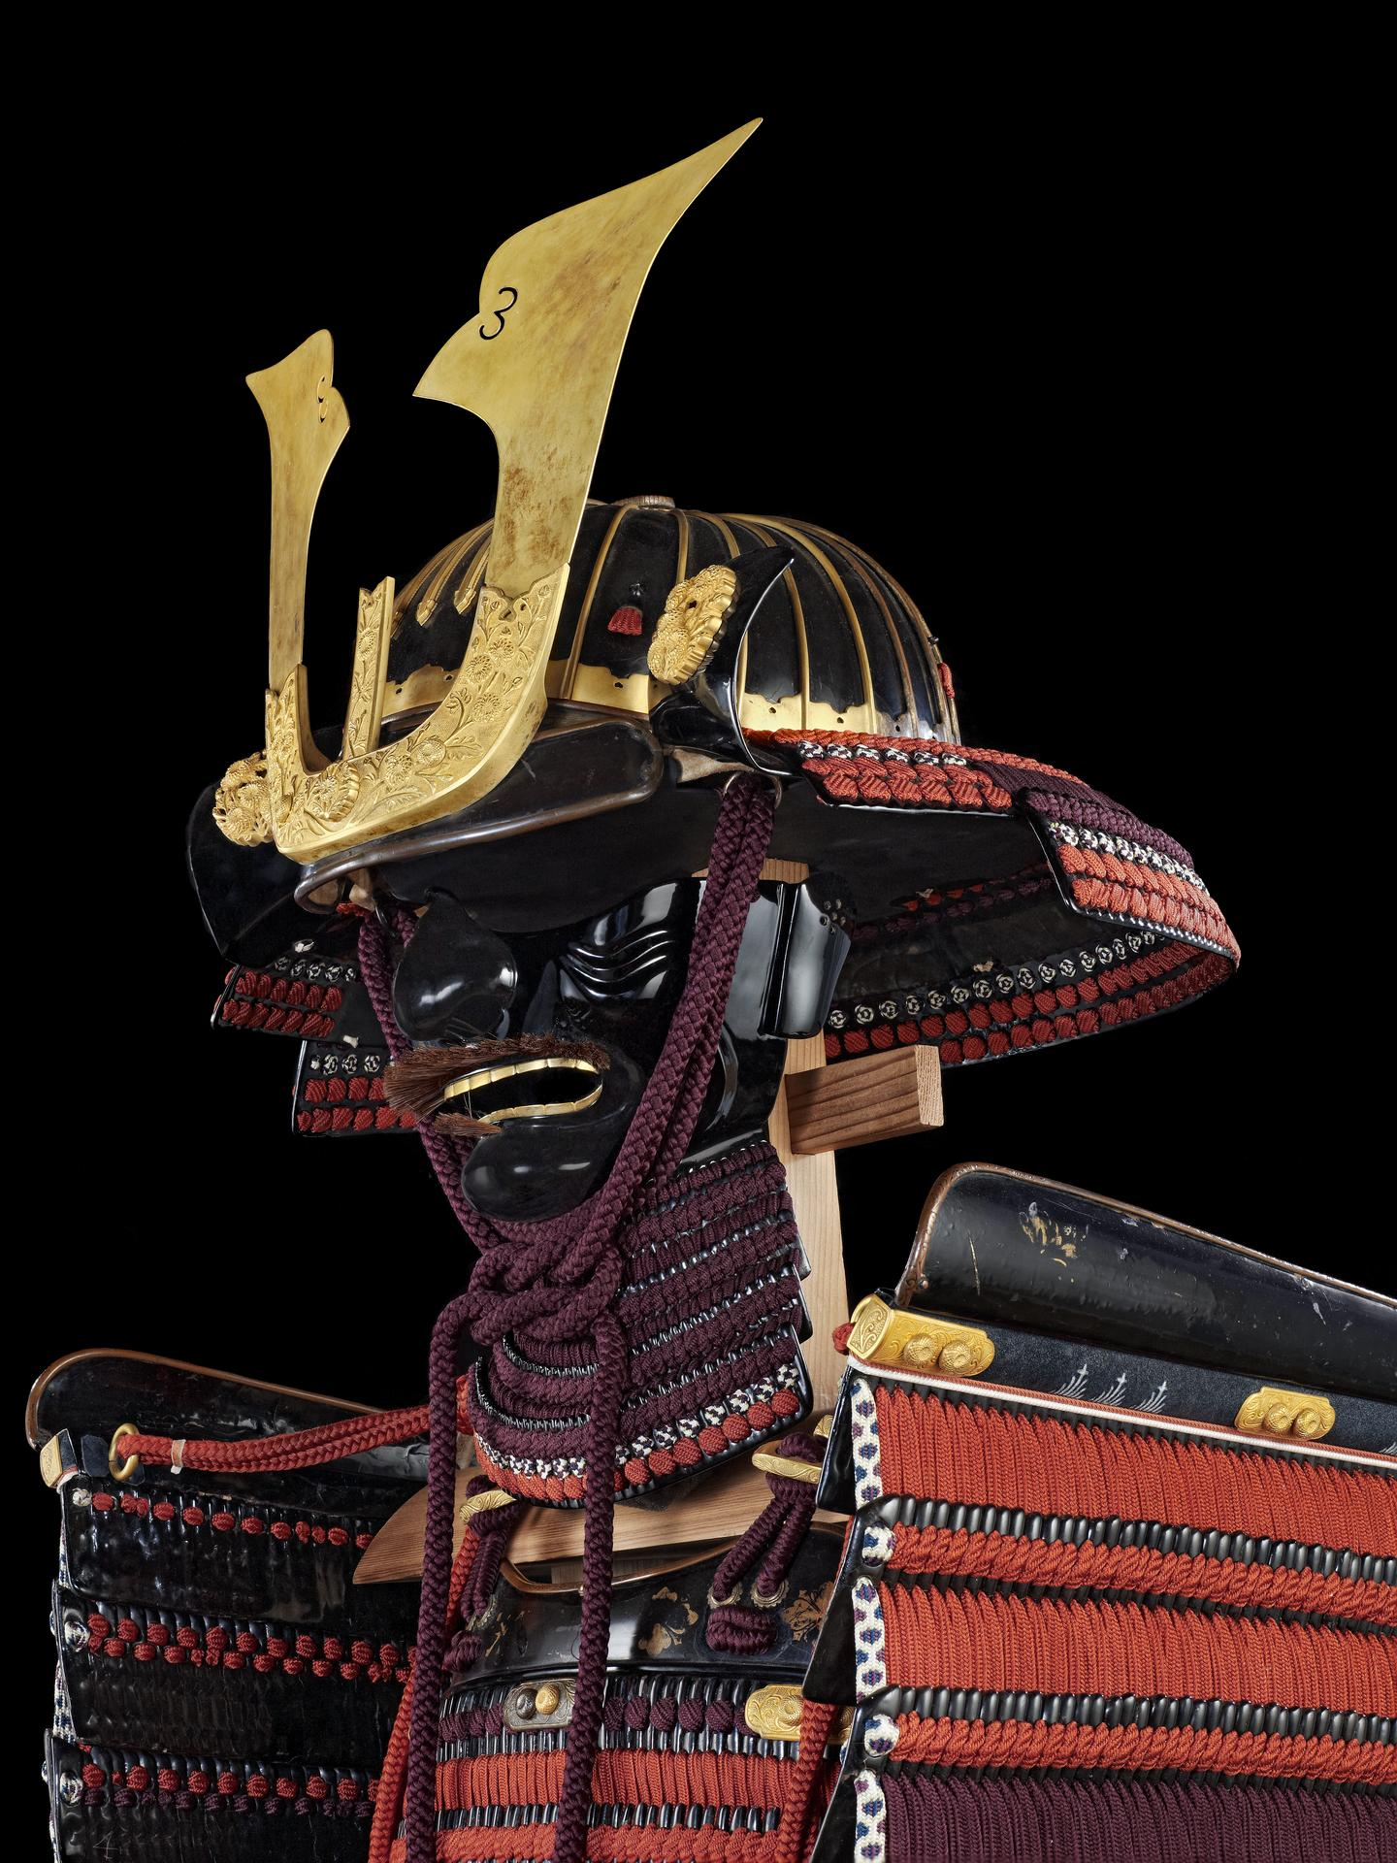

Slide 10
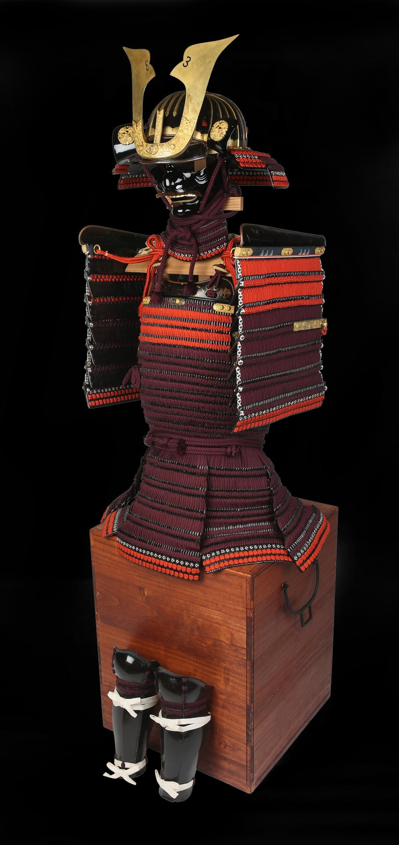
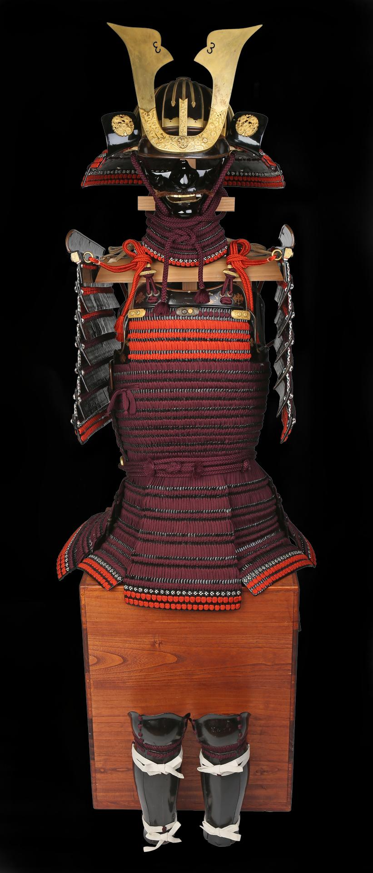
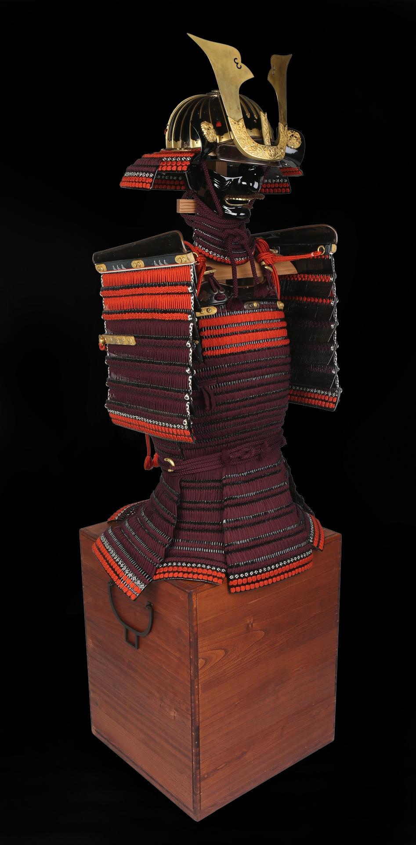

Slide 11
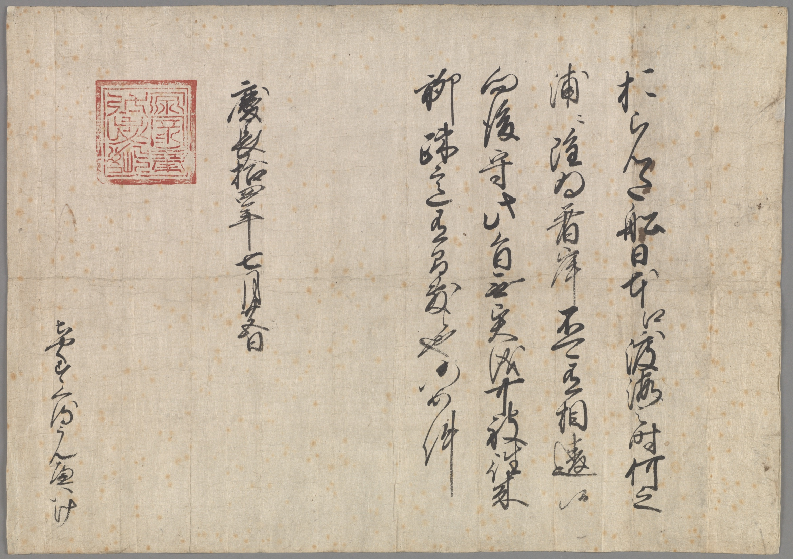
Notes:
Red Seal document trading privileges 1609 from Ieyasu--The "trade pass" (Dutch: handelspas) issued in the name of Tokugawa Ieyasu. The text commands: "Dutch ships are allowed to travel to Japan, and they can disembark on any coast, without any reserve. From now on this regulation must be observed, and the Dutch left free to sail where they want throughout Japan. No offenses to them will be allowed, such as on previous occasions" – dated 24 August 1609 (Keichō 14, 25th day of the 7th month)-available Wikipedia “Will Adams”

Slide 12
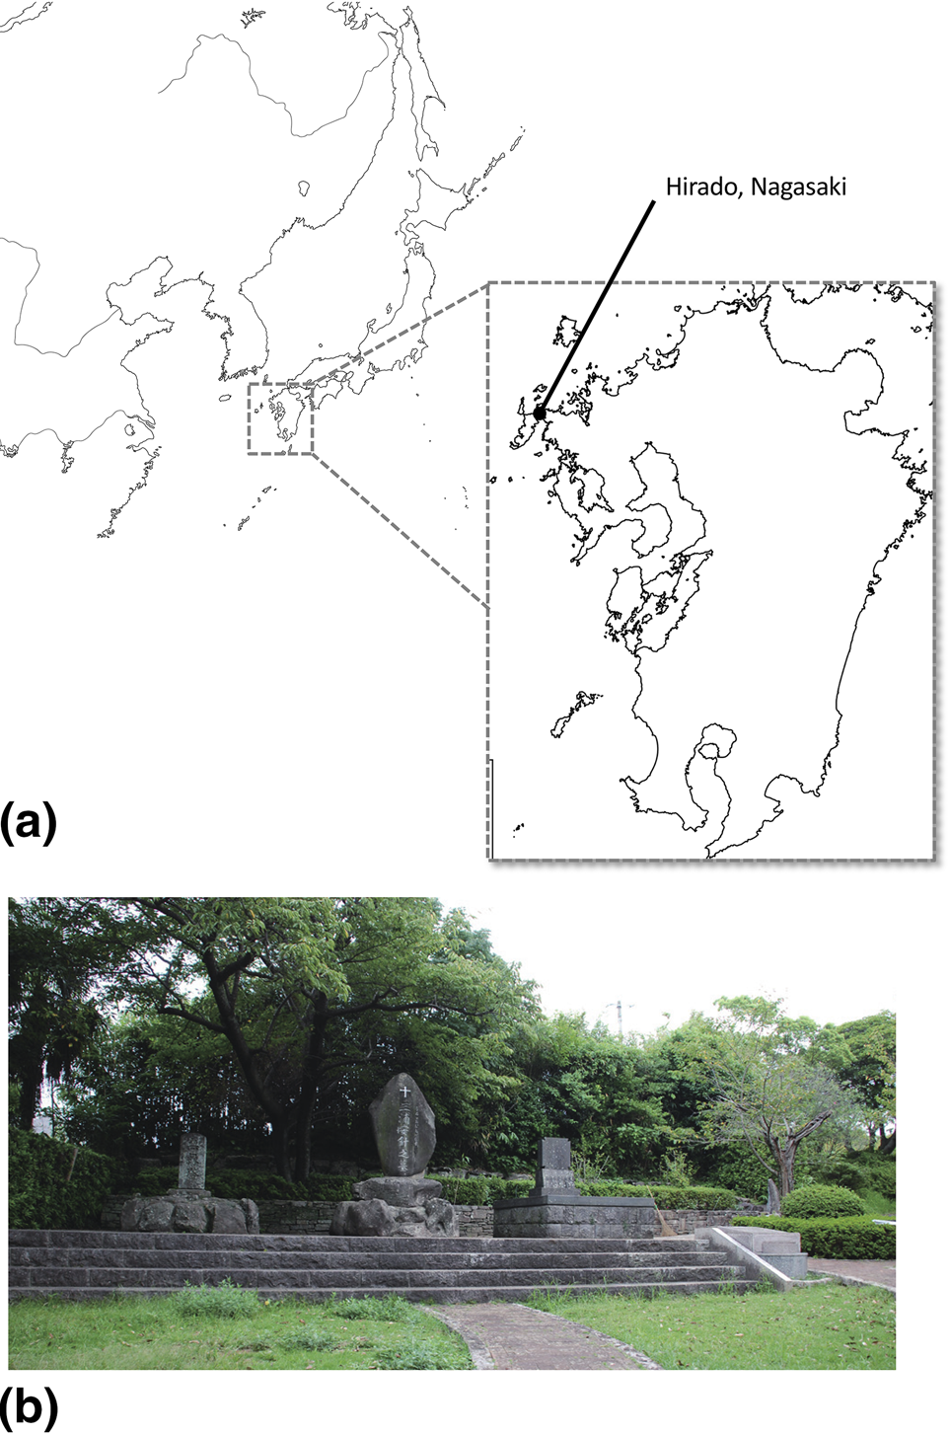

Slide 13
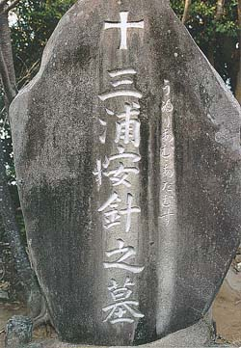
Notes:
Grave of Miura Anjin, Hirado, Nagasaki Prefecture, Japan. The small hiragana characters to the right are a phonetic transcription of "William Adams", using the historical character 'ゐ' for 'wi'.

Slide 14
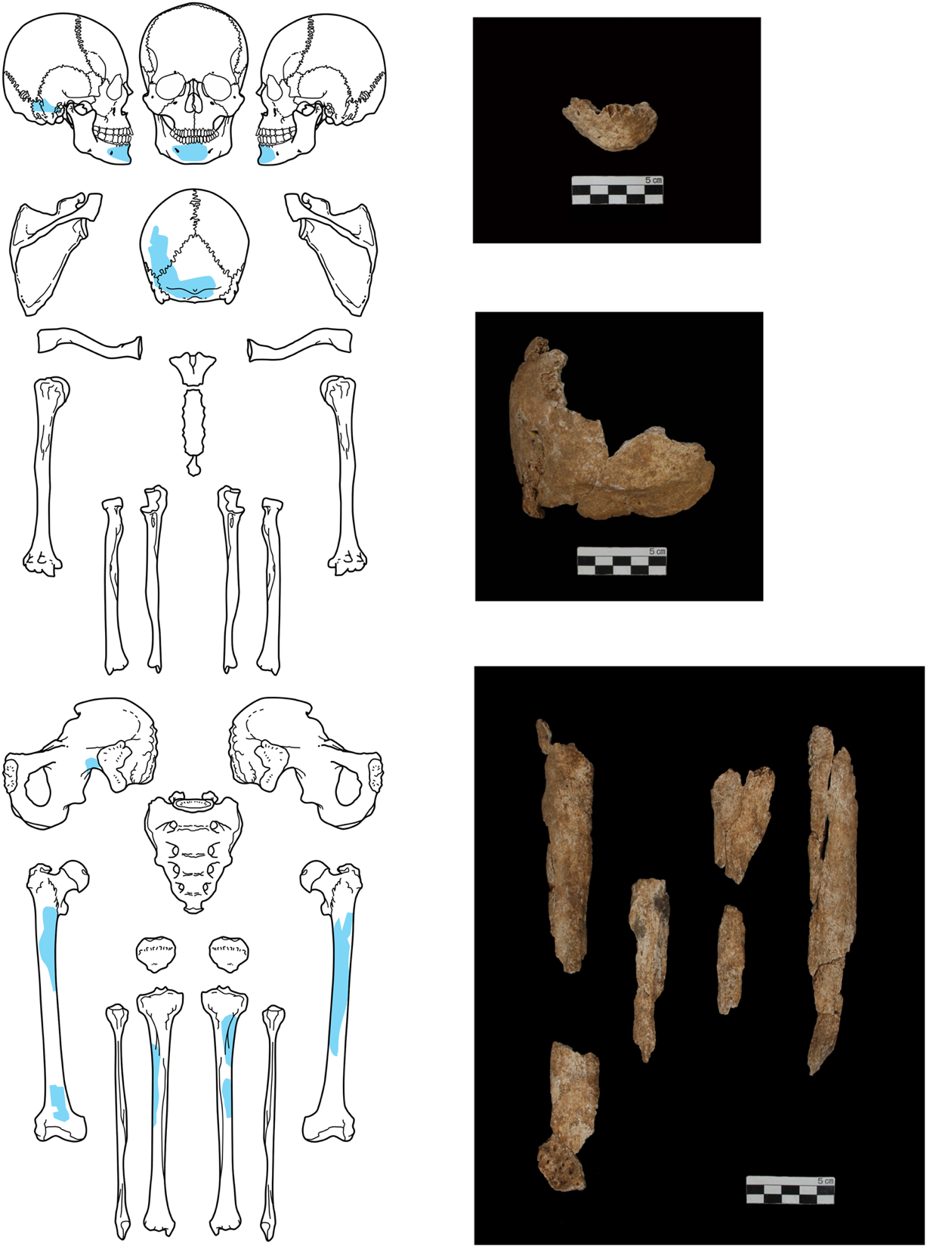
Figure 2. The fragments of human bone recovered during the excavation are colored blue. The diagram shows the mandible at the top, the skull in the middle, and the long bones below.

Slide 15
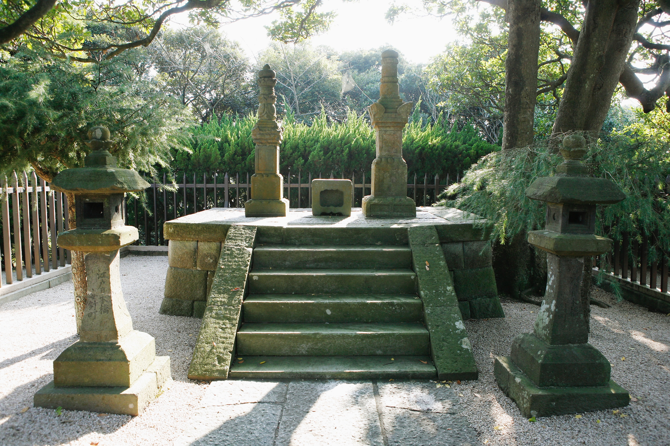
Notes:
The grave of Miura Yasuharu in Tsukayama Park, Yokosuka City. For a visitor’s account, read https://www.williamadams.fr/william-adams-and-yokosuka/ Located Yokosuka near Tokyo

Slide 16
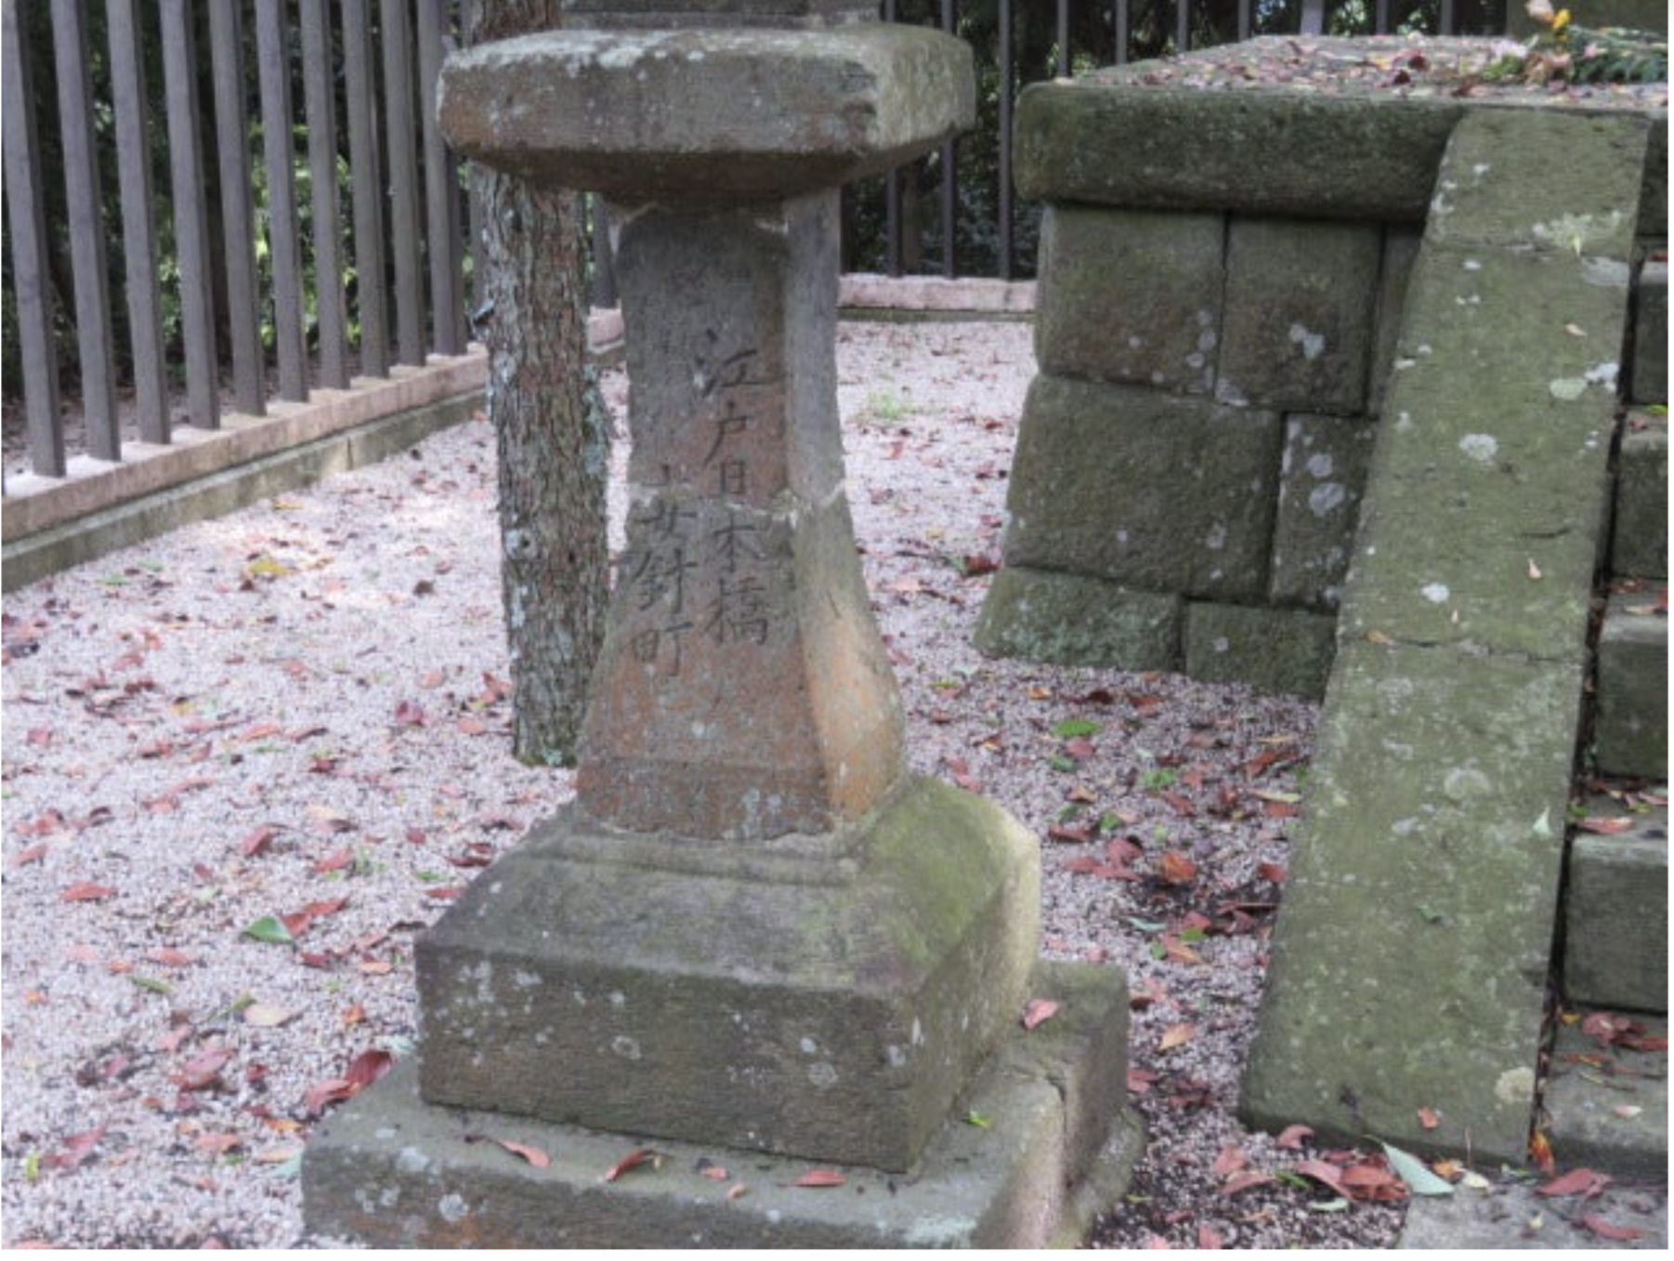

Slide 17
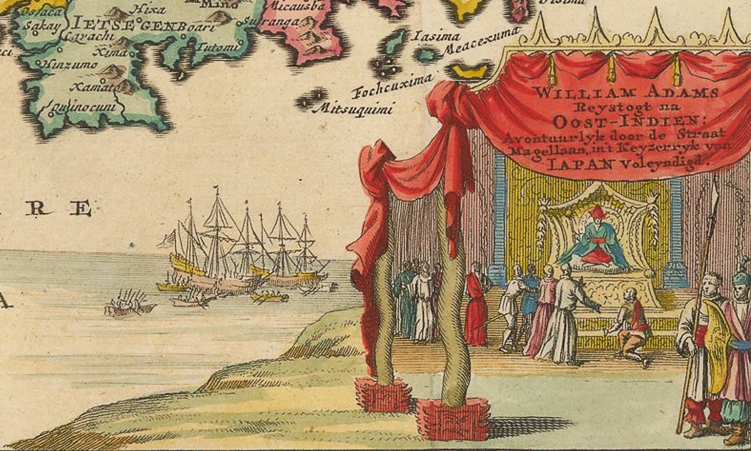
Notes:
William Adams meets Tokugawa Ieyasu, in an idealised depiction of 1707. https://en.wikipedia.org/wiki/William_Adams_(samurai)#/media/File:William_adams_vanderaa.png
Pieter van der Aa - 1. From Naaukeurige Versameling der Gedenk-Waardigste Zee en Land-Reysen (A series of accounts of famous Sea and Land-Voyages). 2. Raremaps.com https://www.raremaps.com/gallery/detail/49776/japan-and-island-of-korea-william-adams-reystogt-na-oost-i-van-der-aa

Slide 18
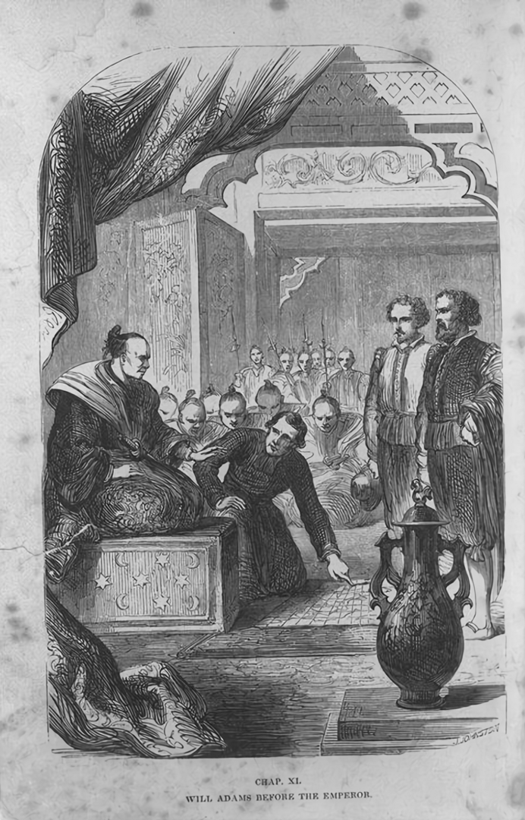
Notes:
William Adams before Shogun Tokugawa Ieyasu. The Shogun was frequently confused by foreigners as the Emperor. Dalton, W. / (Dalton, William). - William Adams: The first Englishman in Japan (Miura Anjin). From: Overseas Images of Japan Database

Slide 19
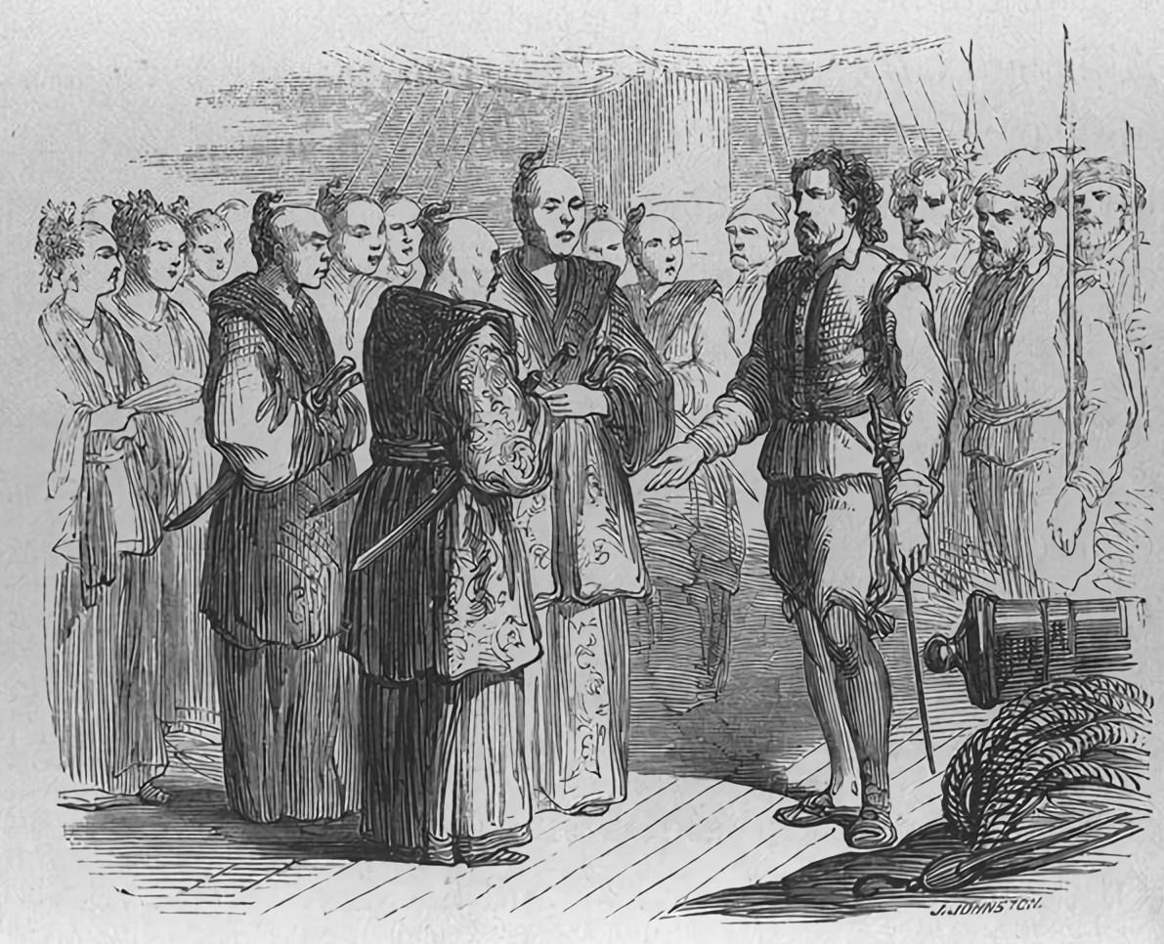
Notes:
1866 imagining of Will Adams

Slide 20
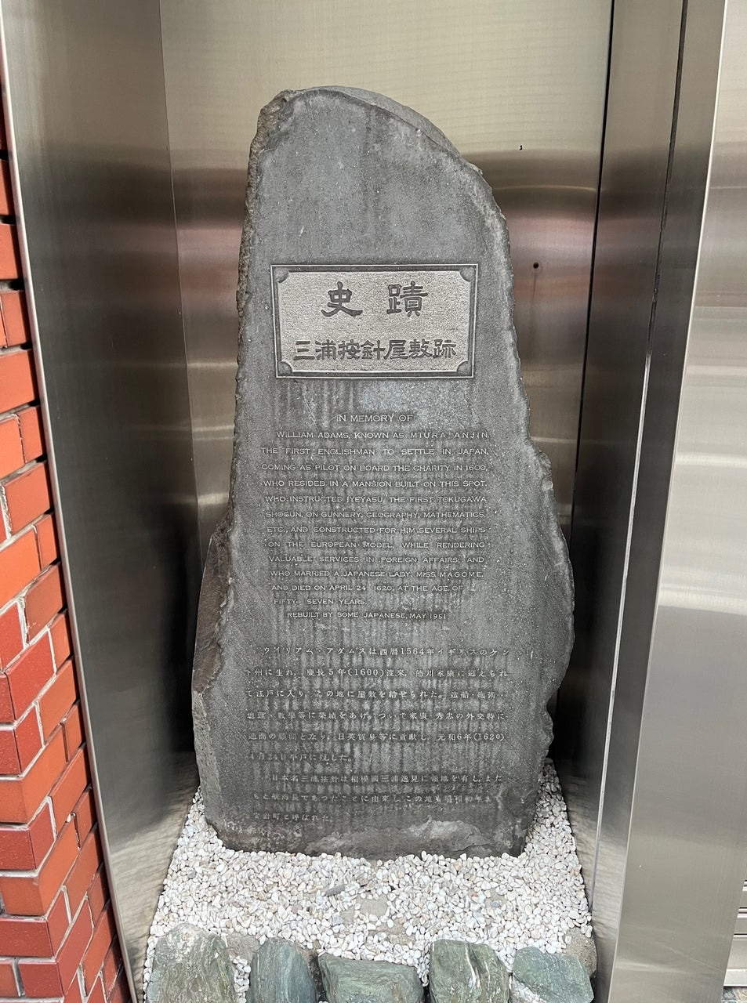
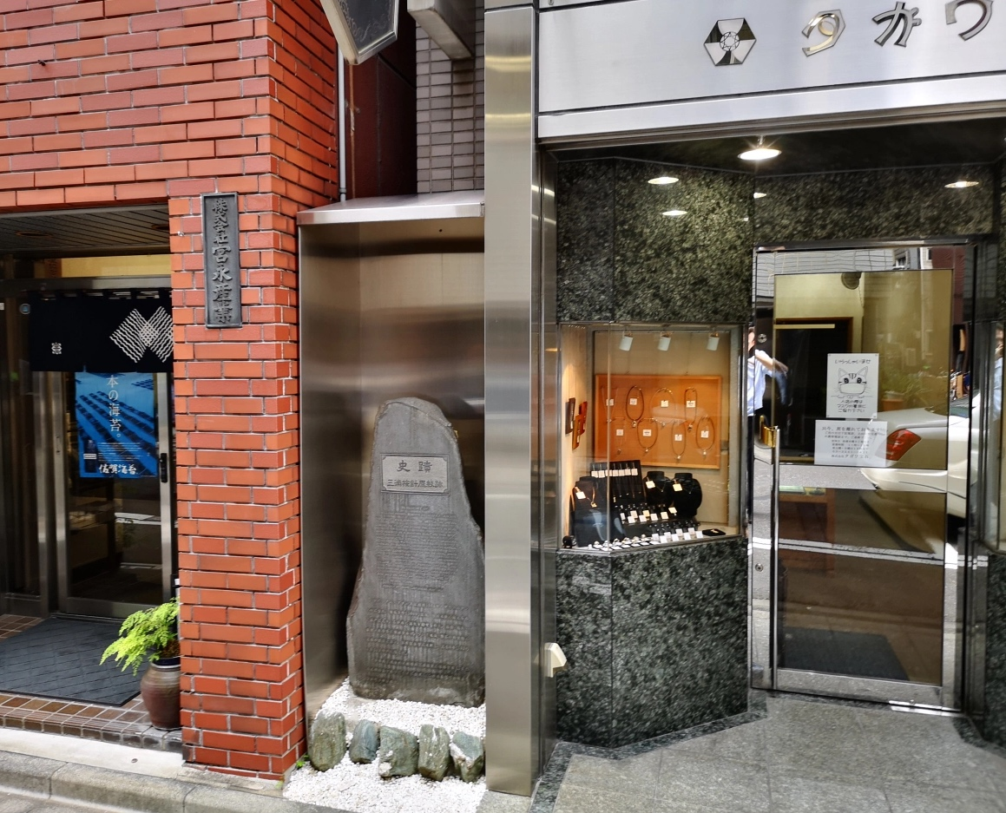
Notes:
Marker in Nihonbashi

Slide 21
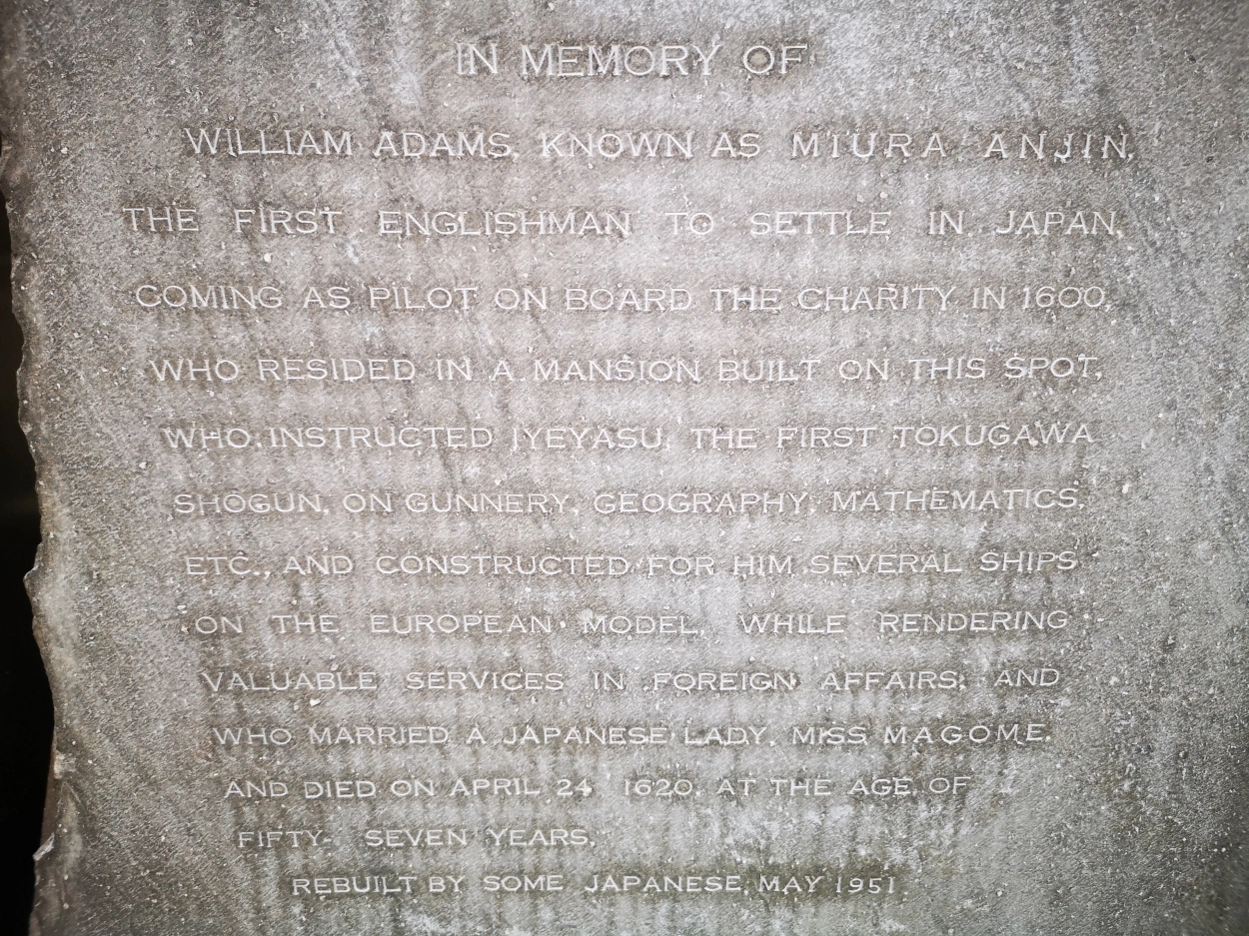
Notes:
https://hikingtokyo.com/2004/12/31/william-adams-miura-anjin-memorial-nihonbashi/

Slide 22
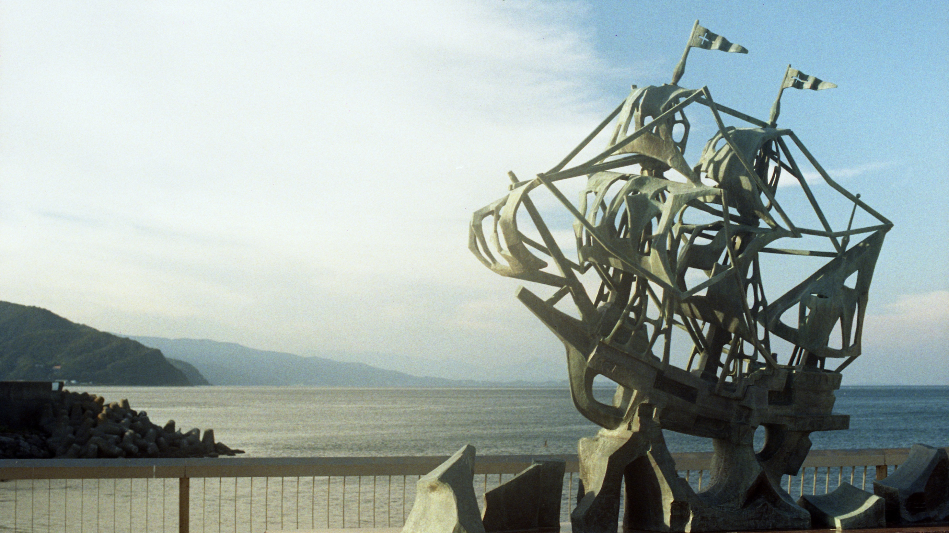
Notes:
San Buena Ventura ship at Anjin Memorial Park, model of 120 ton ship Adams built 1607, seized by Spain 1610--https://hoshinoresorts.com/en/guide/area/chubu/sizuoka/ito/miura-anjin/ https://www.city.ito.shizuoka.jp/gyosei/shiseijoho/shinaishisetsu/koen/5034.html

