Slide 1
Voices from Tang (618-907) through Northern Song (960-1127) Dynasty China: Encounters across Boundaries
Presentation for NCTA Fall 2023
Anna M. Shields, Princeton University

Slide 2
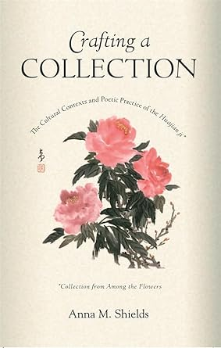
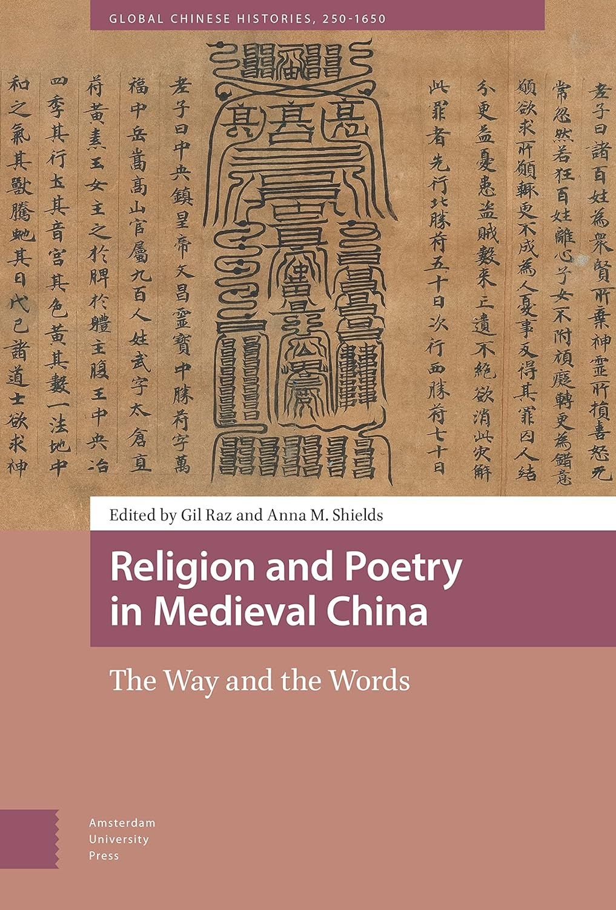
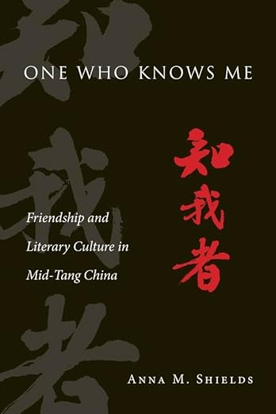

Slide 3
For Today: Views of Boundaries and Encounters in Tang through Song Literature
Temporal boundaries in Chinese history: how political, dynastic boundaries can both reveal and obscure change; significance of “Tang-Song transitions"
Geographic & ethnocultural boundaries: the cosmopolitan Tang, the chaotic division of the 10th century (what happens to “China”/the Central Kingdom 中國?), and China “turning inward” in the Song
Conceptual boundaries: perceptions of demarcated spaces (the Tang empire; the frontier, the city, and ”the Southland,” e.g.); cosmological (border between the terrestrial and celestial realms, e.g.); human boundaries (appearance of new social realms and spaces)

Slide 4
Partial List of Resources
Stephen Owen, An Anthology of Chinese Literature, Beginnings to 1911 (Norton, 1996)
Patricia Ebrey, Cambridge Illustrated History of China (3rd ed., Cambridge, 2022)
Charles Hartman, Han Yu and the T’ang Search for Unity (Princeton UP, 1996)
Ellen Cong Zhang, Transformative Journeys: Travel and Culture in Song China (U Hawaii Press, 2011)
Paul Rouzer, Articulated Ladies: Gender and the Male Community in Early Chinese Texts (Harvard, 2001)
Zong-qi Cai, ed., How to Read Chinese Prose: A Guided Anthology (Columbia UP, 2022) and How to Read Chinese Poetry: A Guided Anthology (CUP,2008)
Linda Rui Feng, City of Marvel and Transformation: Changan and Narrativs of Experience in Tang Dynasty China (U Hawaii Press, 2015)

Slide 5
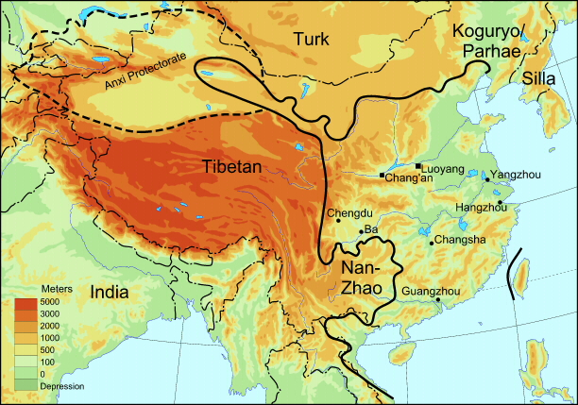
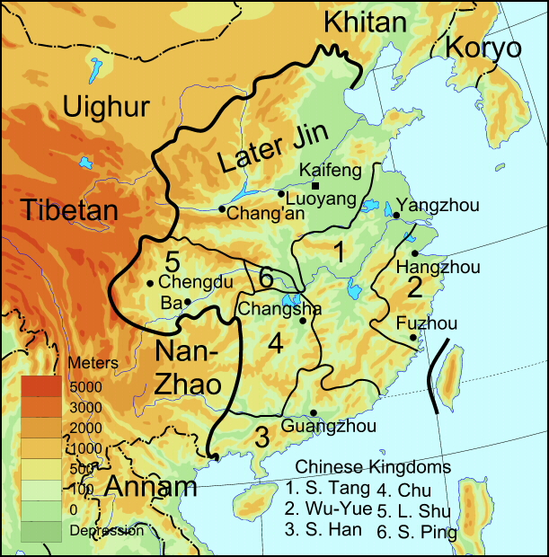
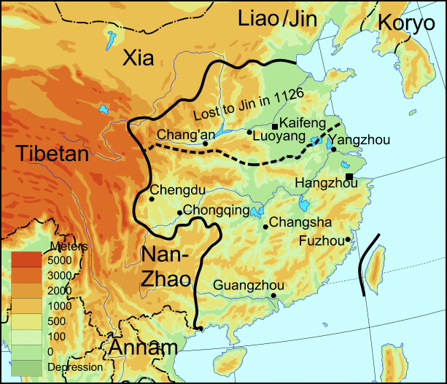
8th-12th Century “China”
Tang empire ca. 742
Five Dynasties & Ten Kingdoms ca. 936
N. Song ca. 1100

Slide 6
Periods of the Tang Dynasty
An Lu-shan Rebellion,
755-763 (nearly ends
the dynasty)
Influence of
“Empress” Wu,
655-705; “early Tang”
Final collapse
of Tang begins
In 880s, formal
date of end is 907
Founding of
Tang, 618
Reign of Emperor
Xuanzong,
712-755;
“High Tang”
Brief era of restoration of
dynastic strength, 780s-820s;
the “mid-Tang”

Slide 7
The Tang Empire, ca. 742

Slide 8
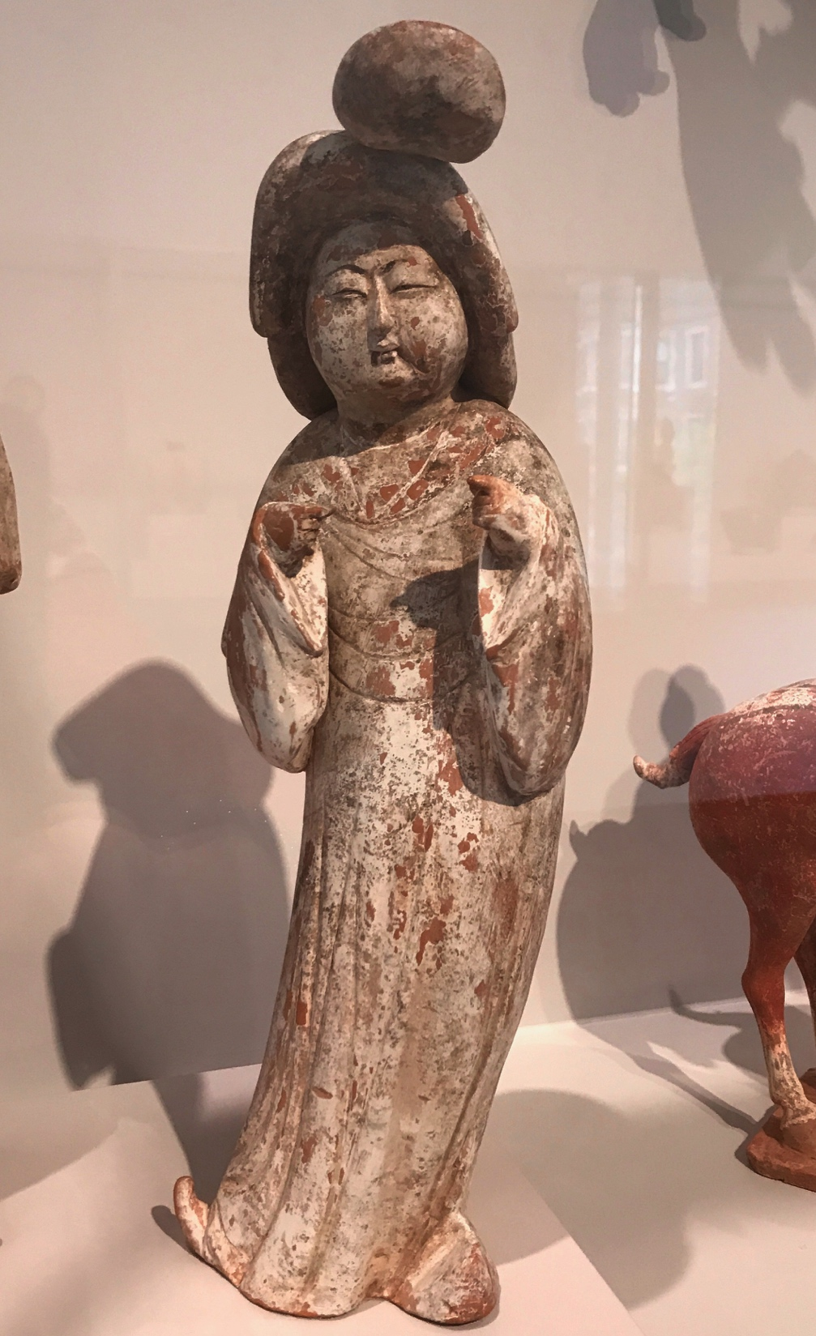
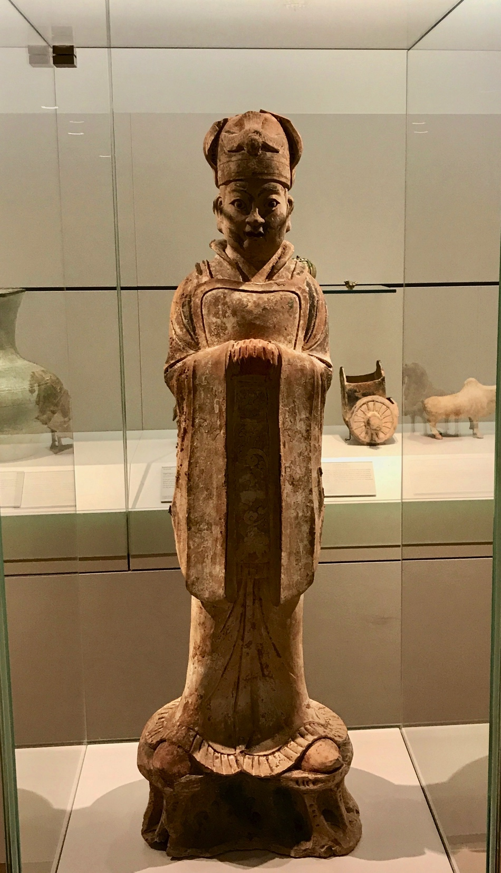
Tang official
(Met)
Tang Palace Lady (Metropolitan Museum)

Slide 9
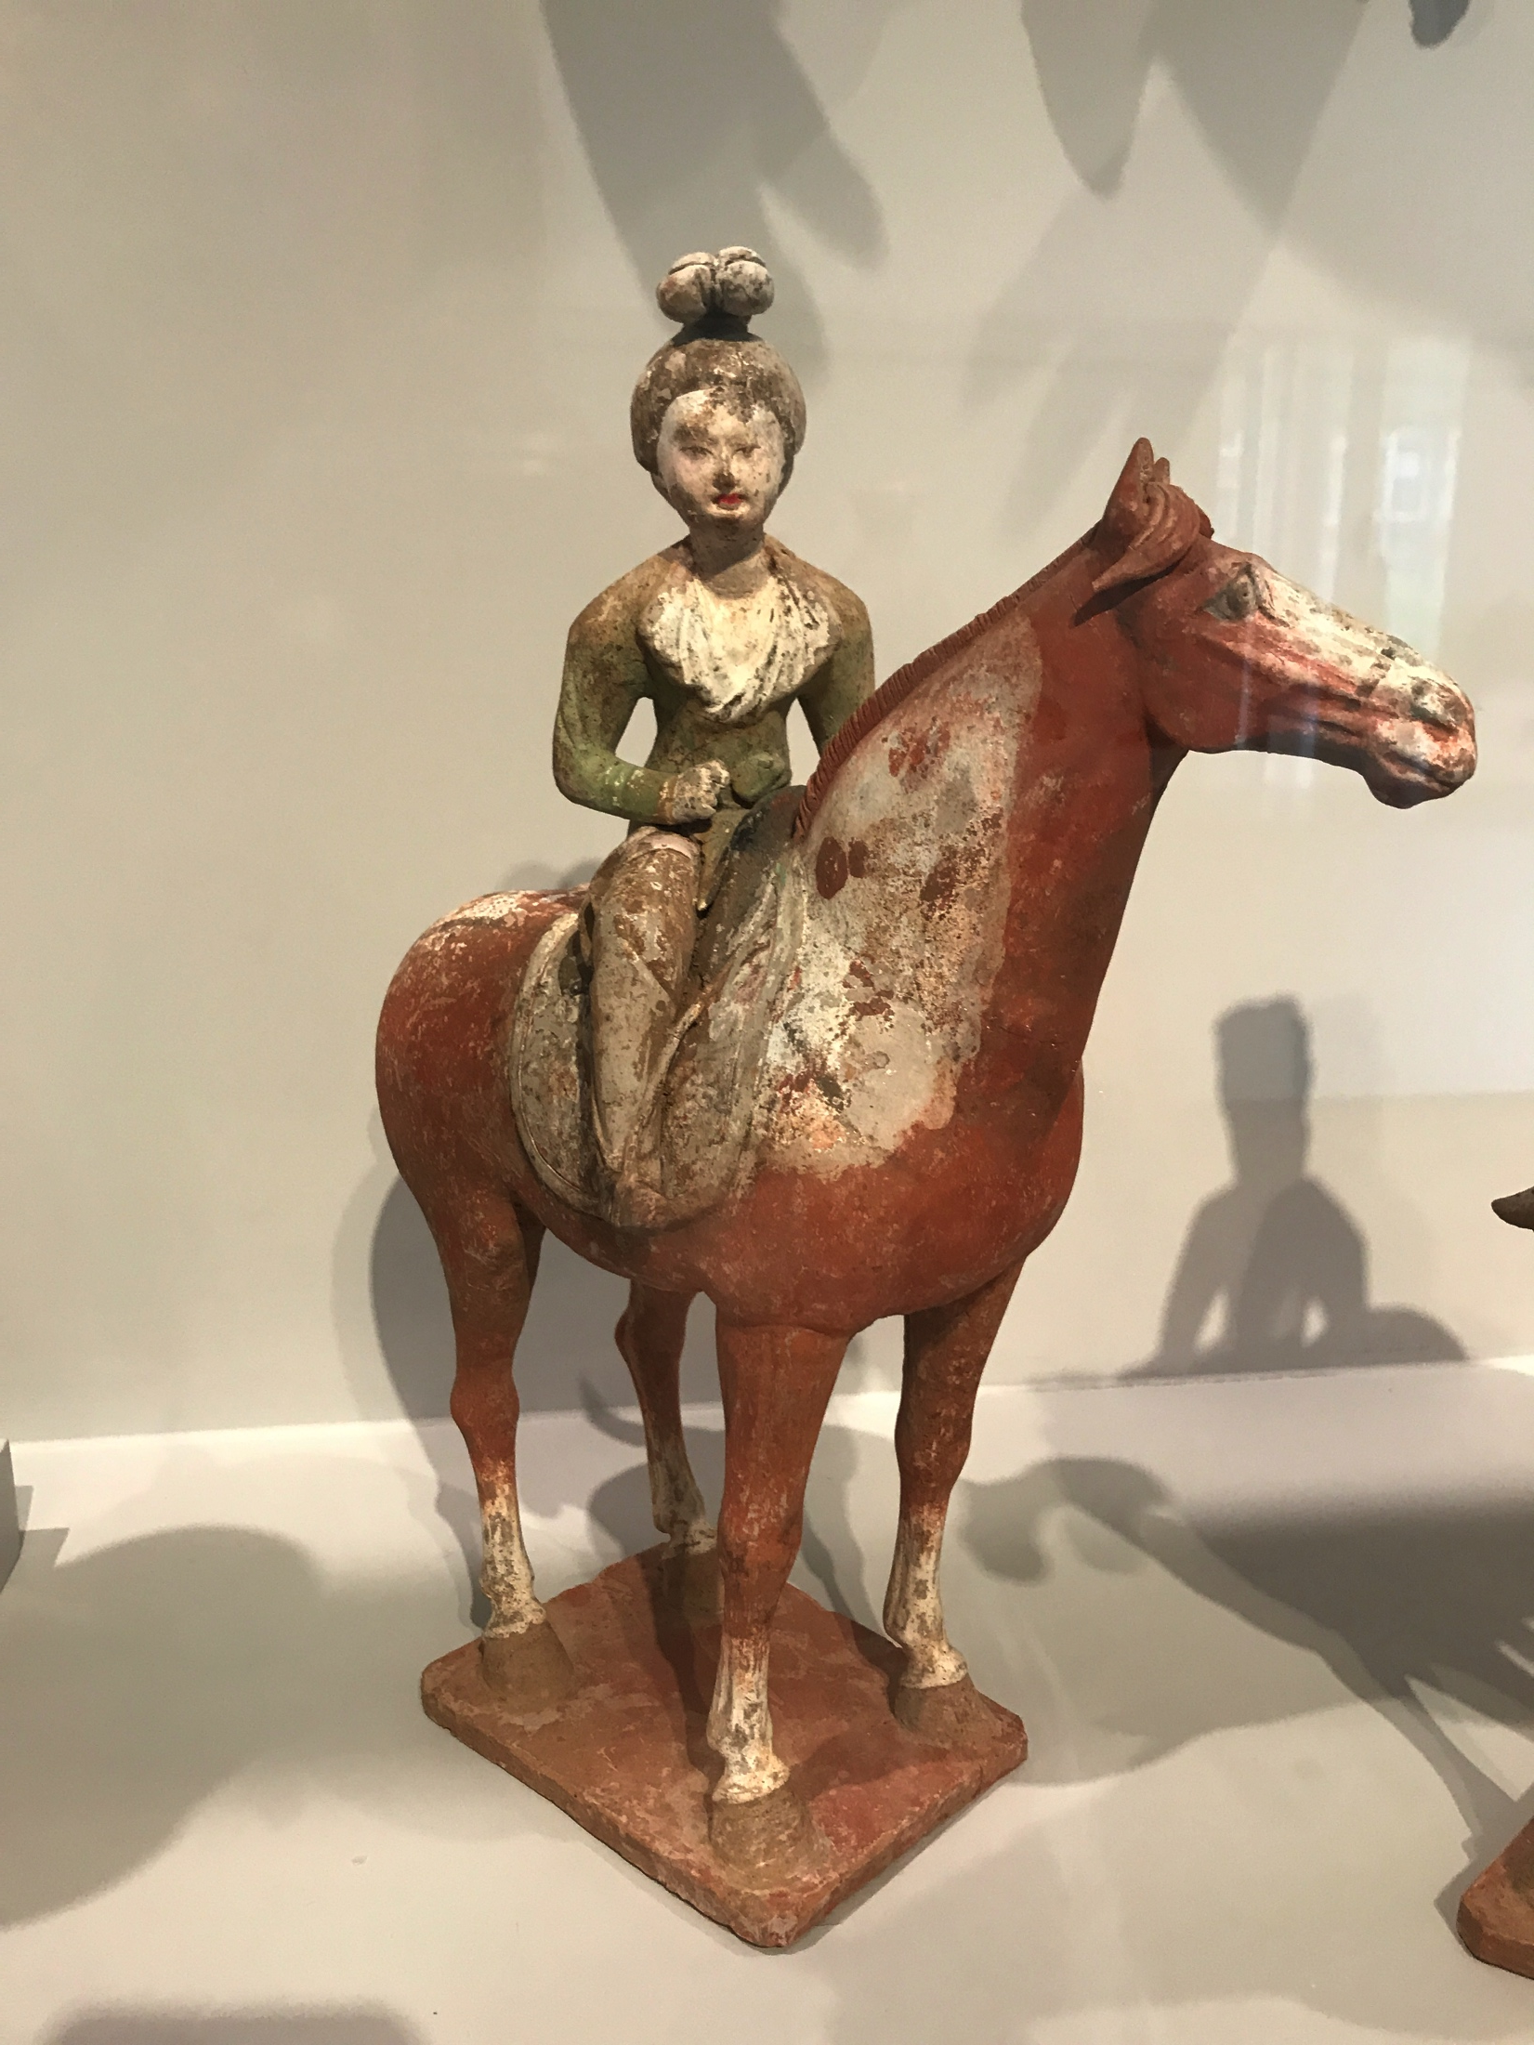
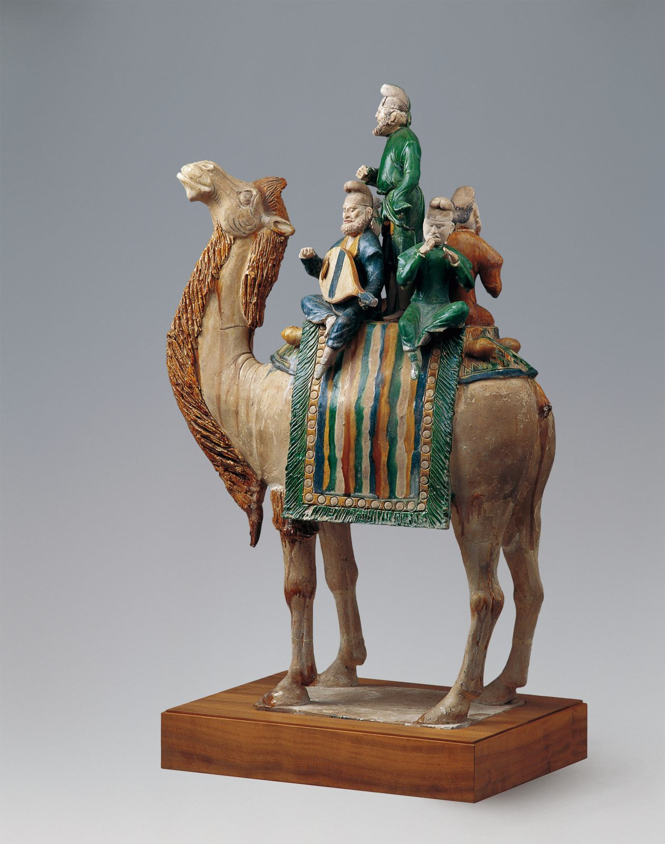
Tang Camel with Sogdians (Smithsonian)
Tang woman riding astride (Met)

Slide 10
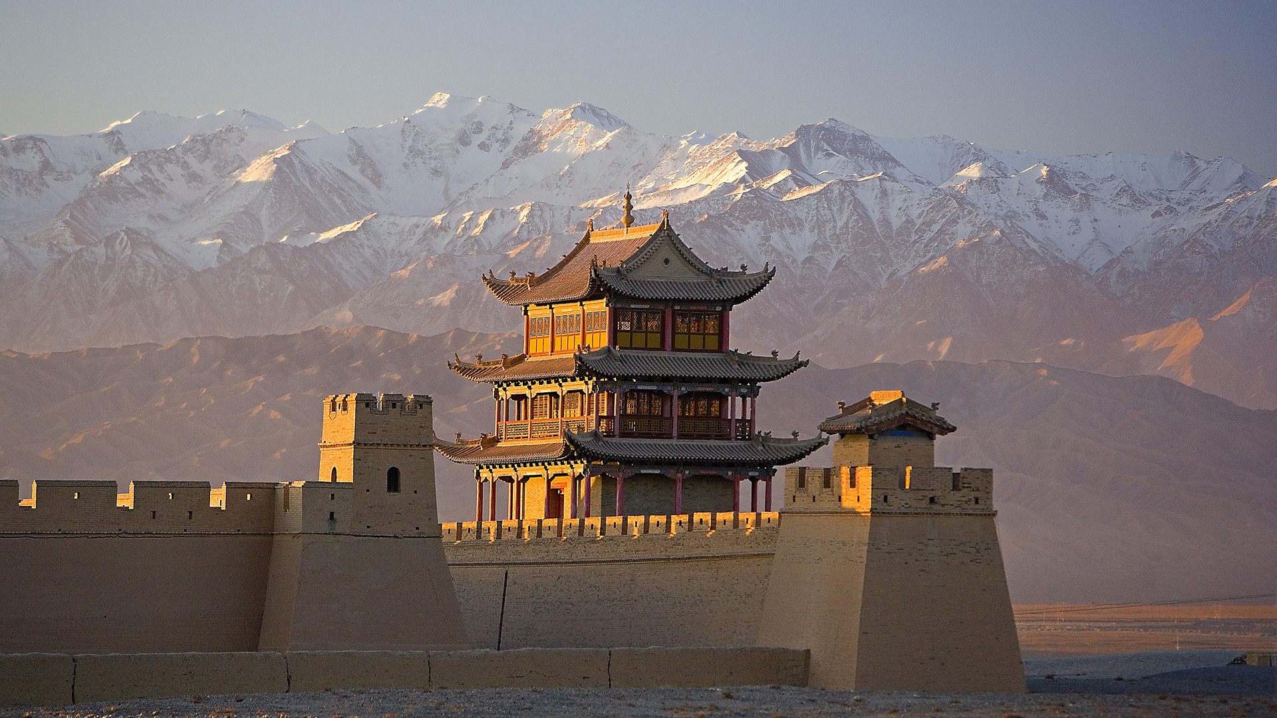
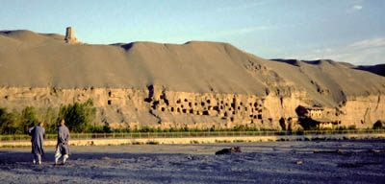
Jiayu Pass, Gansu, China
Dunhuang Caves, Gansu

Slide 11
From the Tang to the “Five Dynasties & Ten Kingdoms”
880s Huang Chao Rebellion: Chang’an sacked, the city devastated & abandoned as capital, people dispersed—beginning of the end
After 907: “Five Dynasties” in northern China & “Ten Kingdoms” (independent regional polities) in Southern China—two (Sichuan & Yangtze river basin) were very culturally vibrant
Old medieval aristocracy disappears; new people, cultural interests emerge over 10th c
Zhao clan (military clan from the north) eventually reunifies China; founding of the Song Dynasty in 960

Slide 13
Transitions from Tang to Song
Emergence of a new elite: destruction of medieval aristocracy, replaced by Song “scholar-officials” 士， 士大夫 and their culture; growth of bureaucracy & exam system
Commercial expansion, rapidly growing economy (cities, monetization, mercantilization, printing, trade)
Shifting southward: growth of southern economy, agriculture and loss of the north in 1127 (new capital at Hangzhou)
Emergence of new literati cultural activities: painting, book collecting, music, tea, etc.
“Turning inward”: rise of “Han” consciousness and national sentiment, particularly in contrast to Khitan & Jurchen peoples

Slide 14
Encounters across Spatial & Conceptual Boundaries
The frontier
The capital city
The unexplored south
The entertainment quarters
And others for future exploration….

Slide 15
Elites & the Role of Literature
The rise of the bureaucracy in Tang: role of the examination system (and the most prestigious jinshi 進士 examination) and emphasis on literary ability
Poetry as a competitive sport: ability to compose→basic skill for elite society
Not just poetry! Proliferation of forms of writing, occasions & official functions of literary composition
Literary writing: how one made oneself known to the world and to posterity

Slide 16
Poetry of the Northwestern Frontier
Tang poet Cen Shen 岑參 (715-770), “The Ballad of Running Horse River: Sending off the Army on a Western Campaign” 走馬川行奉送出師西征
Have you not seen Running Horse River beside a sea of snow,
A vast expanse of level sands stretching yellow to the sky? At Bugur in the ninth month the winds are roaring by night, with a whole river of shattered stones as large as dippers, and along with the wind that fills the earth, the stones run tumultuously. When the Xiongnu grasses turn brown, the horses are at their sleekest, west of Golden Mountain we see smoke and dust flying: The House of Han’s Grand General is taking the army west. The general’s coat of mail is not removed by night, as the army moves on at midnight, pikes bump into each other, the edge of the wind is like a knife, faces are if as sliced.
The coats of horses are streaked with snow, steam rises from their sweat, dappled spots like linked coins instantly turn to ice, drafting indictments back in camp, the inkstone’s water freezes. When nomad horsemen hear of him, their hearts will surely quail, I think is they will never dare to cross their swords with ours: at the western gate of Jushi we await news of the victory.
--Translation adapted from Owen, Anthology of Chinese Literature.
Notes:
君不見走馬川行雪海邊，平沙莽莽黃入天。 輪臺九月風夜吼，一川碎石大如鬥，隨風滿地石亂走。 匈奴草黃馬正肥，金山西見煙塵飛，漢家大將西出師。 將軍金甲夜不脫，半夜軍行戈相撥，風頭如刀面如割。 馬毛帶雪汗氣蒸，五花連錢旋作冰，幕中草檄硯水凝。 虜騎聞之應膽懾，料知短兵不敢接，車師西門佇獻捷。

Slide 17
Coming to the Capital: Han Yu 韓愈 (Tang) and Su Zhe 蘇轍 (Song)
Tang dynasty writer Han Yu (768-824)
“Long ago, when I had just come of age, I was in the capital to sit for the ‘presented scholar’ examinations. I was poor and unable to support myself. Because the youngest son was my friend, I did obeisance before the horse of the Prince of Beiping [Ma Sui]. He listened and commiserated with me, and so I was received at his mansion in the Anyi Ward. The prince was distressed at my poverty and gave me food and clothing. He sent for his two sons and ordered them to treat me as a guest...”
Out the Door 出門 Chang’an has a million people, Past the door, for each there’s a way. but past my door I have nowhere to go. My way is not easy just now. How can it be that I want to be secluded?, But if I rest here a while, it’s actually the world that is at odds with me. Heaven’s fate cannot betray me. Though the ancients are long dead, written in books are the words they left. I open my scrolls, then read and reflect-- like meeting through a thousand years of time. --Translation adapted from Hartman, Han Yü.
Notes:
长安百万家，出门无所之。岂敢尚幽独，与世实参差。 古人虽已死，书上有其辞。开卷读且想，千载若相期。 出门各有道，我道方未夷。且于此中息，天命不吾欺。

Slide 18
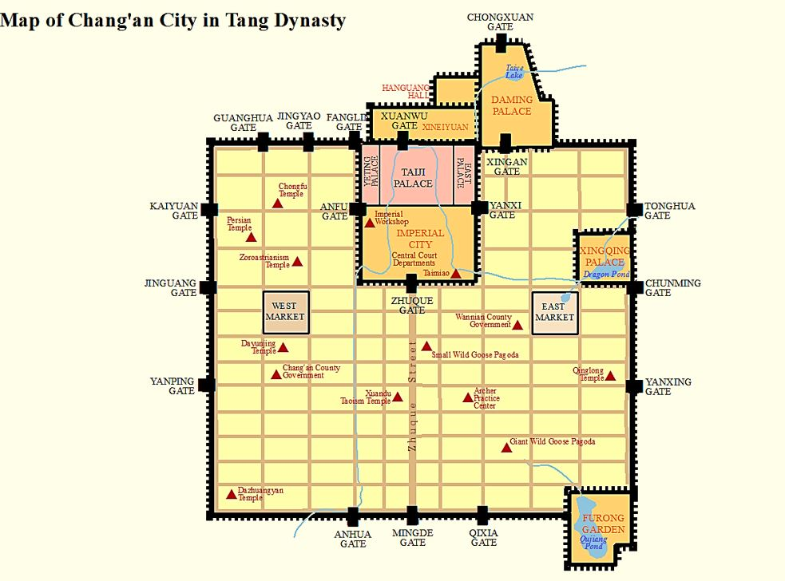

Slide 19
Song dynasty writer Su Zhe (best known as brother of Su Shi), “Letter Presented
To Military Affairs Commissioner and Defender-in-Chief Han Qi” 上樞密使韓太尉書
“I am now nineteen [sui]. Those roamed with when I lived at home were no more than those of my neighborhood or village, and what I experienced did not exceed several hundred li in area—there were no high mountains or great wilds to climb and view in order to broaden myself. . . .I feared I would drown in this backwater, so I resolutely quitted my home to seek out the world’s extraordinary stories and grand spectacles, in order to comprehend the breadth and grandeur of Heaven and earth. I journeyed to the homelands of Qin and Han, unrestrainedly viewing the heights of Zhongnan Mountain and the Ranges of Song and Hua; to the north I looked on the torrent of the Yellow River; stirred, I imagined seeing the renowned heroes of antiquity. When I arrived at the capital [of Bianjing], I looked up to view the might of the Son of Heaven’s palaces and towers, along with the wealth and greatness of the imperial granaries, treasuries, city walls, moats, and gardens—and then I understood the tremendous beauty of all under Heaven. . . . Since I set out among mountains I have seen the heights of Zhongnan, Song, and Hua, among waters I have seen the breadth and depths of the Yellow River, and among people I have visited Lord Ouyang—yet I still have not seen the Defender-in-Chief! Therefore I wish to have the opportunity to observe the brilliant resplendence of your worthy person...and only then will I have thoroughly examined the great sights of all under Heaven and have no regrets.” --Translation by Shields, from Cai, ed. How to Read Chinese Prose.

Slide 20
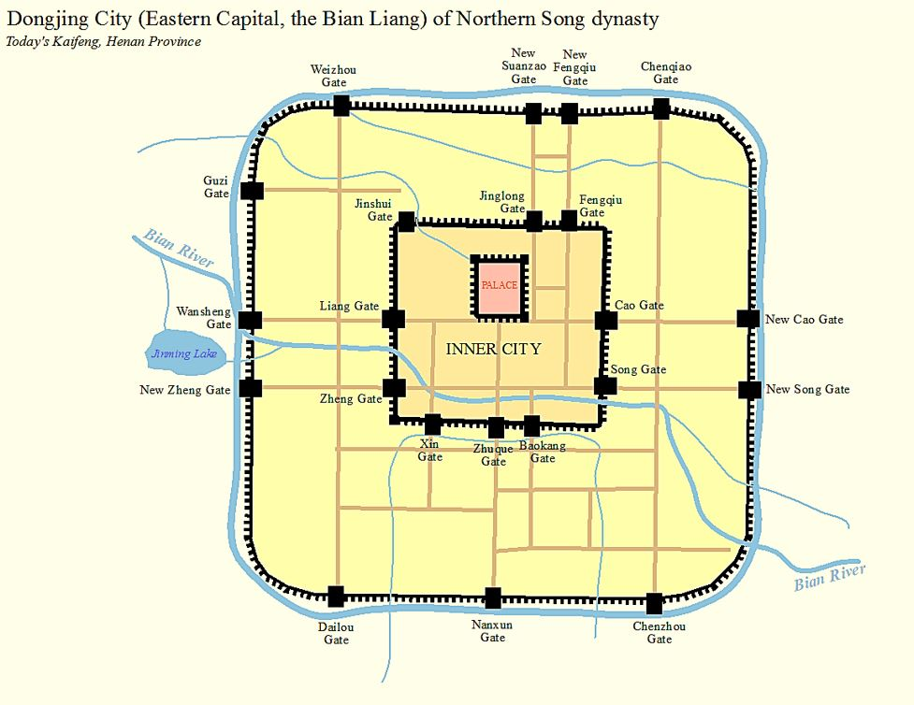
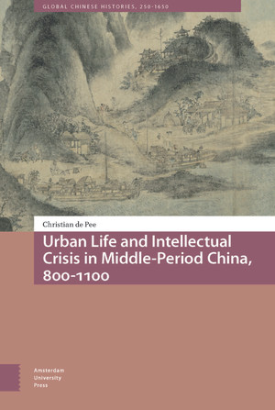

Slide 21
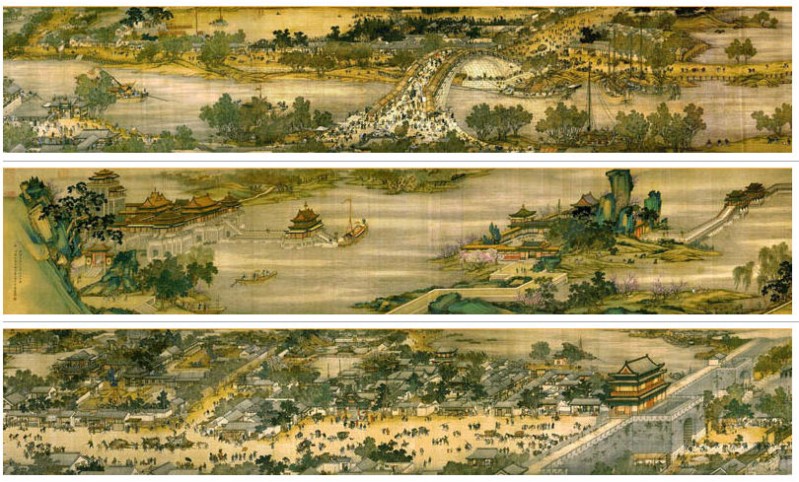
“Qingming Festival on the River”清明上河圖 (att. Zhang Zeduan, held in the Beijing Palace Museum). Video ”tour” of the scroll by Professor Valerie Hansen, Yale University:
https://www.youtube.com/watch?v=7Rp4nMn-Gms

Slide 22
Encounters with southern wilds
Tang writer Liu Zongyuan 柳宗元 (772-819) in exile in Yongzhou 永州八記 (present-day southern Hunan)
From “An Account of the Small Hill West of Gumu Pond”
“Eight days after I reached West Mountain, I was exploring about two hundred paces along the road that leads northwest from the mouth of the valley, and I found Gumu Pond. Twenty-five paces west of the pond, where the water flowed swift and deep, a fish-weir had been made. Almost beyond counting were its rocks, which jutted out menacingly, rearing themselves aloft, spurning the earth in their emergence and rivaling one another in rare shapes…The hill was so small it did not even cover an acre; one might have kept it packed in a basket. I asked the person in charge, who said, “This is land of the Tang family for which they have no used. They put it on the market, but couldn’t sell it. [Liu buys the property and with friends begins to improve it.]
Then the fine trees stood out, the lovely bamboo were exposed, and the unusual
rocks were revealed. When we gazed out from it,the heights of the mountains,
the drifting of clouds, the currents of streams, andthe cavorting of birds and beasts
all cheerfully demonstrated their art and skill in performance for us below the hill.. . .

Slide 23
“In less than ten full days I had obtained two rare places. Even those who
loved scenic spots in olden times may well never have been able to equal this.
I must say that if I were to transport this splendid scenery to [regions of the capital], the nobility who are fond of excursions would rival one another to purchase it. But now it is left forsaken in this province; as they pass by, farmers and fishermen think it worth nothing. . . . Yet I, together with Li Shenyuan and Yuan Keji, have been singularly delighted to get it. Isn’t this a case of having a lucky encounter at last?”
--Translation adapted from Owen, Anthology of Chinese Literature.
What value does Liu Zongyuan make out of exile?
How does he convert “alienness” to “scenery”?

Slide 24
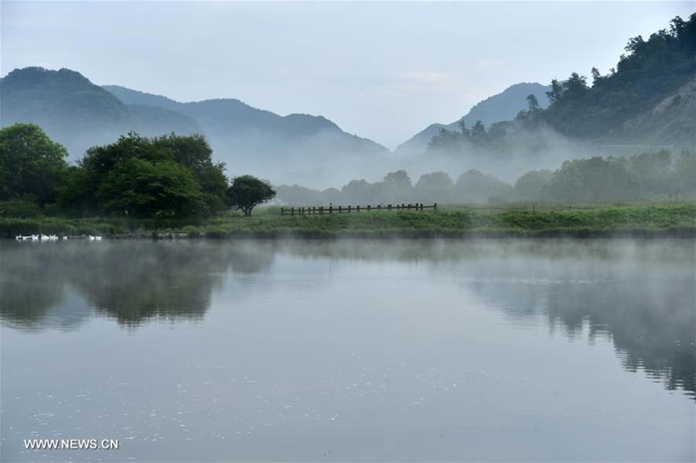
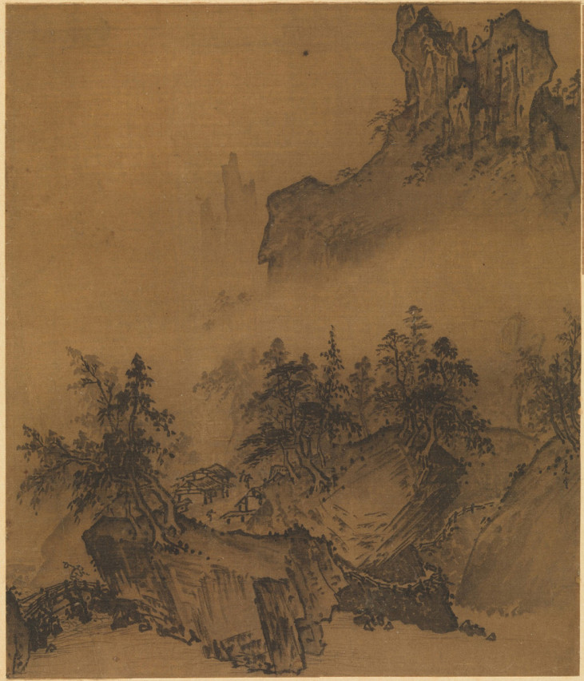
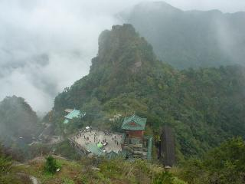
Princeton Art Museum teaching resources: https://static.artmuseum.princeton.edu/asian-art/china/resources/landscape-painting/

Slide 25
The Entertainment Quarters & Courtesan Culture: Liminal Encounters
The “Northern Ward” (Pingkang Ward) of
Chang’an:
The pleasure quarters which held entertainment sites and
brothels, famous for drawing elite men to consort with literate and talented women. Locus of poetry, song, and “romance” among women and literati. Courtesan culture gave rise to the important song lyric genre of romantic love and intense feeling.

Slide 26
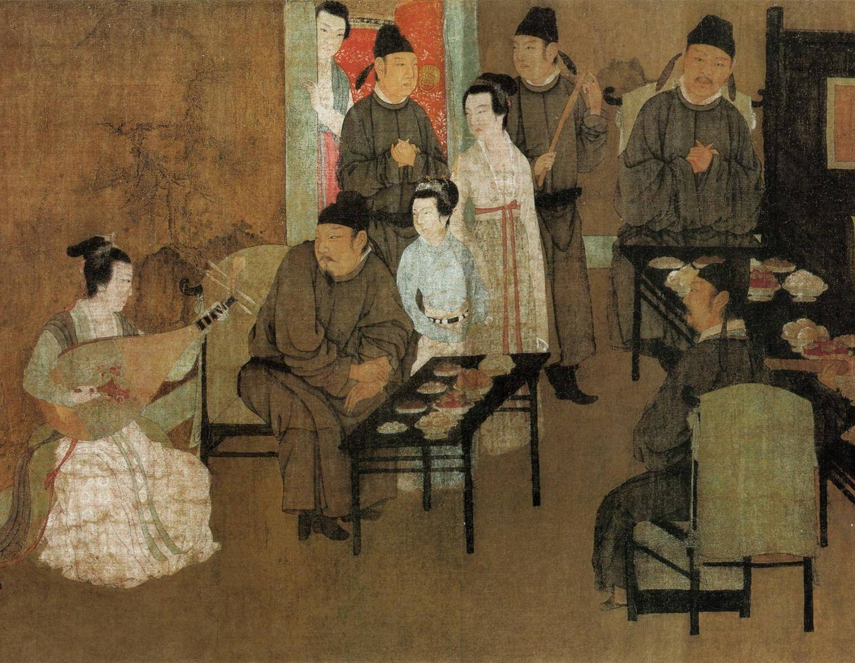
Scene from the Night Revels of Han Xizai, Gu Hongzhong (Palace Museum, Beijing)

Slide 27
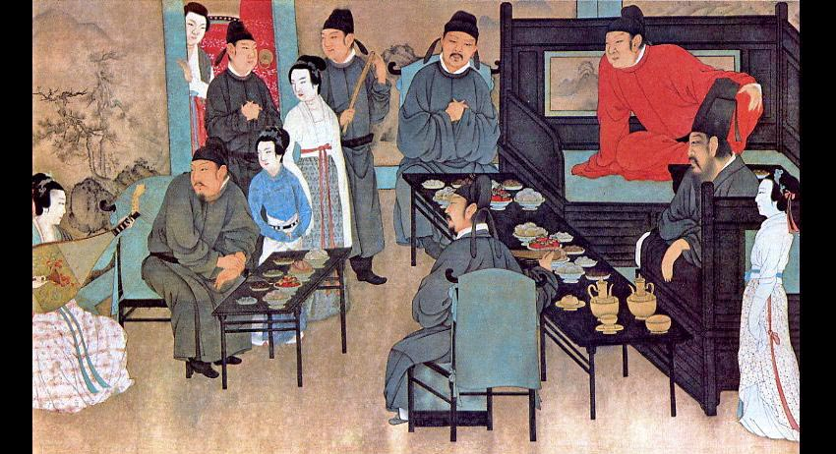
Record of the Northern Ward (880s)
Author Sun Qi about his collection of stories: “I have repeatedly taken the examinations and have been a longtime dweller of the capital. From time to time I also roamed in the [Pingkang] ward,
but certainly not because of its amusements. When I thought about how things
often reverse their course after reaching an apex, I suspected that [all this] could not last. Thus, I wanted to record [what I saw] so that in later eras it may
serve as fodder for conversation.”

Slide 28
Encounters across gender & social class in the enterainment quarters:
“In Chang’an, the illustrious courtesan Liu Guorong was beautiful and
could chant poems. She and the jinshi [degree holder] Guo Zhaoshu
were enamored with each other, and others did not dare to peek [at them].
Later, Zhaoshu was given his first post as the Heavenly Chief Recorder and
parted from Guorong. The next morning he departed [for his post], and
by the time he reached Xianyang, Guorong had dispatched a maid on a pony
to give him a short letter that said:
“At the height of our supine rapture, I
resent that the cockcrow cuts short our affection; with our adoration yet
to reach its height, I lament that the hoofbeats are so without feeling.
My heart is strained and I will eat less because of you. Our next meeting
I shall await, in order to complete our nuptial bliss.”
Many young men of Chang’an could recite [these lines] from memory.”
--Record of the Northern Ward, translation from Feng,
City of Marvels and Transformation.

Slide 29
Song Lyrics from Tang to Song: Romantic Encounters
Southern Tang Ruler Li Yu (att.), to the tune “Pleasures of Meeting”
Without a word, I climbed the western tower,
The moon was like a hook. The silent stretched deep through chestnut trees,
Enclosing autumn, cool and clear. Cut it, but never cut it through, untangle it, then it’s a mess again,
That’s the sadness of being apart.
A flavor of its own in the human heart.
--Translation adapted from Owen, Anthology of Chinese Literature

Slide 30
Yan Jidao (Northern Song), to the tune “Partridge Weather”
With such feeling your brightly colored sleeves held up the goblet of jade to me, but in those days we didn’t care if faces flushed red with the wine,
When you danced the moon low in the willows
And sang out the breeze in the peach blossom fan. Then, after we each went our way, I thought back to when we firt met and have joined you so often in dreams, that perhaps tonight I overdo it, taking the silver lamp in hand to shine on you, still afraid that this meeting too is a dream.
--Translation adapted from Owen, Anthology of Chinese Literature

Slide 31
Concluding thoughts
Encounters & boundaries: where you least expect them, including within human relationships and the known world
“National” and ”dynastic” (spatial & temporal) boundaries can disguise deep, underlying patterns of change and transformation
Many others to explore! (intercultural encounters, boundaries of human/supernatural realm, long tales of “romance,” e.g.)
Who is speaking, and why? Why should we listen?

