Slide 1
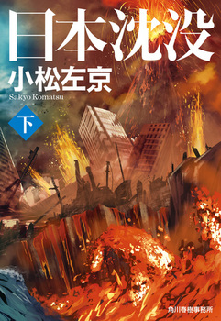
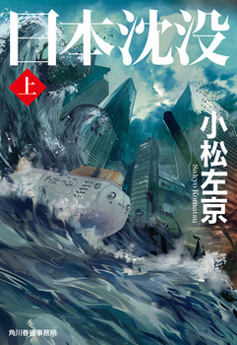
Is Japan Sinking? Contemporary Japan through the lens of disasters and crises
Ryo Morimoto
Assistant Professor of Anthropology
Princeton University
日本沈没/Japan Sinks 1976 by Komatsu Sakyo

Slide 3
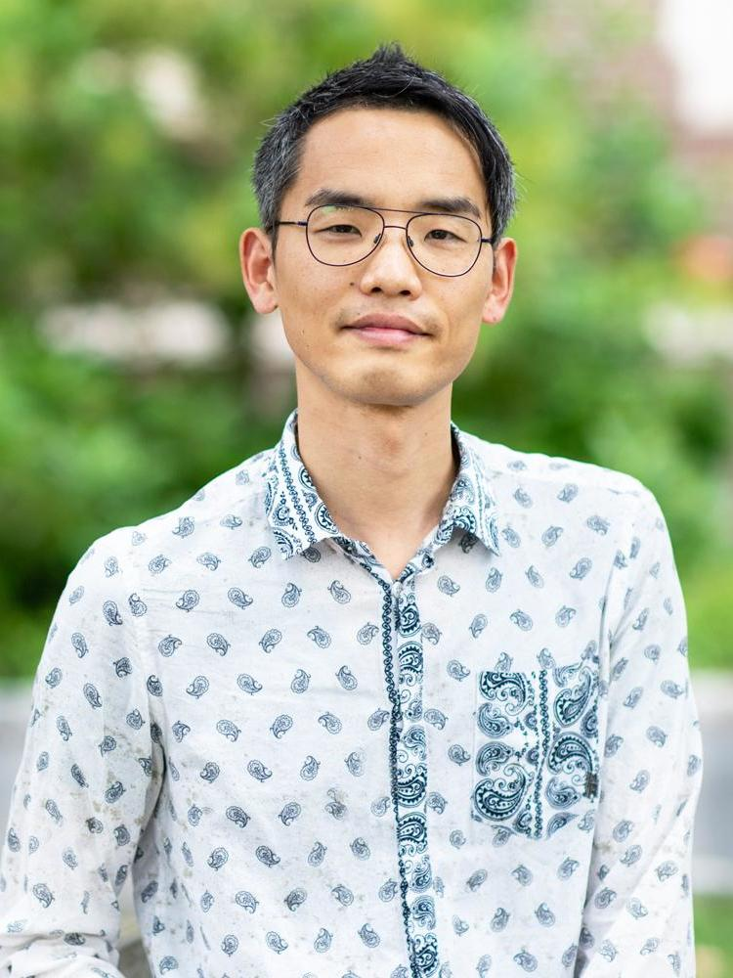
First-gen college student and scholar, grew up in Western Japan (Kurashiki City, Okayama Pref)
Hikikomori in the mid 90s and left Japan in the late 90s
Studied philosophy, psychology, and anthropology in Colorado and Massachusetts
Joined Princeton in 2018
Courses taught at Princeton
ANT/ENV219: Catastrophes across Cultures: The Anthropology of Disaster
ANT446/ENV364 Nuclear Things and Toxic Colonization
ANT/ENV/AMS 245 Nuclear Princeton: An Indigenous Approach to Science, Technology and the Environment
Ph. D. Anthropology Brandeis U
MA Anthropology
BA Psychology (U of Colorado)
AA Arapahoe Community College

Slide 4
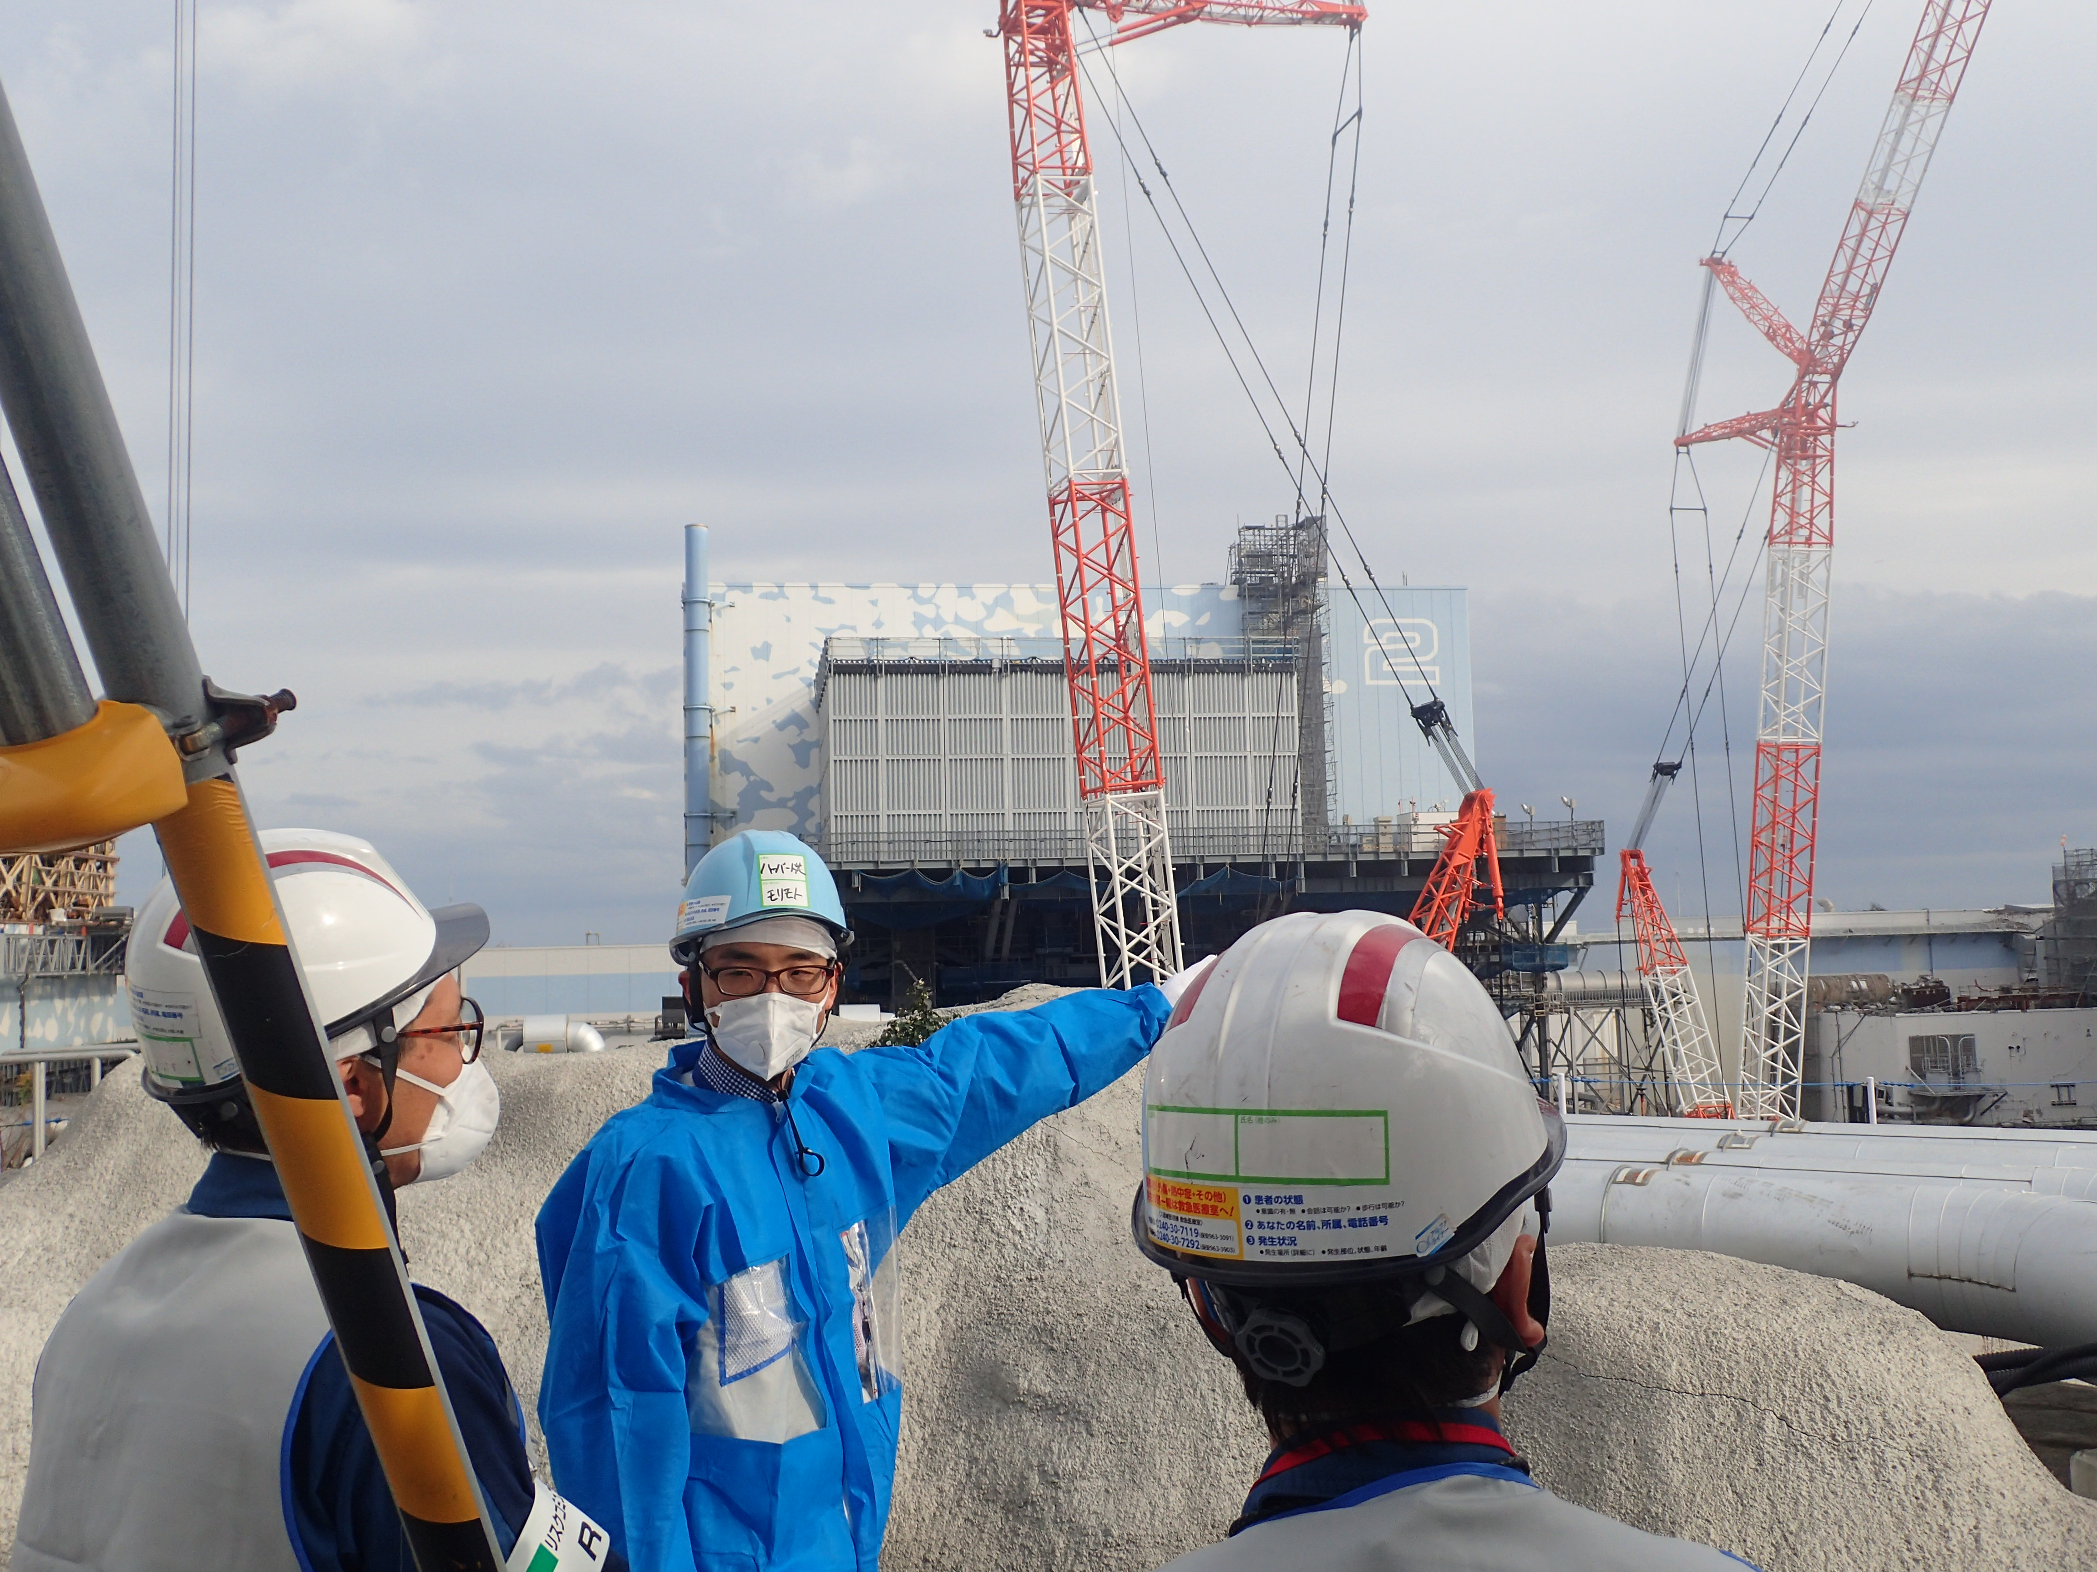
Research Topics
Areas: Japan and the U.S.
Disaster Studies
Nuclear/Radiation/Toxicity
The Environment/Ecology
Waste
Land Use, Ancestors
Aging Population
Robotics (Science & Tech)
Archive/Archiving
Former project manager of Japan Disasters Digital Archive at the Reischauer Institute of Japanese Studies, Harvard University).

Slide 5
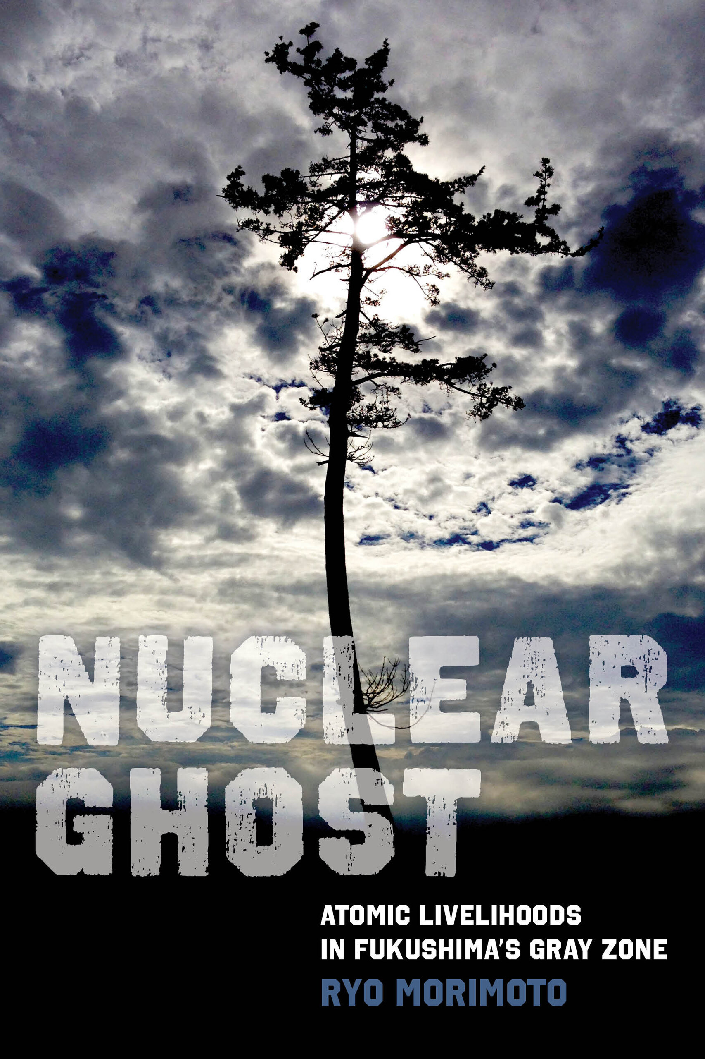
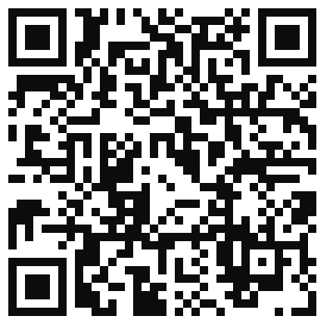
INTRODUCTION Ch 1: Naming the Nuclear Ghosts Ch 2: Spirited Away Ch 3: Kaleidoscopic Harm Ch 4: The Compensation Game Ch 5: Radioactive Mosquitos: The Limits of Scientific Risk Communication Ch 6: Between Fūhyō and Fūka Ch 7: Frecon Baggu and The Archive of (Half)lives Ch 8: In Search of the Invisibles Ch 9: A Wild Boar Chase EPILOGUE

Slide 6
Layering Hazard Maps
https://disaportal.gsi.go.jp/maps/?ll=34.755153,134.901123&z=7&base=pale&ls=Disaster_lore_all&disp=1&vs=c1j0l0u0t0h0z0

Slide 7
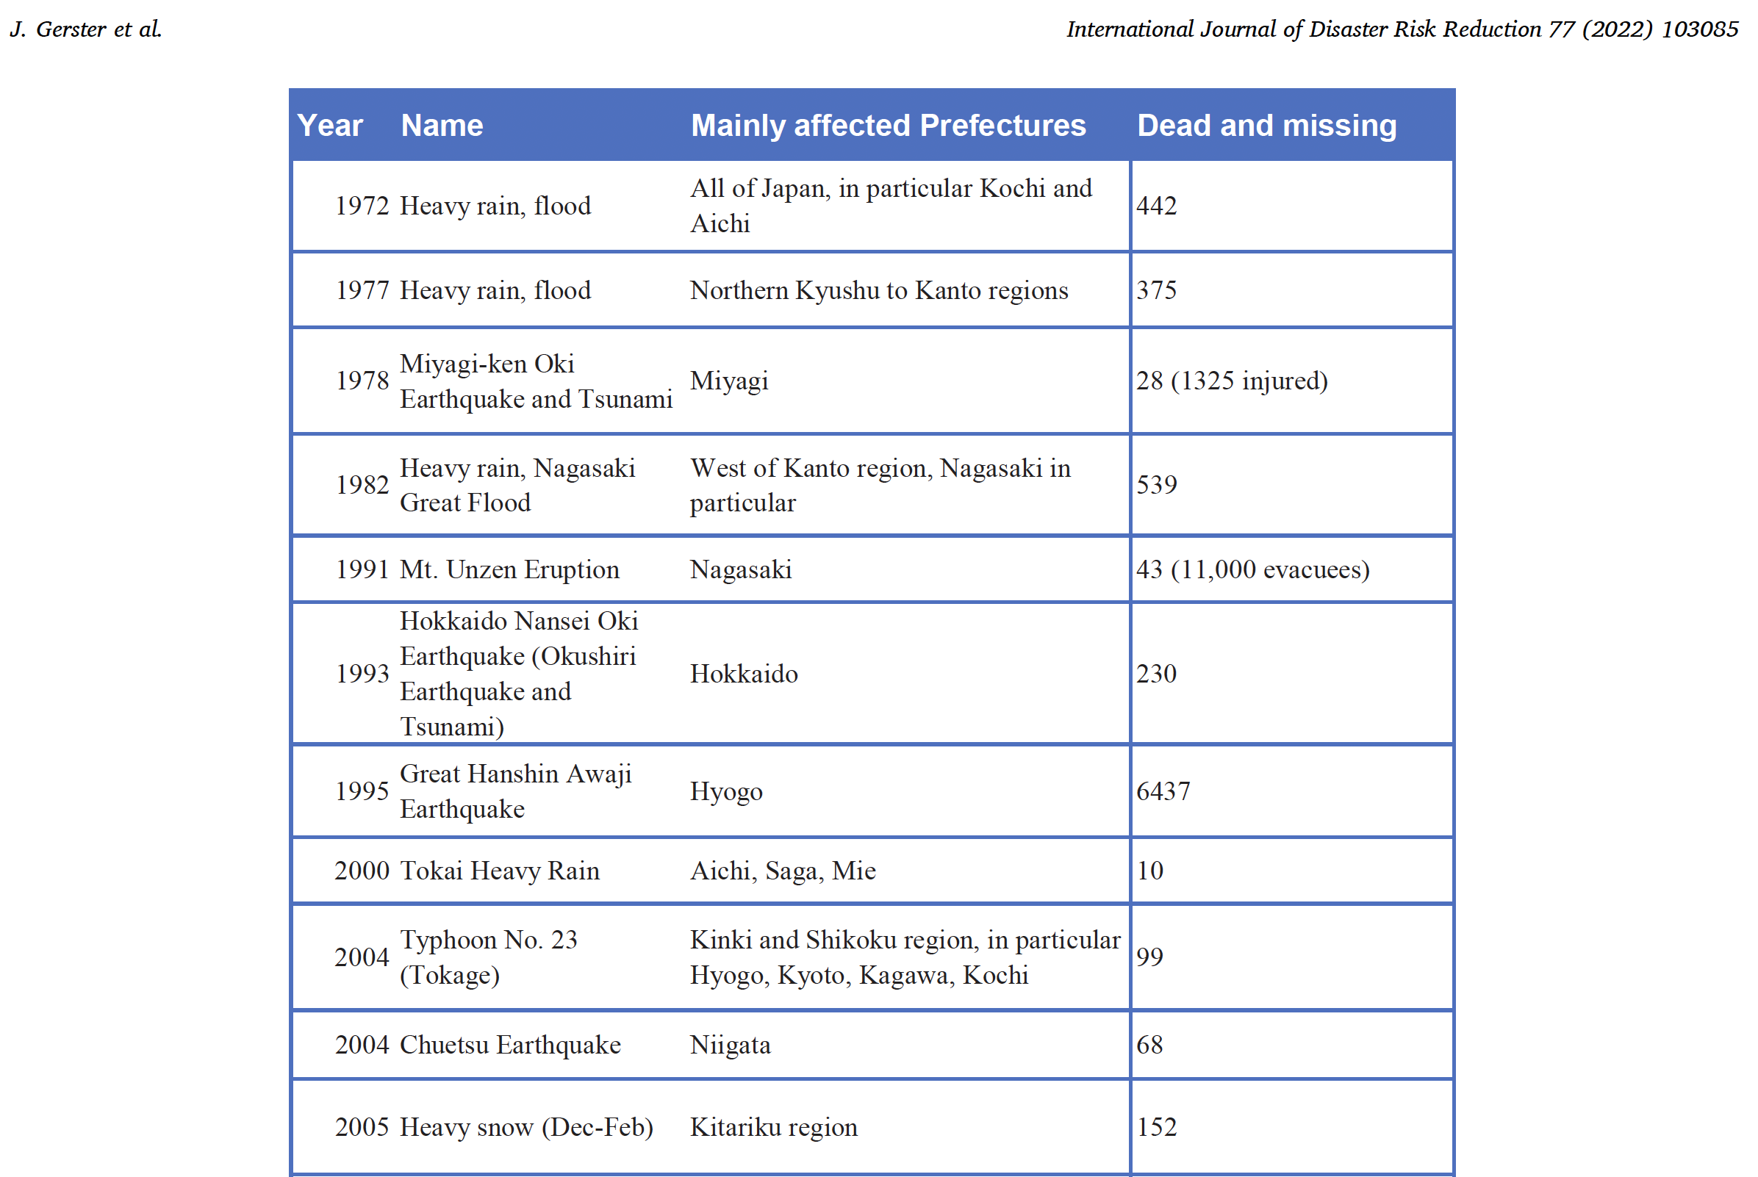
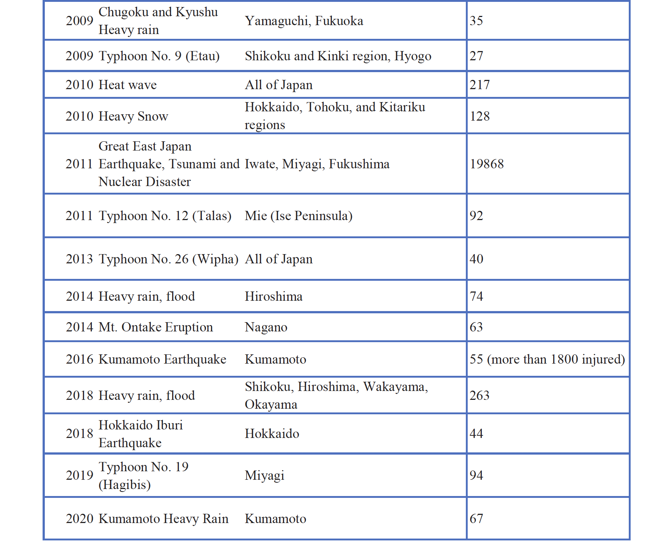
Taken from, Gerster, J., Boret, S., Morimoto, R., Gordon, A., and Shibayama, A. 2022. “The Potential of Disaster Digital Archives in Disaster Education: The Case of the Japan Disasters Digital Archive (JDA) and Its Geo-Location Functions.” International Journal of Disaster Risk Reduction, 77: 103085.

Slide 8
災間 (Saikan)/ In-between disasters
Nihei, Norihiro. 2012. “ ‘Saikan’ no shikou: Kurikaesu hizukeno tameni.” In Henkyo kara hajimaru: Tokyo/Tōhoku hen, 122–58. Tokyo: Akashi Shoten.

Slide 9
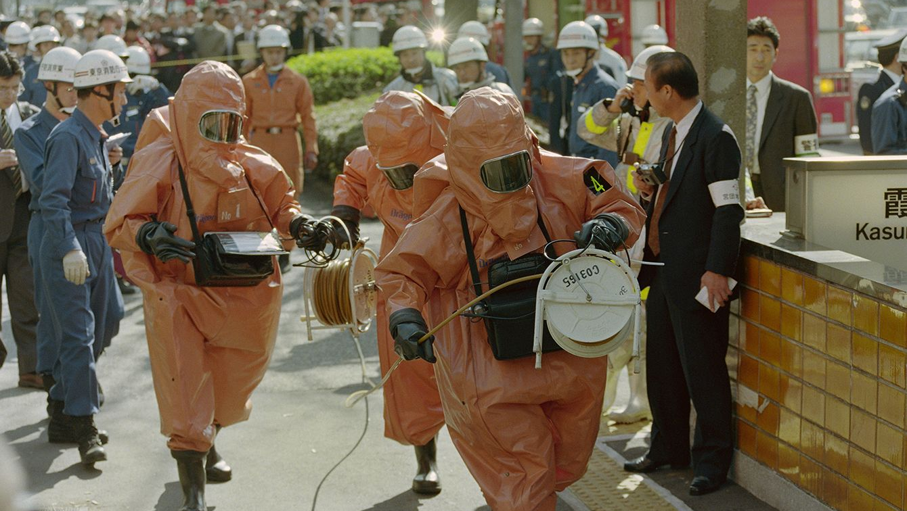
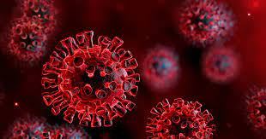
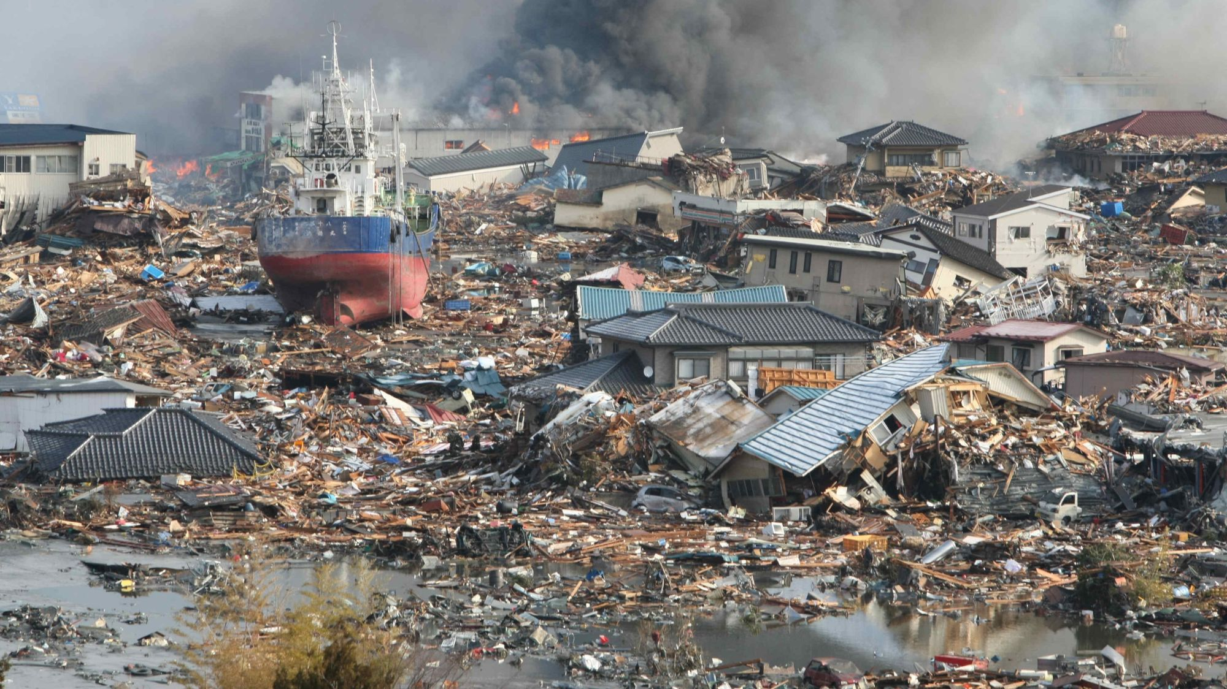
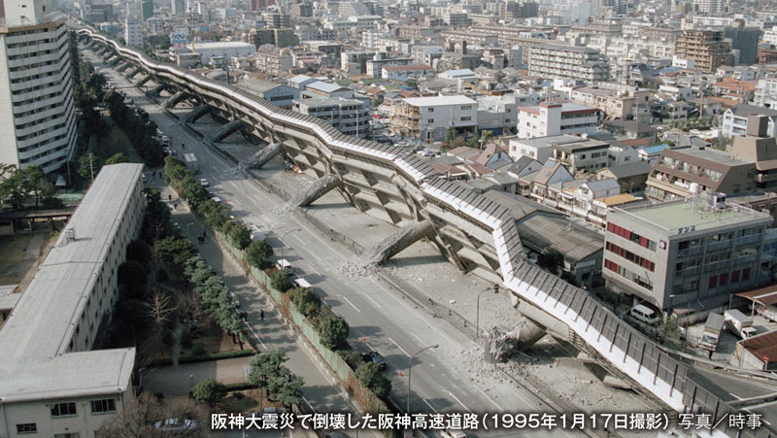
1995, 2011, & 2020

Slide 10
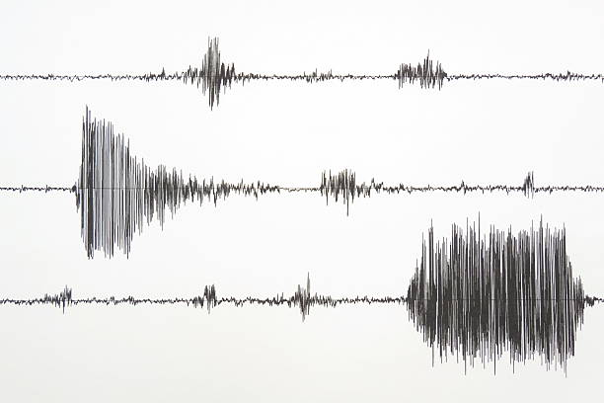
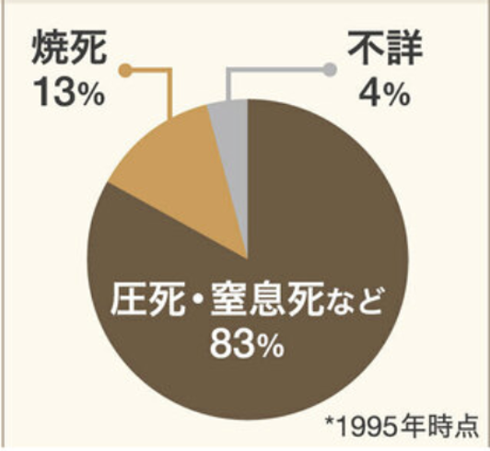
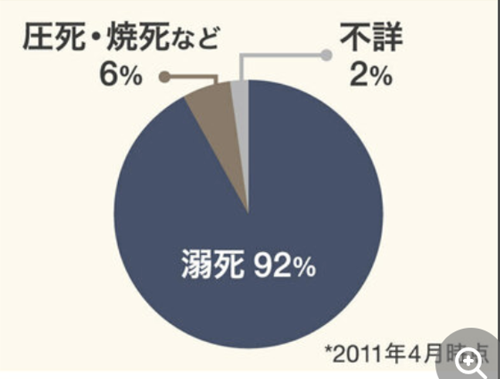
1.17 & 3.11
03/11/2011 2:46 PM
M 9.0, over two mins
Subduction-zone type earthquake
Urban-Rural (8 prefectures: Aomori, Iwate, Miyagi, Fukushima, Ibaraki, Chiba, Gunma, and Saitama)
Tsunami = 118,363 houses destroyed
# of dead & missing = 15,900 & 2,523
Disaster-related death = ~3,789
01/17/1995 5:46 AM
M 7.3, about ten secs
Inland type earthquake
Urban center (1 prefecture)
Pancake and fire = 104,906 houses destroyed completely
# of dead & missing = 6434 & 3
Disaster-related death = ~900

Slide 11
YouTube Population Pyramid of Japan (1920 – 2020) / 2020 Japan Census https://youtu.be/exUUQUS9jow

Slide 12
2000
2015
1995
2005
2011

Slide 13
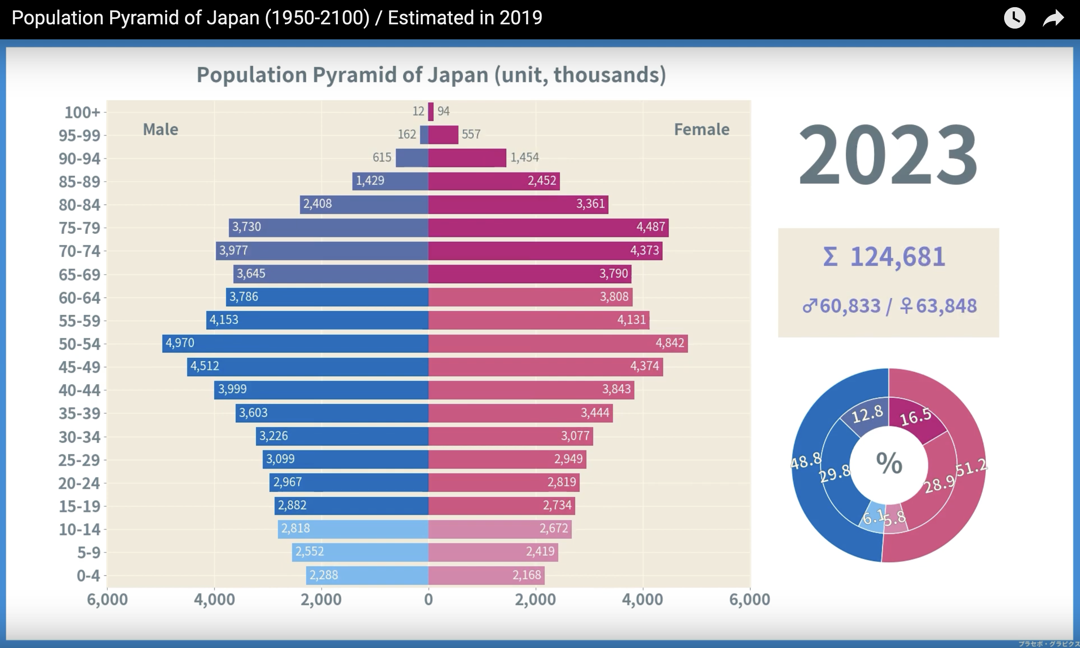

Slide 14
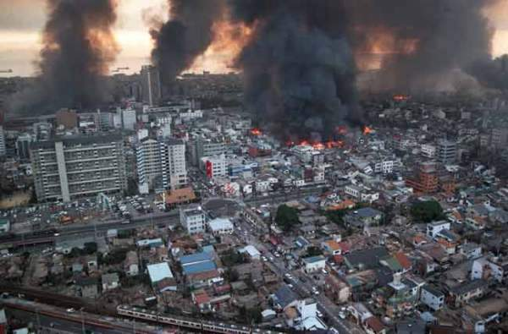
Lessons Learned from 1.17
The First Year of Volunteerism (Emergence of NPOs) = 167 million volunteers in Hyōgo
The emergence of more robust building codes
Better Disaster planning and mitigation (Hyper rescue team, Disaster Medical Assistant Team [DMAT])
Earthquake → Fire
Better coverage of earthquake insurance (from 397 million households (9%) to 518 million households (11.6%). In 2018, 1883 million households (32,.8%))
Kodokushi/孤独死 (Lonely death)
Higher Risks for Elders and Foreigners
PSTD as a post-disaster consequence

Slide 15
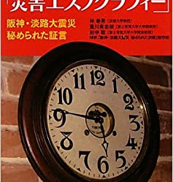
Lessons Learned from 1.17 cont.
The Rise of Social Scientific approaches to studying disasters
Understanding that there is no “natural disaster.” Disaster is always a social and political process with a natural trigger. Disaster happens to people.
Victim- and Survivor-Centered Narratives = A challenge to the media and governmental representations
Who is the expert of a disaster?
The critique of the authority
Anticipation of social-media
The issue of confidentiality and consent → 20-year rule.
Growing efforts to preserve Disaster-related history/records → comparison to 9/11 is fruitful.

Slide 16
Is 3.11 a new species of trouble?

Slide 17
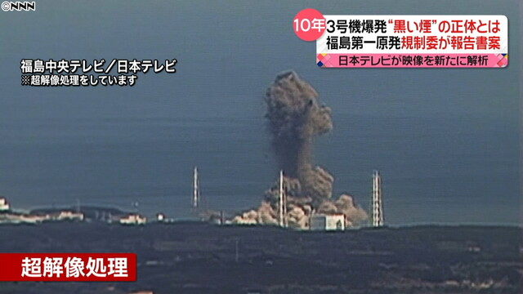
Fukushima Central TV March 15, 2011
Hydrogen Explosion at the Reactor 3, Tokyo Electric Power Company Fukushima Daiichi Nuclear Power Plant.

Slide 18
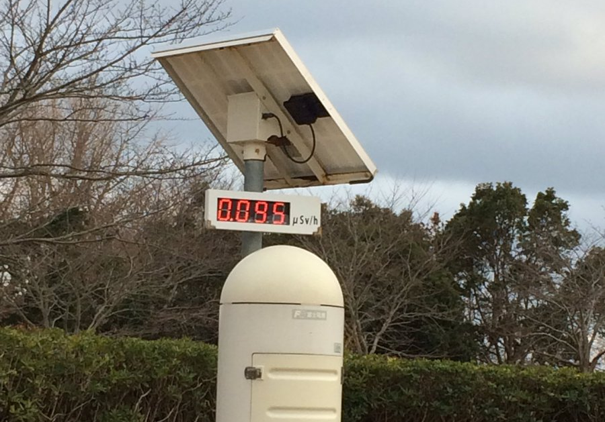
Visualizations of Radiation
Gamma Camera
Air Borne Radiation Map
Monitoring Post

Slide 19
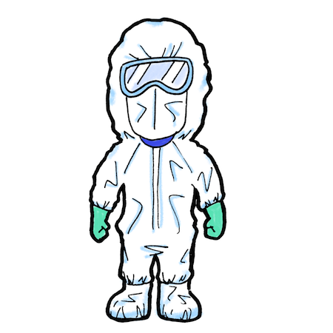
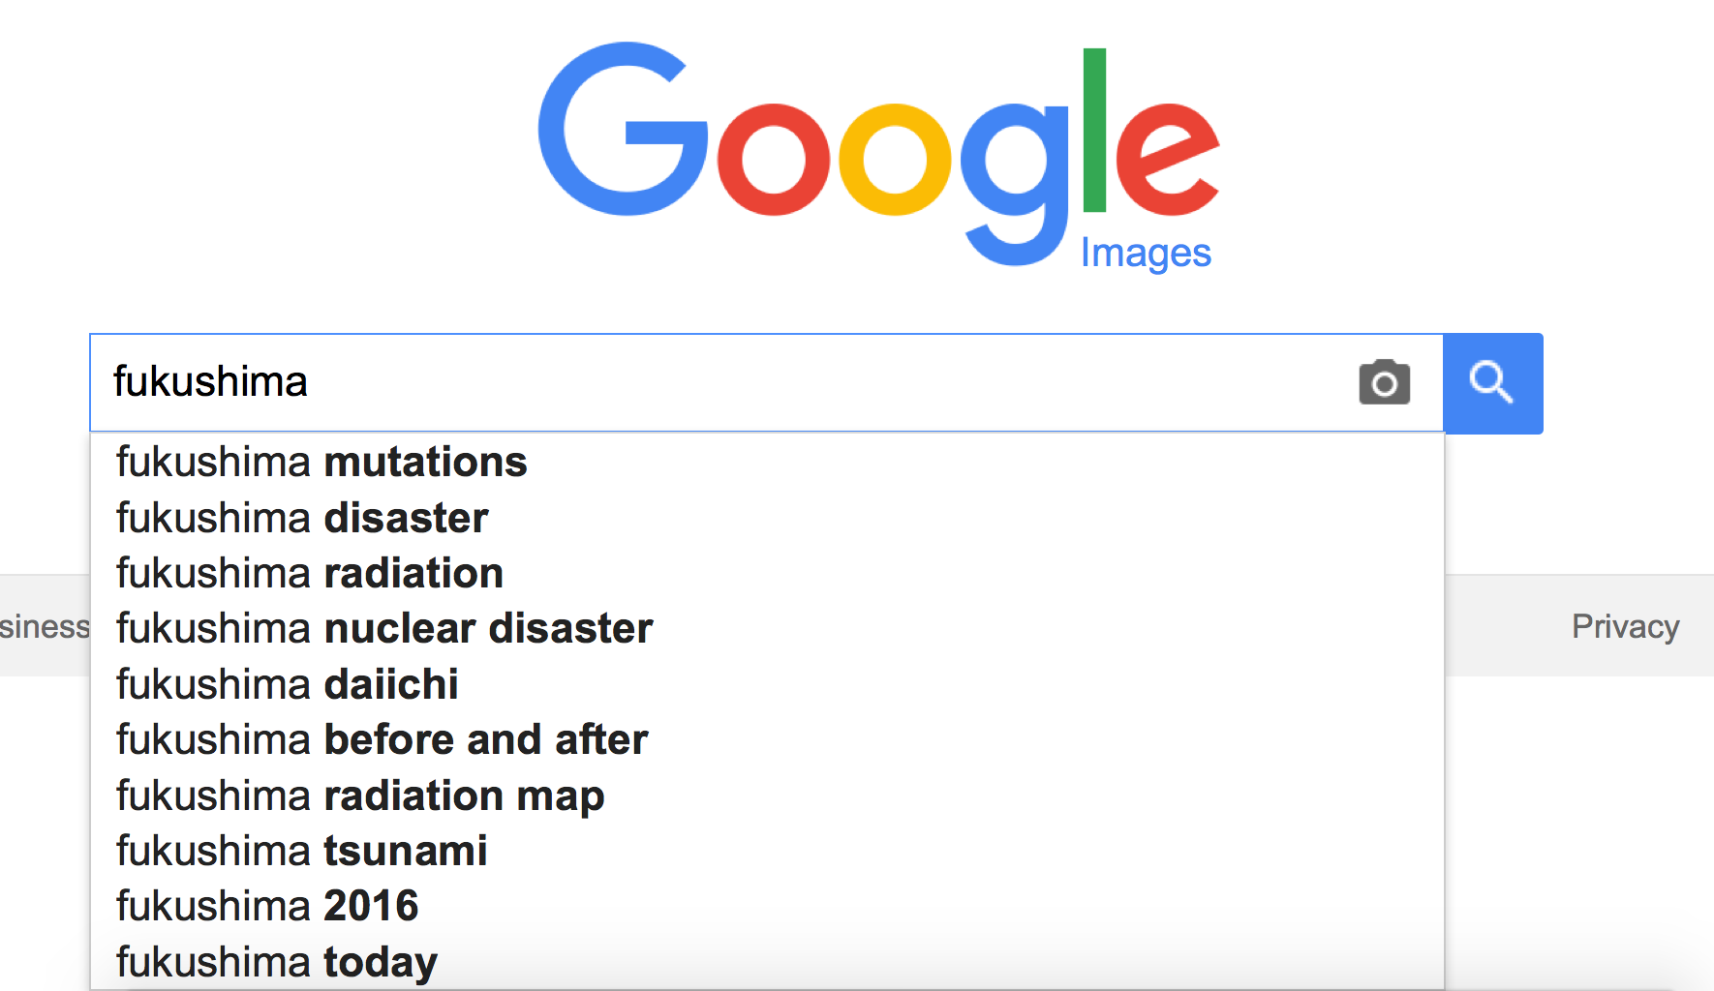
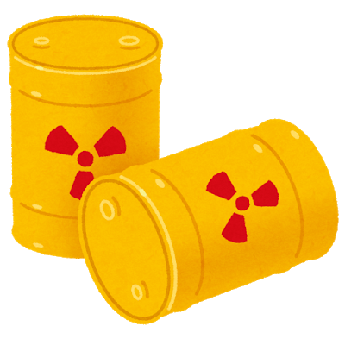
How was “Fukushima” perceived globally?

Slide 20
https://trends.google.com/trends/?geo=US&hl=en-US

Slide 21
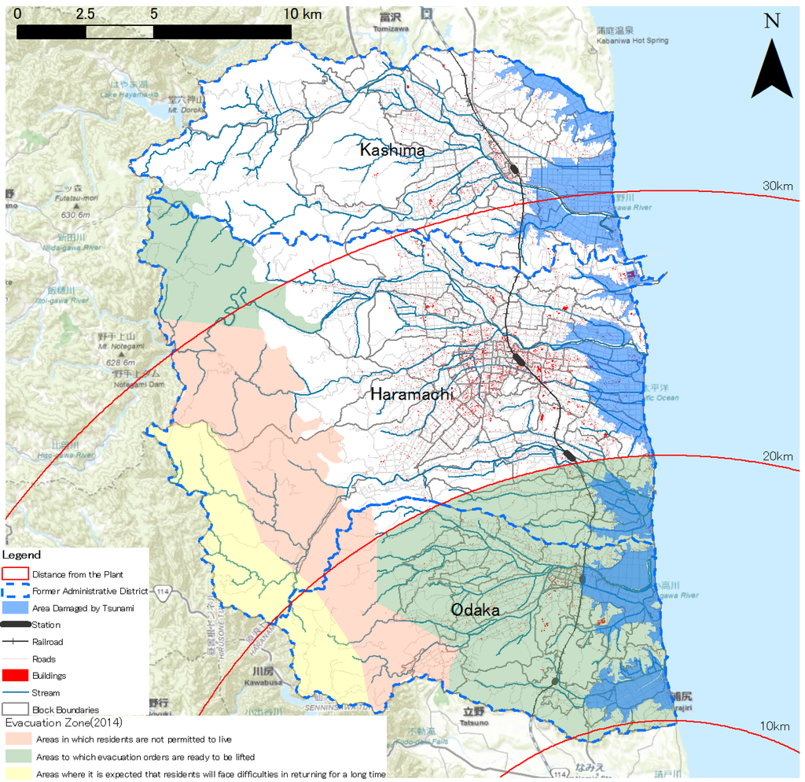
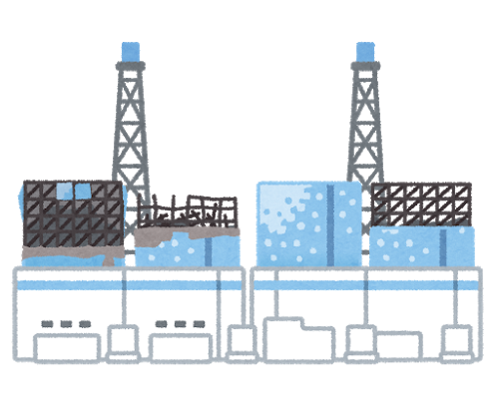
Minamisōma (153.9 mi²)
Kashima
30km
Return prohibited
Haramachi
Minamisōma
20km
Fukushima Daiichi
Mandatory evacuation until July 2016
Return difficult (long term)
Odaka
Located 10–36km (6.2–22mi) north of the Fukushima nuclear plant with three districts.
Only municipality within the 20km (12.4mi) from the damaged plant that did not enforce total evacuation.
10km
Fukushima Daiichi Nuclear Power Plant

Slide 22
Minamisōma
Kashima
Post-disasters & fallout
Lost 636 from the earthquake and tsunami & 516 from the nuclear disaster-related life-changes.
Its population dropped from 71,000 in 2010 to below 10,000 in April 2011, and it is over 57,000 in March 2023.
The rate of aging population increased to over 32%
As of Nov. 2022, there has been a bit over 4,000 cases of COVID.
30km
Return prohibited
Haramachi
20km
Evacuation zone (till July 2016)
Mandatory evacuation until July 2016
Odaka
Return difficult (long term)
10km
Fukushima Daiichi Nuclear Power Plant

Slide 23
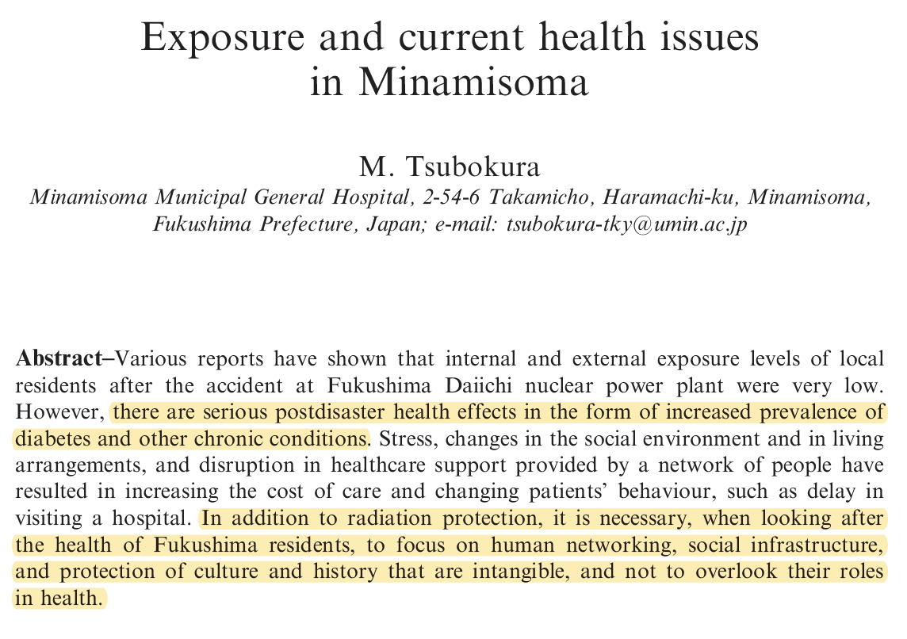
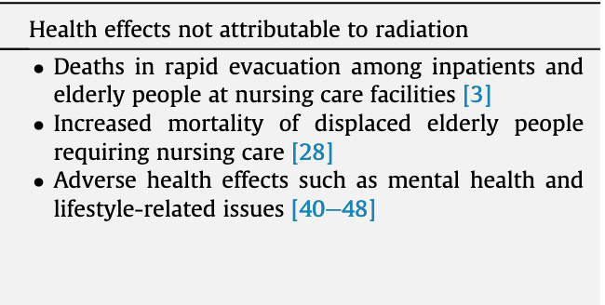
Emergency response more harmful than radiation?

Slide 24
Local experience of radiation: financial compensation
Outside the zone
$1,000/month per individual for 7 months
Kashima
30km
Inside the 30km zone
$1,000/month per individual for 18 months
Haramachi
Return prohibited
20km
Inside 20km zone evacuated to outside the zone
$1,000/month per individual for 88 months (one year after the reopening of the zone in July 2016)
Return difficult (long term)
Mandatory evacuation until July 2016
Odaka
10km

Slide 25
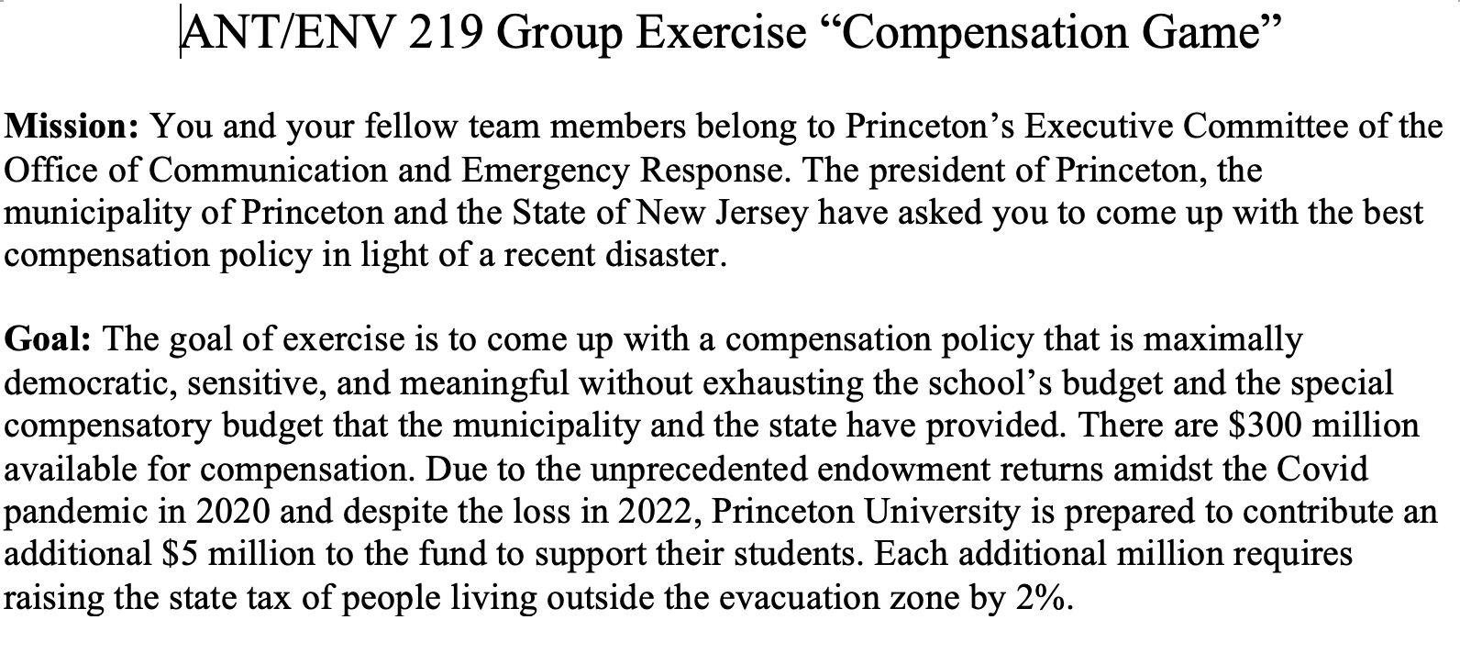
Compensation Game – exercise
Teaching students to decenter their perspectives
What does it mean to be in the position of power?
Is there one just way of distributing money?

Slide 26
Invisible Threats

Slide 27
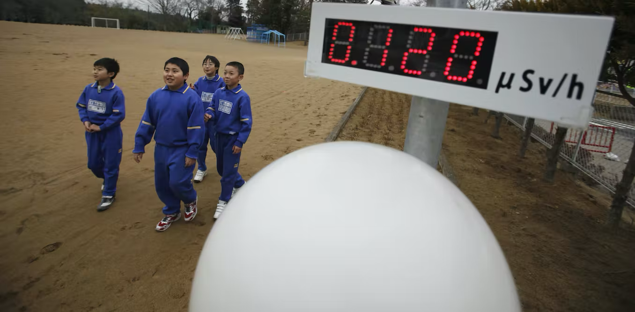
Lessons from 3.11
An invisible threat in society
leads to the scientification of knowledge
Those who do not follow the expert advice is considered “irrational.”
Devalue people’s situated experience of the hazard
masks existing social, cultural, and political issues
The issue is the invisible hazard not other things!
People are differently vulnerable. Different threats different distribution of risks
leads to the atomization of people and the corrosion of community
It becomes hard to communicate with each other without feeling to be judged
Social-media further siloing people by reinforcing group-think
3.11 can be a great way to make students reflect on their experiences of the COVID-19 pandemic!

Slide 28
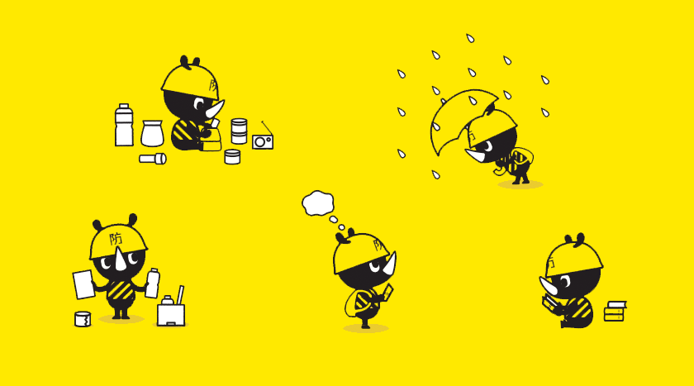
Bosai-Gensai (防災・減災) Paradigm
With careful planning, disaster damage can be reduced
How can we prepare?
Hazard Maps – brings together the evaluation of the current conditions (geography, geology, demography, etc.), past experiences, and local knowledge.
Learning to familiarize oneself with where they live
Anticipating future disasters
Exploring locally-specific history and conditions
Establishing a sense of community → learning who is more vulnerable
1.17 and 3.11 both indicate the significance of memorializing one’s place prior to a disaster → the local knowledge helps to be more prepared and resilient.
3.11 and the COVID-19 pandemic indicate how the state can use science to control its population → we need to be more tolerable to the diversity of perspectives but also need to learn to build relations based on mutual respect and open dialogues.
Does your school/local community have its own hazard maps? If not, a great way to mobilize your students to make one!
Tokyo Bosai A Manual for Disaster Preparedness: http://designmadeinjapan.com/magazine/graphic-design/tokyo-bosai-a-manual-for-disaster-preparedness/

Slide 29
Some useful tools
Japan Disasters Digital Archive https://jdarchive.org
Hurricane Digital Memory Bank https://hurricanearchive.org/
Hiroshima Archive https://hiroshima.archiving.jp/index_en.html
Preventing Accidents: Hazard Mapping: https://people.utm.my/shamsul/files/2018/11/Hazard_Mapping.pdf

Slide 30
Helpful Readings and Other Materials
Andrew Gordon. 2014. Ch 18: Shock, Disaster, and Aftermath: Japan since 2008 in A Modern History of Japan 3rd ed, pp. 336-354. Oxford: Oxford University Press.
Brett Walker. 2015. CH 15: Natural Disasters and the Edge of History in A Concise history of JAPAN, pp. 283-304. Cambridge: Cambridge University Press.
Haruki Murakami. After the Quake (Super-Frog Saves the World) and Underground.
Movie: Suzume (2023) trailer https://youtu.be/IfKNOUUtyCA
Netflix series The Days (2023) trailer https://youtu.be/EtB8P59xWjw

